Slide 1
자연어처리의 최신동향-3 : Transformer기반 사전학습모델(Pre-trained Models)
Hyopil Shin(Seoul National University)
hpshin@snu.ac.kr http://knlp.snu.ac.kr
Based on Xu Han et al. (2021), Pre-trained Models: Past, present and Future, https://www.sciencedirect.com/science/article/pii/S2666651021000231 and 2021 Spring Class Student Presentations

Slide 2

자연어처리의 최신 동향:
1. 트랜스포머(Transformer)에 이르기까지의 자연어처리의 진화 : 언어 모델링(Language Modeling)관점에서의 진화(Evolutions): N-Grams, Word Embeddings, Sequence to Sequence Model, Attention, and Transformers
2. 트랜스포머(Transformer): 2017년 이후 자연어처리의 Game Changer가 된 Transformer
3. 트랜스포머기반 사전학습모델(Pre-Trained Models): Transformer Architecture를 활용한 다양한 종류의 사전학습모델(Autoregressive, Autoencoding, sequence to sequence, and multimodal Models)
4. 트랜스포머를 활용한 응용: Transformer와 사전학습모델의 Semantic Search, Sentence-Bert, Question Answering, Summarization, Chatbot, Dialogue 등 다양한 분야에서의 활용

Slide 3

Revisit To Transformer
Review What We talked about in Last Session

Slide 4
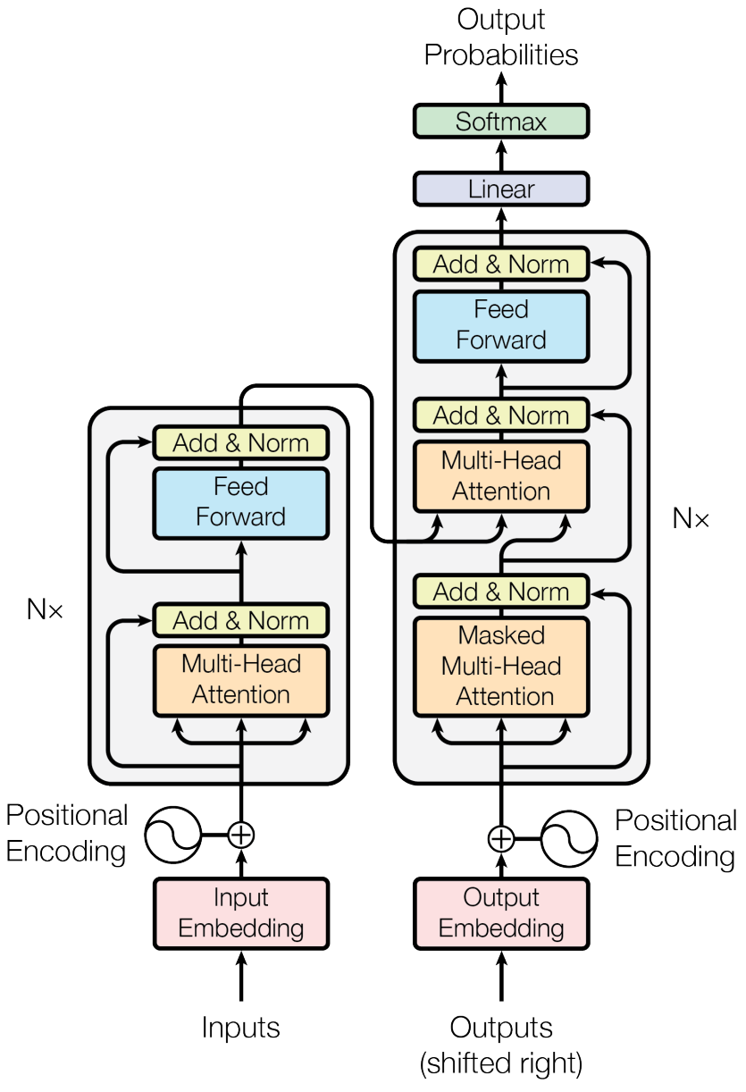
Revisit to Transformer
Parallel Processing
Tokenization
Positional Embedding
Three types of Attentions: Multi-head Self-Attention, Masked Multi-head Self-Attention, Cross Attention
Layer Normalization
Residual Connection

Slide 5

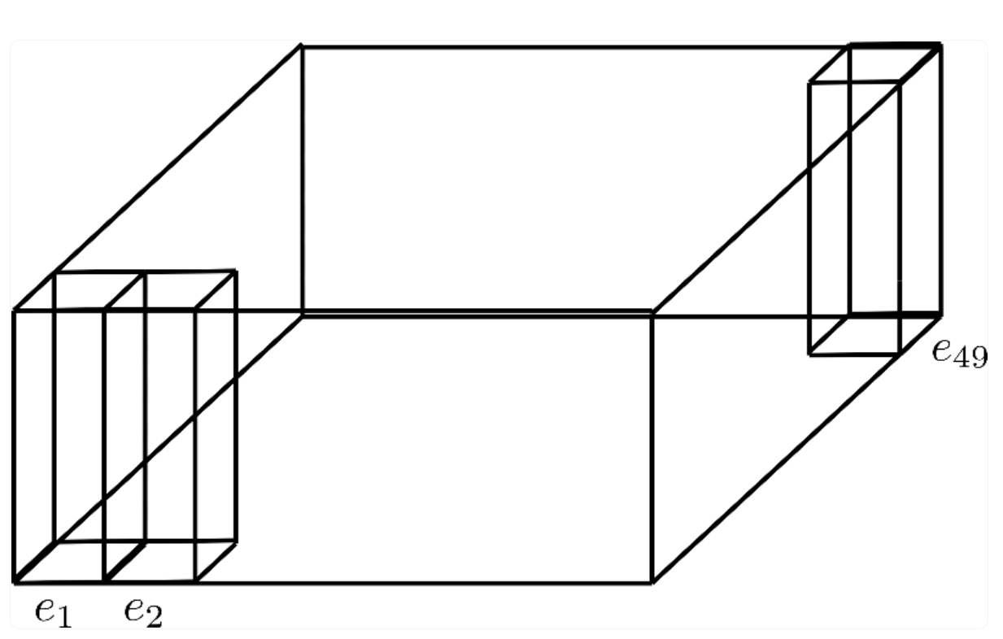
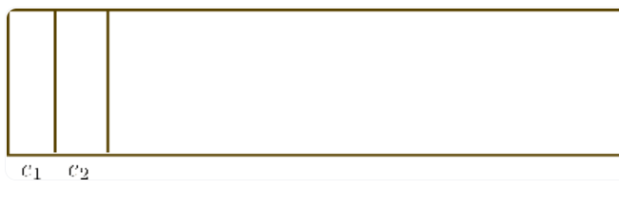
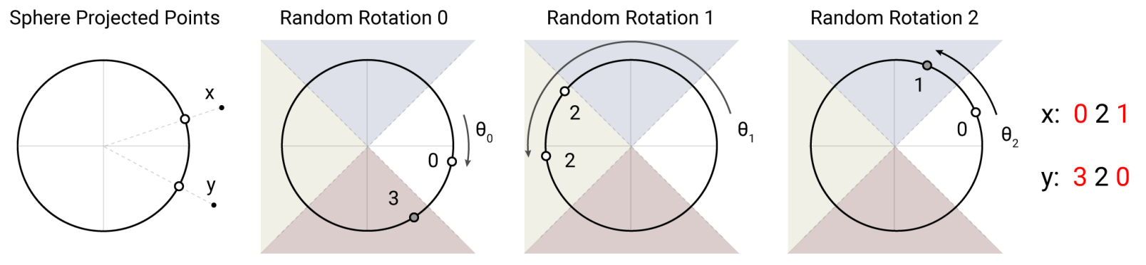
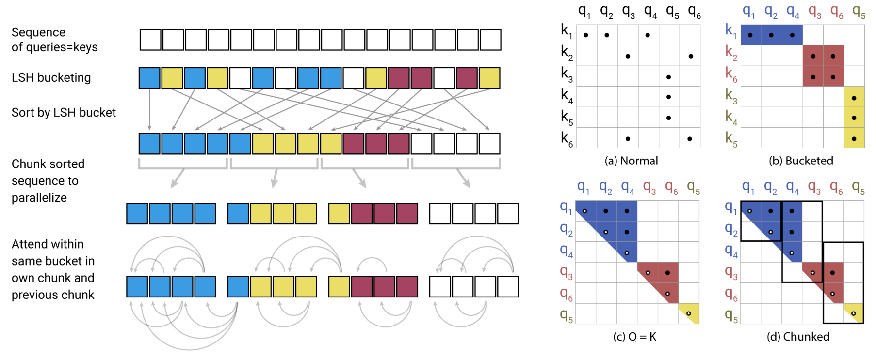
Reformer: The Efficient Transformer, 2020
https://arxiv.org/abs/2001.04451
 | Large Transformer models can be prohibitively costly, especially on long sequences. To improve the efficiency of Transformers, authors introduce two techniques, locality sensitive hashing (LSH) attention, reversible transformer Reversible layers, introduced in Gomez et al. (2017), enable storing a single copy of activations in the whole model, so the N factor disappears. |  | Axial positional encoding, LSH Attention, Chunking Feed Forward Layer, Reversible Residual Layer
 |  | Splitting activations inside feed-forward layers and processing them in chunks removes the d _{ff} factor and saves memory inside feed-forward layers. Approximate attention computation based on locality-sensitive hashing replaces the O(L²) factor in attention layers with O(LlogL) and allows operating on long sequences.
 | Axial Positional Encodings are not explained in the official Reformer paper, but are extensively used in the official codebase The Reformer authors managed to drastically shrink the positional encodings in size by cutting the hidden size dimension in two and factorizing the dimension.
 | A shared QK, Query = Key, Using the same linear layer to go from A to Q and K, and a separate one for V. Sharing QK does not affect the performance of Transformer (Note. Focus on the keys in K that are closest q_{i}) Finding nearest neighbors quickly in high-dimensional spaces can be solved by local sensitive hashing (LSH). In this paper, the hashing scheme is that nearby vectors get the same hash with high probability and that hash-buckets are of similar size with high probability. Simplified depiction of LSH Attention showing the hash-bucketing, sorting, and chunking sorted sequence to parallelize and the resulting causal attentions.
 | Reversible Residual networks (RevNet) were introduced by Gomez et al. (2017). The main idea is to allow the activations at any given layer to be recovered from the activations at the following layer using the model parameters Reversible Transformer is applying the RevNet idea to the Transformer by combining the attention and feed-forward layers inside the RevNet block. Computations in feed-forward layers are completely independent across positions in a sequence, so the computation can be split into c chunks
 | From the paper: https://github.com/google/trax/tree/master/trax/models/reformer
Introduction
Keywords
Axial Positional Encoding
Axial Positional Encoding
LSH Attention
Local Sensitive Hashing
LSH
Attention
Reversible
Transformer
Code
https://huggingface.co/blog/reformer
/ 135

Slide 6
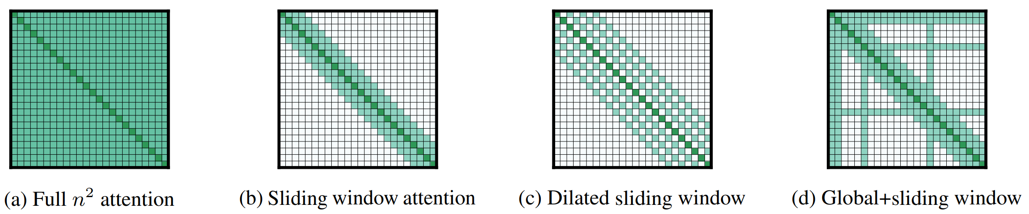
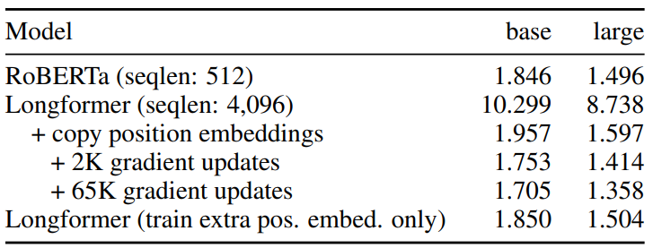
Longformer: The Long-Document Transformer, 2020
https://arxiv.org/abs/2004.05150
 | Transformer-based models are unable to process long sequences due to their self-attention operation, which scales quadratically with the sequence length. Longformer’s attention mechanism is a drop-in replacement for the standard self-attention and combines a local windowed attention with a task motivated global attention. |  | Sliding Window Attention, Dilated Sliding Window Attention, Global Attention, Bits Per Character (BPC), Longformer-Encoder-Decoder
 | A fixed-size window attention surrounding each token. Using multiple stacked layers of such windowed attention results in a large receptive field, where top layers have access to all input locations and have the capacity to build representations that incorporate information across the entire input, similar to CNNs
 | To further increase the receptive field without increasing computation, the sliding window can be “dilated” In multi-headed attention, settings with different dilation configurations per head improves performance by allowing some heads without dilation to focus on local context.
 | The windowed and dilated attention are not flexible enough to learn task-specific representations. Accordingly, authors add “global attention” on few pre-selected input locations. For example, for classification global attention is used for the [CLS] token while in QA global attention is provided on all question tokens.
 | The resulting model can process sequences up to 4,096 tokens long. Longformer consistently outperforms the RoBERTa. |  | From the paper: https://github.com/allenai/longformer Convert RoBERTa to Longformer: https://github.com/allenai/longformer/blob/master/scripts/convert_model_to_long.ipynb
Introduction
Keywords
Sliding Window Attention
Dilated
Sliding Window
Global Attention
Results
MLM BPC
Code
/ 135

Slide 7
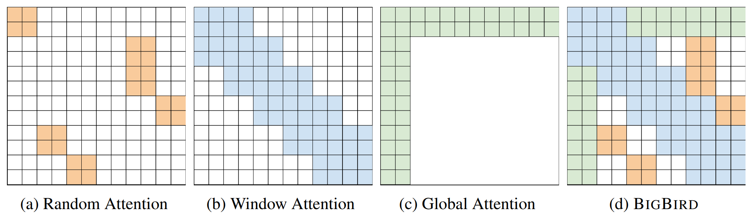
Big Bird: Transformers for Longer Sequences, 2020
https://arxiv.org/abs/2007.14062
 | One of Transformers-based models core limitations is the quadratic dependency (mainly in terms of memory) on the sequence length due to their full attention mechanism. BIGBIRD, a sparse attention mechanism that reduces this quadratic dependency to linear. |  | Sparse attention mechanism, Sparse random graph, Random Block, Local Window, Global Tokens
 | Can we achieve the empirical benefits of a fully quadratic self-attention scheme using fewer inner-products? Do these sparse attention mechanisms preserve the expressivity and flexibility of the original network?
 | BIGBIRD model uses the generalized attention mechanism, which is described by a directed graph whose vertex set is [n] and the set of arcs (directed edges) represent the set of inner products that the attention mechanism will consider. The problem of reducing the quadratic complexity of self-attention can now be seen as a graph sparsification problem. Sparse random graph for attention mechanism should have two desiderata: small average path length between nodes and a notion of locality.
 | Each query block attends to r random key blocks. All tokens attending to a set of r random tokens.
 | While creating the block, we ensure that the number of query blocks and the number of key blocks are the same. This helps defining the block window attention. All tokens attending to a set of w local neighboring tokens.
 | Global tokens attending on all parts of the sequence.
 | The proposed sparse attention can handle sequences of length up to 8x of what was previously possible using similar hardware. Max sequence length: 4096 |  | From the paper: https://github.com/google-research/bigbird
Introduction
Keywords
Key Questions
Model
Concept
Random Block
Local Window
Global Tokens
Results
Code
/ 135

Slide 8
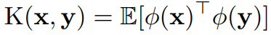
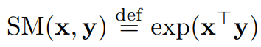
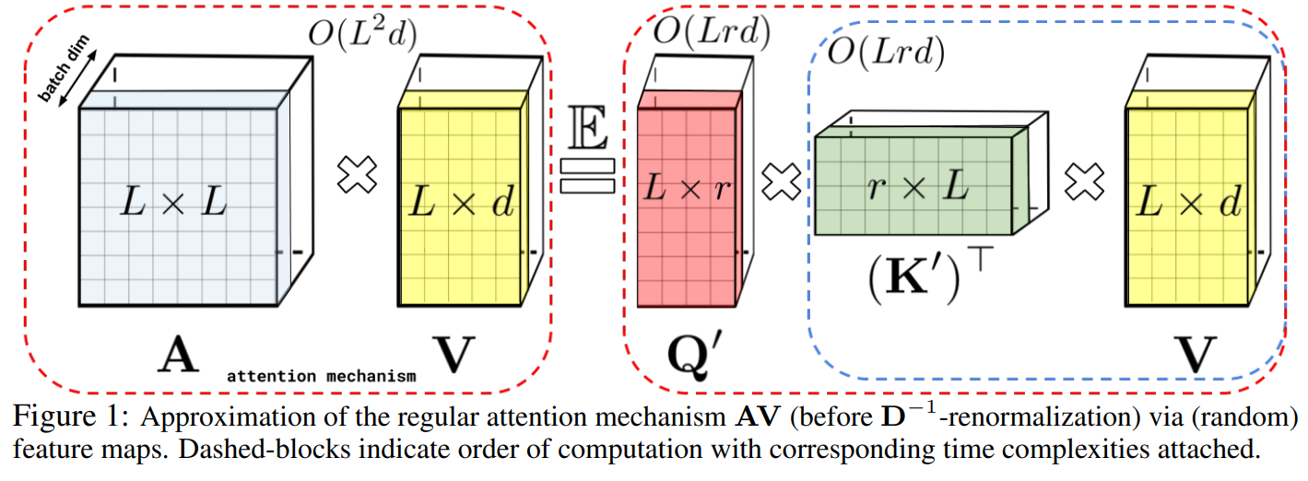
Rethinking Attention with Performers, 2020
https://arxiv.org/abs/2009.14794
 | Transformers are powerful neural network architectures. Regular Transformer scales quadratically with the number of tokens L in the input sequence, which is expensive for large L and precludes its usage with limited computational resources even for moderate values of L. Performers, capable of provably accurate and practical estimation of regular (softmax) full-rank attention, but of only linear space and time complexity and not relying on any priors such as sparsity or low-rankness. |  | Kernelizable attention mechanisms, Fast Attention Via positive Orthogonal Random features mechanism (FAVOR+)
 | A new method for estimating softmax (and Gaussian) kernels with positive orthogonal random features which FAVOR+ leverages for the robust and unbiased estimation of regular (softmax) attention The softmax-kernel which defines regular attention matrix A is Positive Random Features for Softmax
 | A Performer replaces only the attention component with our method, while all other components are the same as for the regular Transformer Compared speed-wise the backward pass of the Transformer and the Performer. In terms of L, the Performer reaches nearly linear time and sub-quadratic memory consumption The Performer achieves nearly optimal speedup and memory efficiency possible. The combination of both memory and backward pass efficiencies for large L allows respectively, large batch training and lower wall clock time per gradient step
 | The Areas where Performer can be impactful: biological sequence analysis, lower energy consumption, research on efficient Transformers architectures |  | From the paper: https://github.com/google-research/google-research/tree/master/performer Port HuggingFace Weight to Performer: https://github.com/tenexcoder/huggingface-tutorials/tree/main/performer
Introduction
Keywords
[ Regular Attention Matrix ]
[ Kernel K, and Approximate attention ]
Performer Attention Mechanism
[ Approximation of the Regular Attention Mechanism ]
Experiments
Broad
Impact
Code
/ 135

Slide 9
BackGround: Transfer Learning
Transfer Learning and and Self-Supervised Learning

Slide 10
Background(Learning Methods): Transfer Learning
In NLP, we trained on a general language modeling (LM) task and then fine tuned on text classification (or other task). This would, in principle, perform well because the model would be able to use its knowledge of the language semantics acquired from the generative pre-training.
capture long-term dependencies in language
effectively incorporates hierarchical relations
help the model learn sentiments
large data corpus is easily available for LM

Slide 11
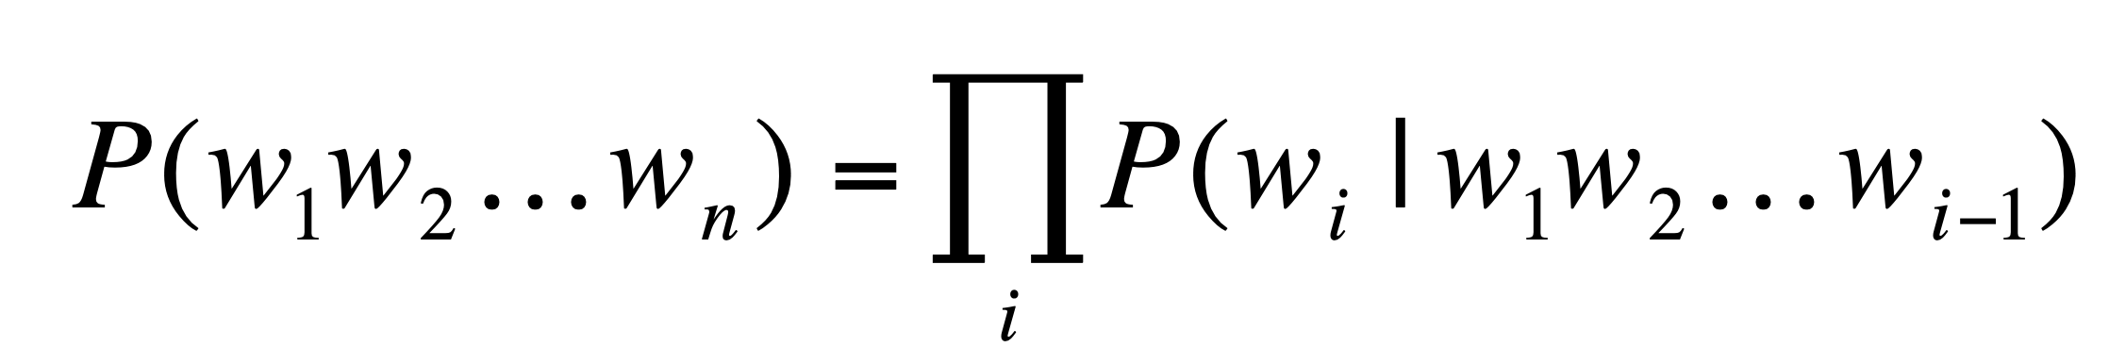
Revisit To Language Model(언어모델)
언어모델링: Assign a Probability to a sentence → Predict Next Word
확률기반 언어모델: N-gram based - Unigram, Bigram, Trigram…
Neural Network기반 언어모델: Word Embedding(Static)- Word2vec, Glove, Fasttext…
Transformer 기반 언어모델(Dynamic): BERT, GPT…

Slide 12
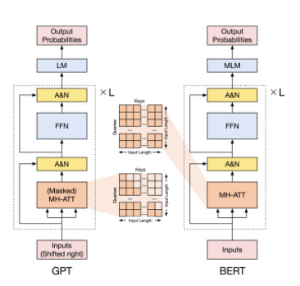
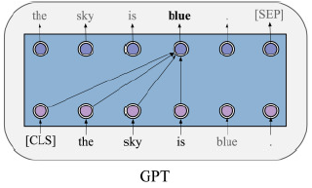
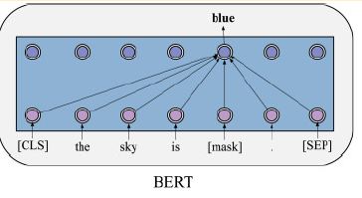
GPT
BERT
Generative Pre-trained Transformer
Bidirectional Encoder Representations from Transformers
Given large-scale corpora without labels, GPT optimizes a standard autoregressive language modeling, that is, maximizing the conditional probabilities of all the words by taking their previous words as contexts.
The adaptation procedure of GPT to specific tasks is fine-tuning, by using the pre-trained parameters of GPT as a start point of downstream tasks.
In the pre-training phase, BERT applies autoencoding language modeling rather than autoregressive language modeling used in GPT. More specifically, inspired by cloze (Taylor, 1953), the objective masked language modeling (MLM) is designed.
By modifying inputs and outputs with the data of downstream tasks, BERT could be fine-tuned for any NLP tasks.

Slide 13
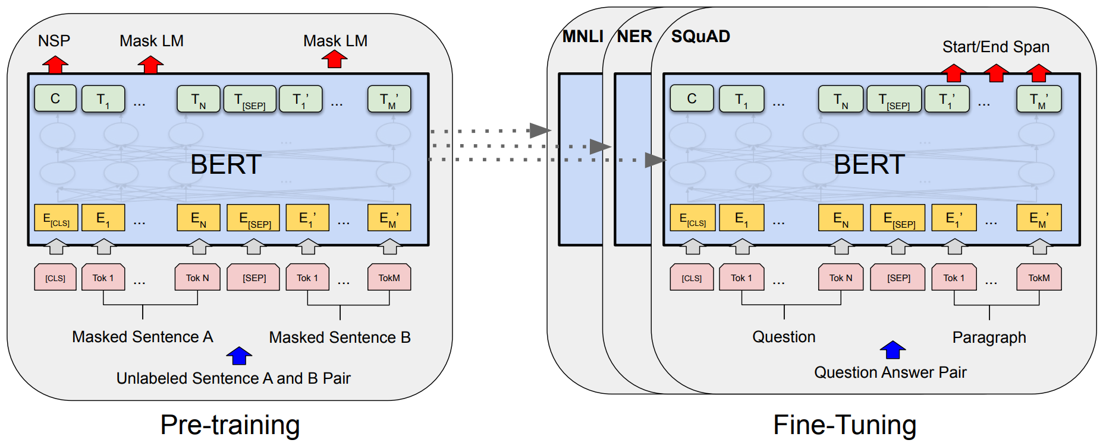
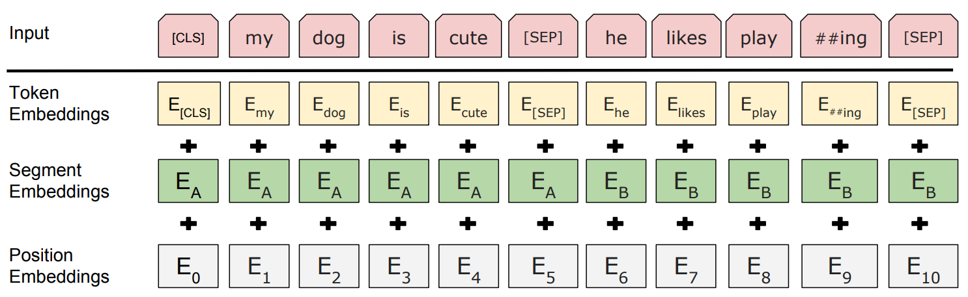
BERT: Pre-training of Deep Bidirectional Transformers for Language Understanding, 2018
https://arxiv.org/abs/1810.04805
 | There are two existing strategies for applying pre-trained language representations to downstream tasks: feature-based and fine-tuning. The major limitation is that standard LMs are unidirectional, and this limits the choice of architectures that can be used during pre-training. Such restrictions are sub-optimal for sentence-level tasks, and could be very harmful when applying fine-tuning based approaches to token-level tasks. |  | BERT (Bidirectional Encoder Representations from Transformer) , Autoencoding LM, Masked Language Model (MLM), Next Sentence Prediction (NSP), WordPiece embeddings
 | BERT is designed to pre-train deep bidirectional representations from unlabeled text by jointly conditioning on both left and right context in all layers. Using a “masked language model” (MLM) pre-training objective and a “next sentence prediction” (NSP) task that jointly pre-trains text-pair representations. |  | A multi-layer bidirectional encoder from Transformer Base model: Layer L=12, Hidden size H=768, Attention Heads A=12, Total Parameters=110M Big model: Layers=24, Hidden size H=1024, Attention Heads A=16, Total Parameters=340M
 | There are two steps in the framework: pre-training and fine-tuning. Pre-training: the model is trained on unlabeled data over different pre-training tasks. Fine-tuning, the BERT model is first initialized with the pre-trained parameters, and all of the parameters are fine-tuned using labeled data from the downstream tasks. |  | A single sentence and a pair of sentences in one token sequence A “sentence” can be an arbitrary span of contiguous text, rather than an actual linguistic sentence. A “sequence” refers to the input token sequence to BERT Using WordPiece embeddings with a 30,000 token vocabulary A special classification token ([CLS]): the first token of every sequence A special token ([SEP]): Separating sentences Adding an embedding indicating whether it belongs to sentence A or B
Motivation
Keywords
Introduction
Model
Architecture
Overall Procedures
Input/Output
Representation
/ 135

Slide 14
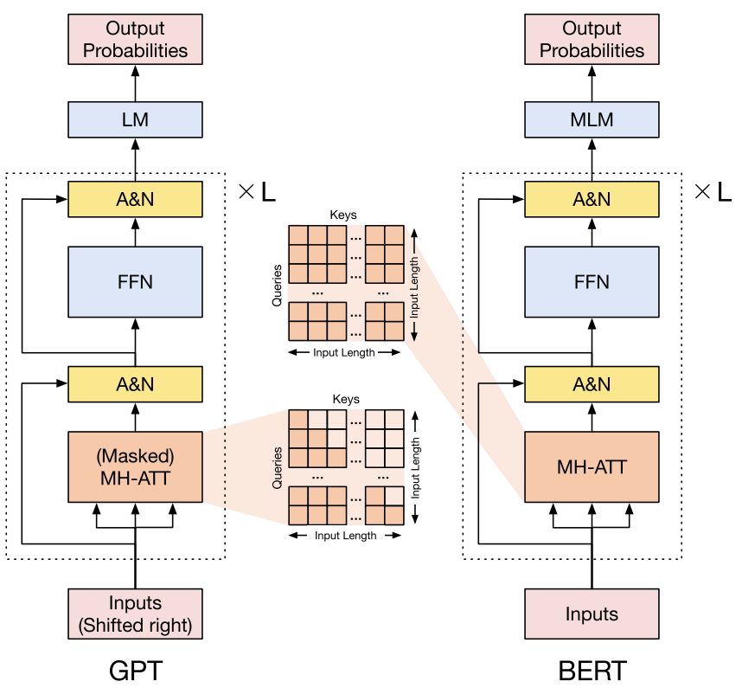
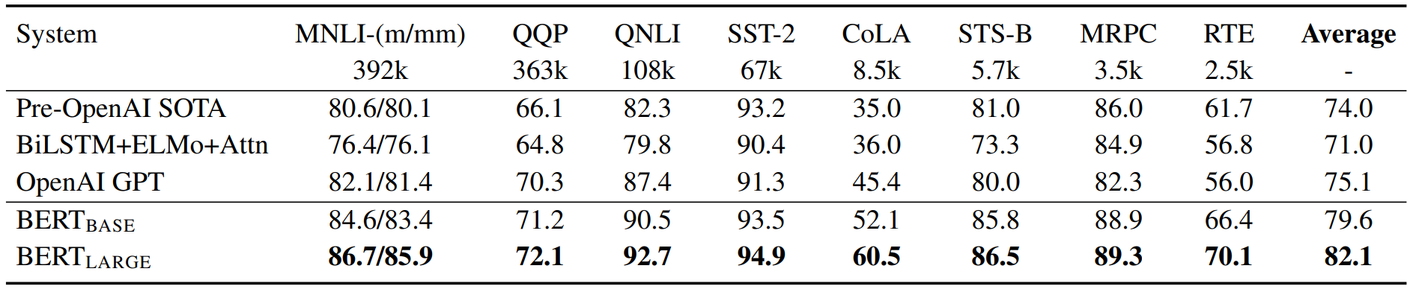
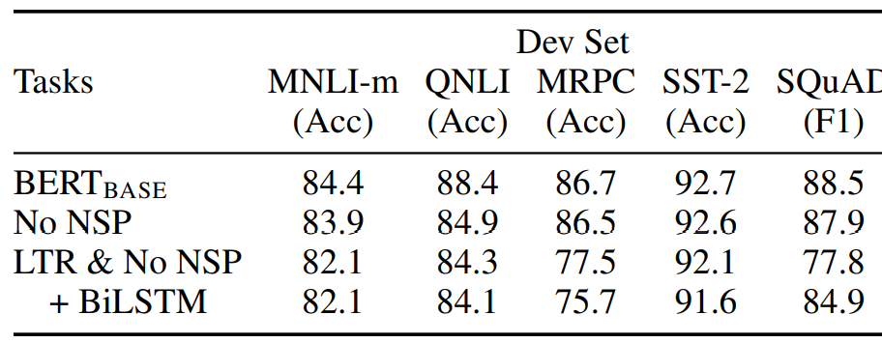
BERT: Pre-training of Deep Bidirectional Transformers for Language Understanding, 2018
https://arxiv.org/abs/1810.04805
 | Masking some percentage of the input tokens at random, and then predict those masked Tokens Masking 15% of all WordPiece tokens in each sequence at random There is a mismatch between pre-training and fine-tuning, since the [MASK] token does not appear during fine-tuning. To mitigate this, replacing the i-th token (15% of tokens) with (1) the [MASK] token 80%, (2) a random token 10% of the time (3) the unchanged i-th token 10% of the time. |  | The BooksCorpus (800M words) (Zhu et al., 2015) and English Wikipedia (2,500M words) For Wikipedia extracting only the text passages and ignore lists, tables, and headers Use a document-level corpus rather than a shuffled sentence-level corpus
 | When choosing the sentences A and B for each pre-training example, 50% of the time B is the actual next sentence that follows A (labeled as IsNext), and 50% of the time it is a random sentence from the corpus (labeled as NotNext).
 | GLUE Test results Ablation Studies
 |  |  | From the paper: https://github.com/ google-research/bert
Masked LM
Pre-training Data
Next
Sentence
Prediction
BERT vs. GPT
Results
Code
/ 135

Slide 15
After GPT and BERT
RoBERTa(Liu et al., 2020d) is one of the success variants of BERT, which mainly has four simple and effective changes: (1) Removing the NSP task; (2) More training steps, with bigger batch size and more data; (3) Longer training sentences; (4) Dynamically changing the pattern.
Some work improves the model architectures and explores novel pre-training tasks, such as XLNet (Yang et al., 2019), UniLM (Dong et al., 2019), MASS (Song et al., 2019), SpanBERT (Joshi et al., 2020) and ELECTRA (Clark et al., 2020).
Besides, incorporating rich data sources is also an important direction, such as utilizing multilingual corpora, knowledge graphs, and images.
Since the model scale is a crucial success factor of PTMs, researchers also explore to build larger models to reach over hundreds of billions of parameters, such as the series of GPT (Radford et al., 2019; Brown et al., 2020), Switch Transformer (Fedus et al.,2021), and meanwhile conduct computational efficiency optimization for training PTMs(Shoeybi et al., 2019; Rajbhandari et al., 2020; Ren et al., 2021).

Slide 16
Pre-trained Models: Past, Present, and Future
Based on the paper Han Xu et al. (2021), https://www.sciencedirect.com/science/article/pii/S2666651021000231

Slide 17
4 Important Directions of PTMs | The details of various latest PTMs | PTMs
Designing Effective Architecture | Combining Autoregressive and Autoencoding Modeling | XLNet, GLM
 | Applying Generalized Encoder-Decoder | MASS, BART, PEGASUS, T5
 | Cognitive-Inspired Architectures | LAMA,REALM
 | More Variants of Existing PTMs: Masking Strategy | SpanBERT
Utilizing Multi-Source Data | Multilingual Pre-Training | Unicoder
 | Multimodal Pre-training | ViLBERT, Unicoder-VL, CLIP, DALL-E, CogView, codeGen
 | Knowledge-Enhanced Pre-Training | KEPLER, ERNIE, KnowBERT, KGLM, Commonsense story generation
Improving Computational Efficiency | System-Level Optimization | Megatron-LM
 | Efficient Pre-Training | Train no Evil, Progressive layer dropout
 | Model Compression | ALBERT, Compressing BERT, DistillBERT, MINILM
Interpretation and Theoretical Analysis | Knowledge of PTMs: Linguistic Knowledge | Word/contextual representation, BERT structure
 | Knowledge of PTMs: World Knowledge | Evaluate commonsense
 | Robustness of PTMs | Trick me if you can, BERT’s robustness
 | Structural Sparsity of PTMs | BERT’s structure sparsity
 | Theoretical Analysis of PTMs | Theoretical Analysis of Unsupervised PTM

Slide 18
01
Designing Effective Architecture
Improve the model architectures and explore novel pre-training tasks

Slide 19
Design effective architecture
Combing autoregressive and autoencoding modeling
Transformer-XL: Attentive Language Models Beyond a Fixed-Length Context
XLNet: Generalized Autoregressive Pretraining for Language Understanding
RETHINKING ATTENTION WITH PERFORMERS
GLM: All NLP Tasks Are Generation Tasks: A General Pretraining Framework
Applying generalized encoder-decoder
MASS: Masked Sequence to Sequence Pre-training for Language Generation
T5: Exploring the Limits of Transfer Learning with a Unified Text-to-Text Transformer
BART:Denoising Sequence-to-Sequence Pre-training for Natural Language Generation, Translation, and Comprehension
PEGASUS: Pre-training with Extracted Gap sentences for Abstractive Summarization
Cognitive-inspired architectures
Language Models as Knowledge Bases?
REALM: Retrieval-Augmented Language Model Pre-Training
More variants of existing PTMs: masking strategy
SpanBERT: Improving Pre-training by Representing and Predicting Spans

Slide 20
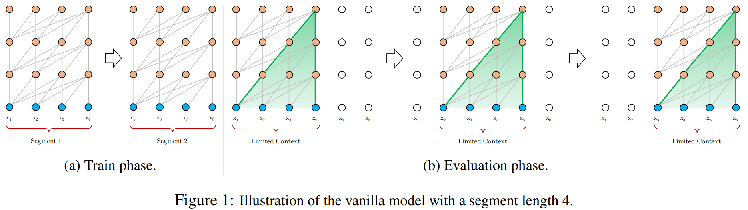
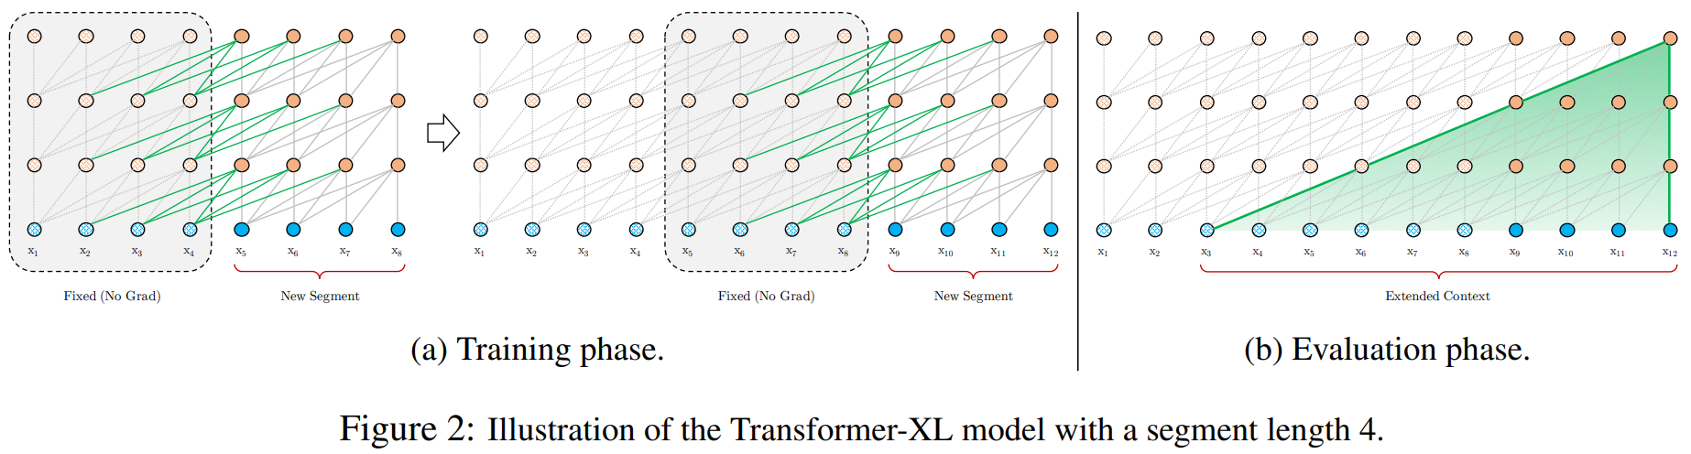
Transformer-XL: Attentive Language Models Beyond a Fixed-Length Context, 2019
https://arxiv.org/abs/1901.02860
 | Transformers have a potential of learning longer-term dependency, but are limited by a fixed-length context in the setting of language Modeling As a consequence of the fixed context length, the model cannot capture any longer-term dependency beyond the predefined context length. (context fragmentation) |  | Transformer-XL, Segment-level recurrence mechanism, Relative positional encoding,
 | Transformer-XL that enables learning dependency beyond a fixed length without disrupting temporal coherence Segment-level recurrence mechanism: Reusing the hidden states obtained in previous segments. The reused hidden states serve as memory for the current segment, which builds up a recurrent connection between the segments. As a result, modeling very long-term dependency becomes possible because information can be propagated through the recurrent connections. Relative positional encoding: formulation that generalizes to attention lengths longer than the one observed during training
 | With this recurrence mechanism applied to every two consecutive segments of a corpus, it essentially creates a segment-level recurrence in the hidden states. During training, the hidden state sequence computed for the previous segment is fixed and cached to be reused as an extended context when the model processes the next new segment. The concatenation of two hidden sequences along the length dimension. Consequently, the largest possible dependency length grows linearly w.r.t. the number of layers as well as the segment length. Besides achieving extra long context and resolving fragmentation, another benefit that comes with the recurrence scheme is significantly faster evaluation.
Motivation
Keywords
Introduction
Segment-level Recurrence Mechanism
/ 135

Slide 21
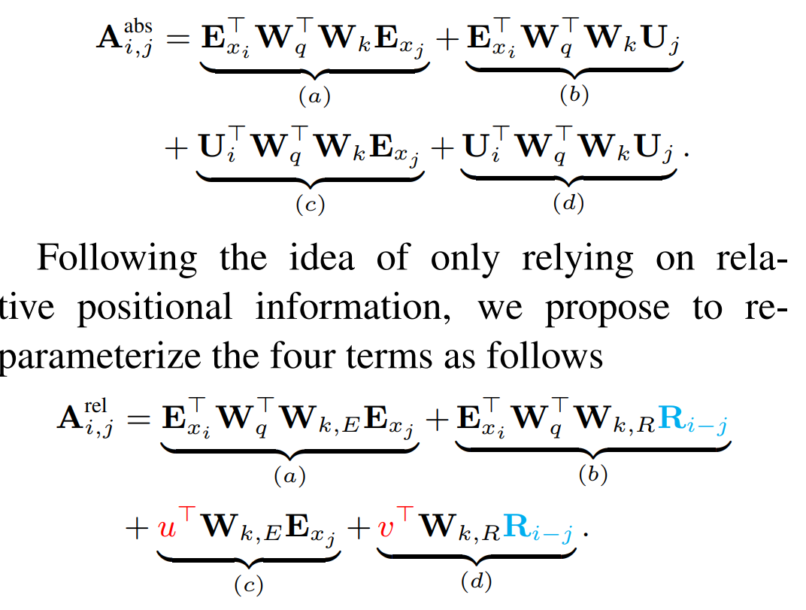
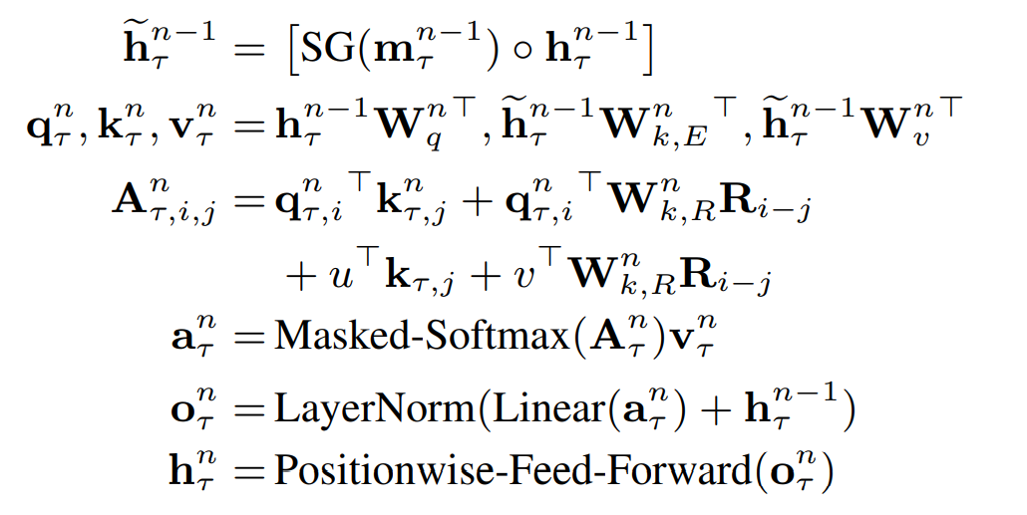
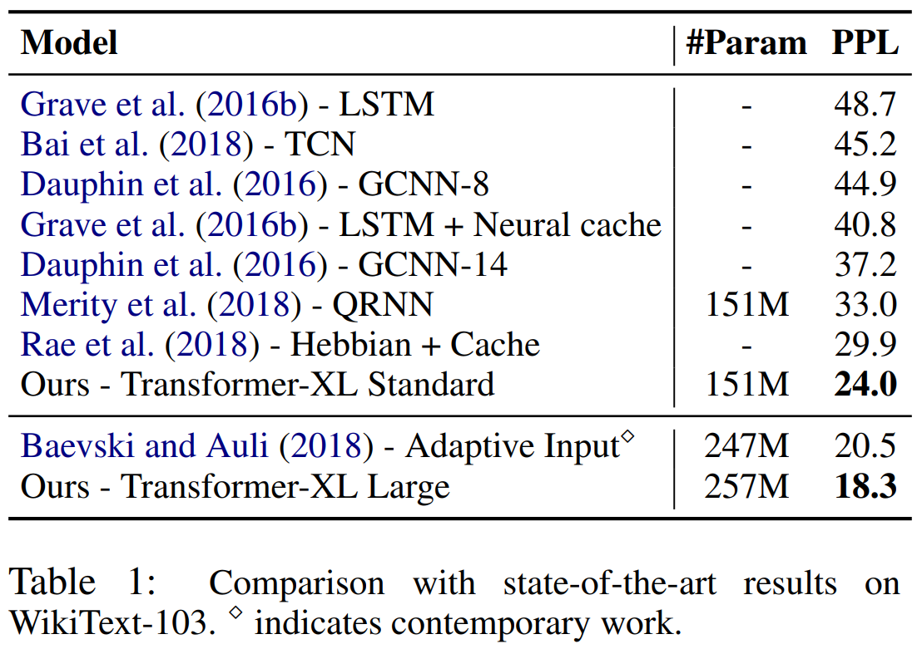
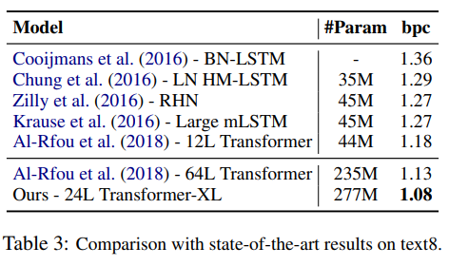
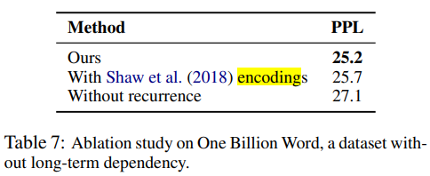
Transformer-XL: Attentive Language Models Beyond a Fixed-Length Context, 2019
https://arxiv.org/abs/1901.02860
 | How can we keep the positional information coherent when we reuse the states? In the standard Transformer (Vaswani et al., 2017), the attention score between query q_{i} and key vector k_{j} within the same segment can be decomposed as Replace all appearances of the absolute positional embedding U_{j} for computing key vectors in term (b) and (d) with its relative counterpart R_{i−j} . Introduce a trainable parameter u, v ∈ R^{d} to replace the query in term (c), (d). |  | Term (a) represents content-based addressing, (b) captures a content-dependent positional bias, (c) governs a global content bias, and (d) encodes a global positional bias.
 | The computational procedure for a N-layer Transformer-XL with a single attention head here.
 | improve the state-of-the-art results of bpc/perplexity to 0.99 on enwiki8, 1.08 on text8, 18.3 on WikiText-103, 21.8 on One Billion Word, and 54.5 on Penn Treebank (without finetuning). | Applying Transformer-XL to a variety of datasets on both word-level and character-level language modeling | Applying Transformer-XL to a variety of datasets on both word-level and character-level language modeling
 |  |  | From the paper: https://github.com/kimiyoung/ transformer-xl
Relative Positional Encodings
[ Standard Transformer ]
[ Transformer-XL ]
Model
Results
Code
/ 135

Slide 22
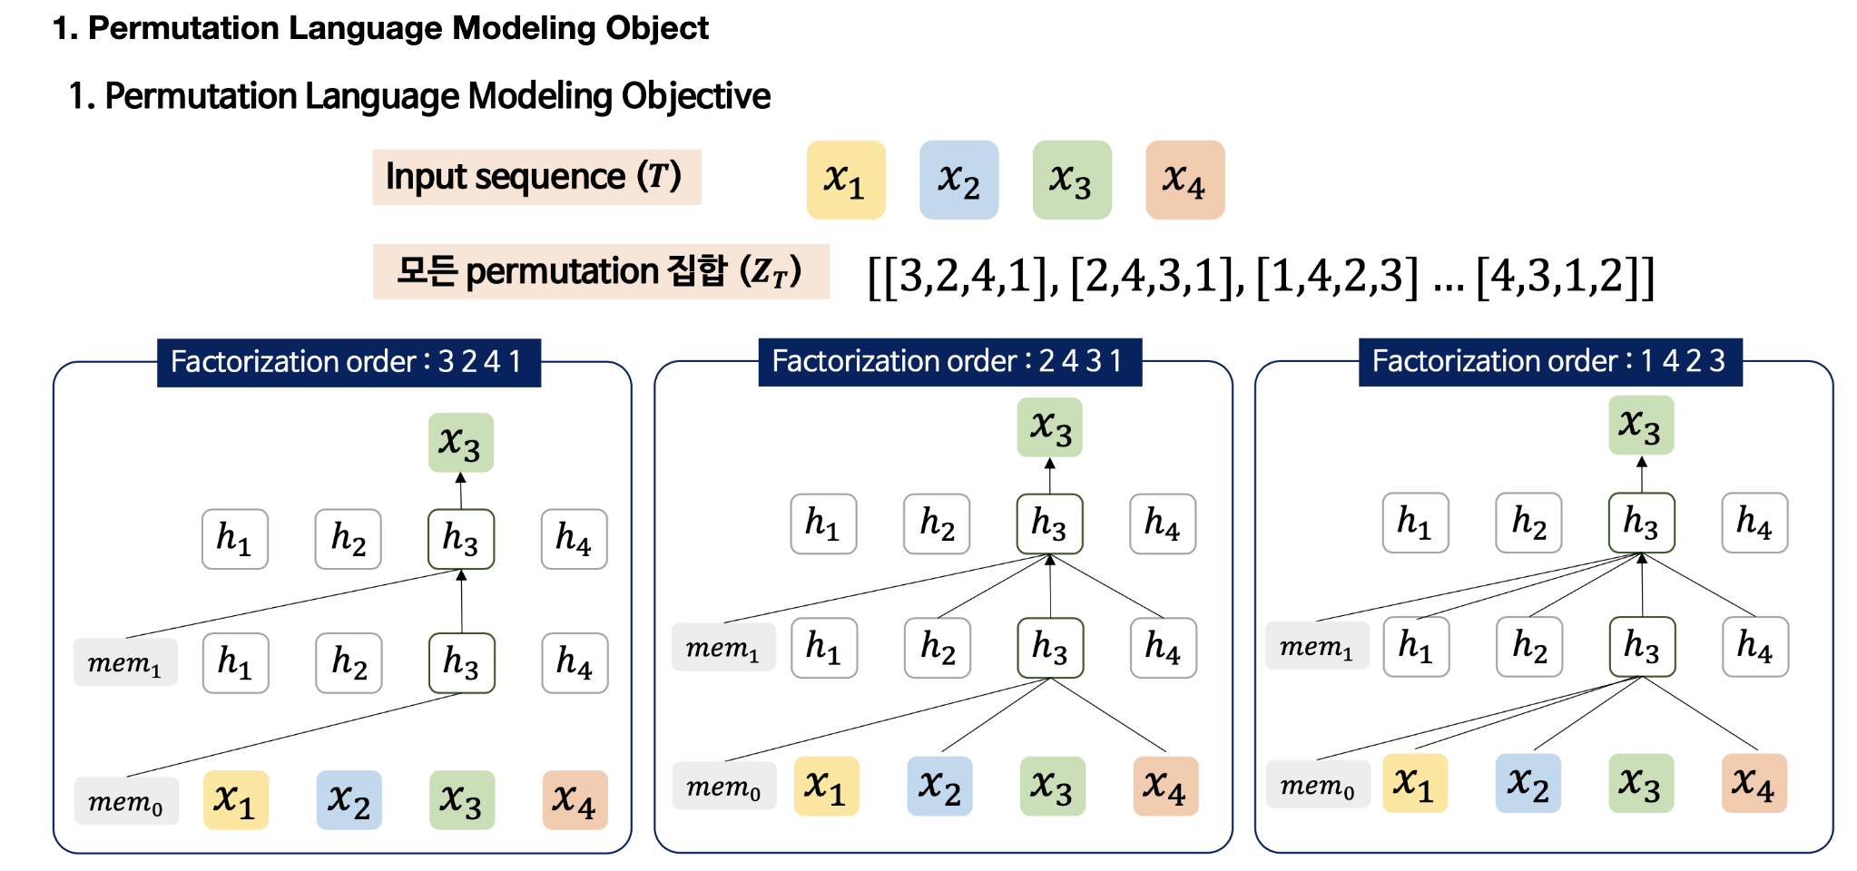
XLNET(Generalized Autoregressive Pretraining for Language Understanding

Slide 23
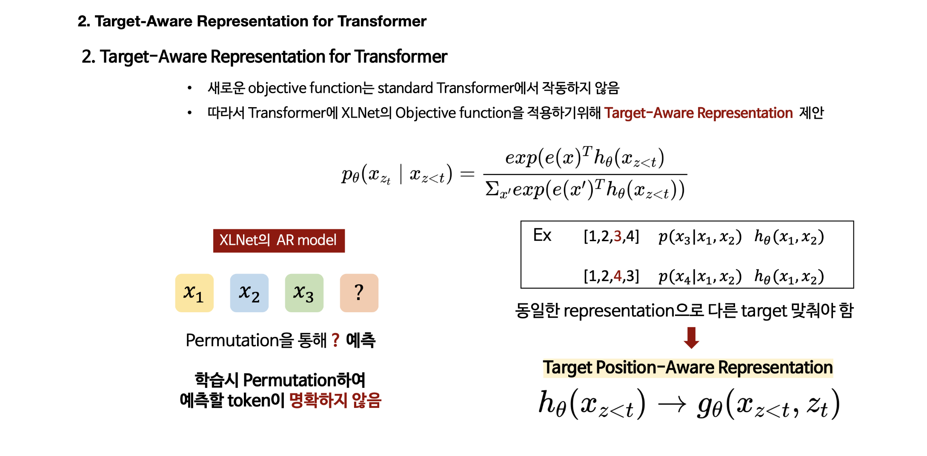
XLNET(Generalized Autoregressive Pretraining for Language Understanding

Slide 24
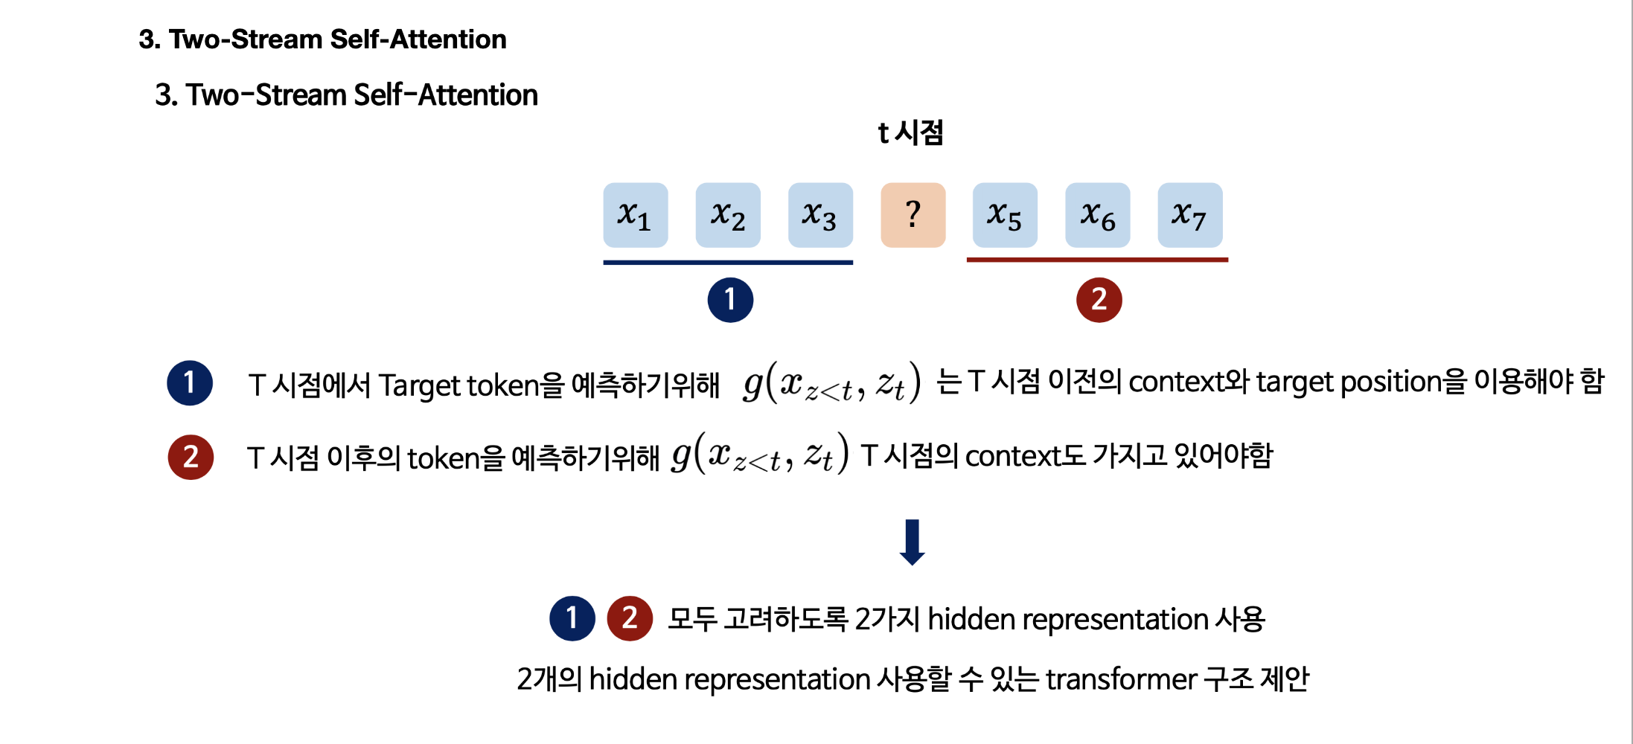
XLNET(Generalized Autoregressive Pretraining for Language Understanding

Slide 25
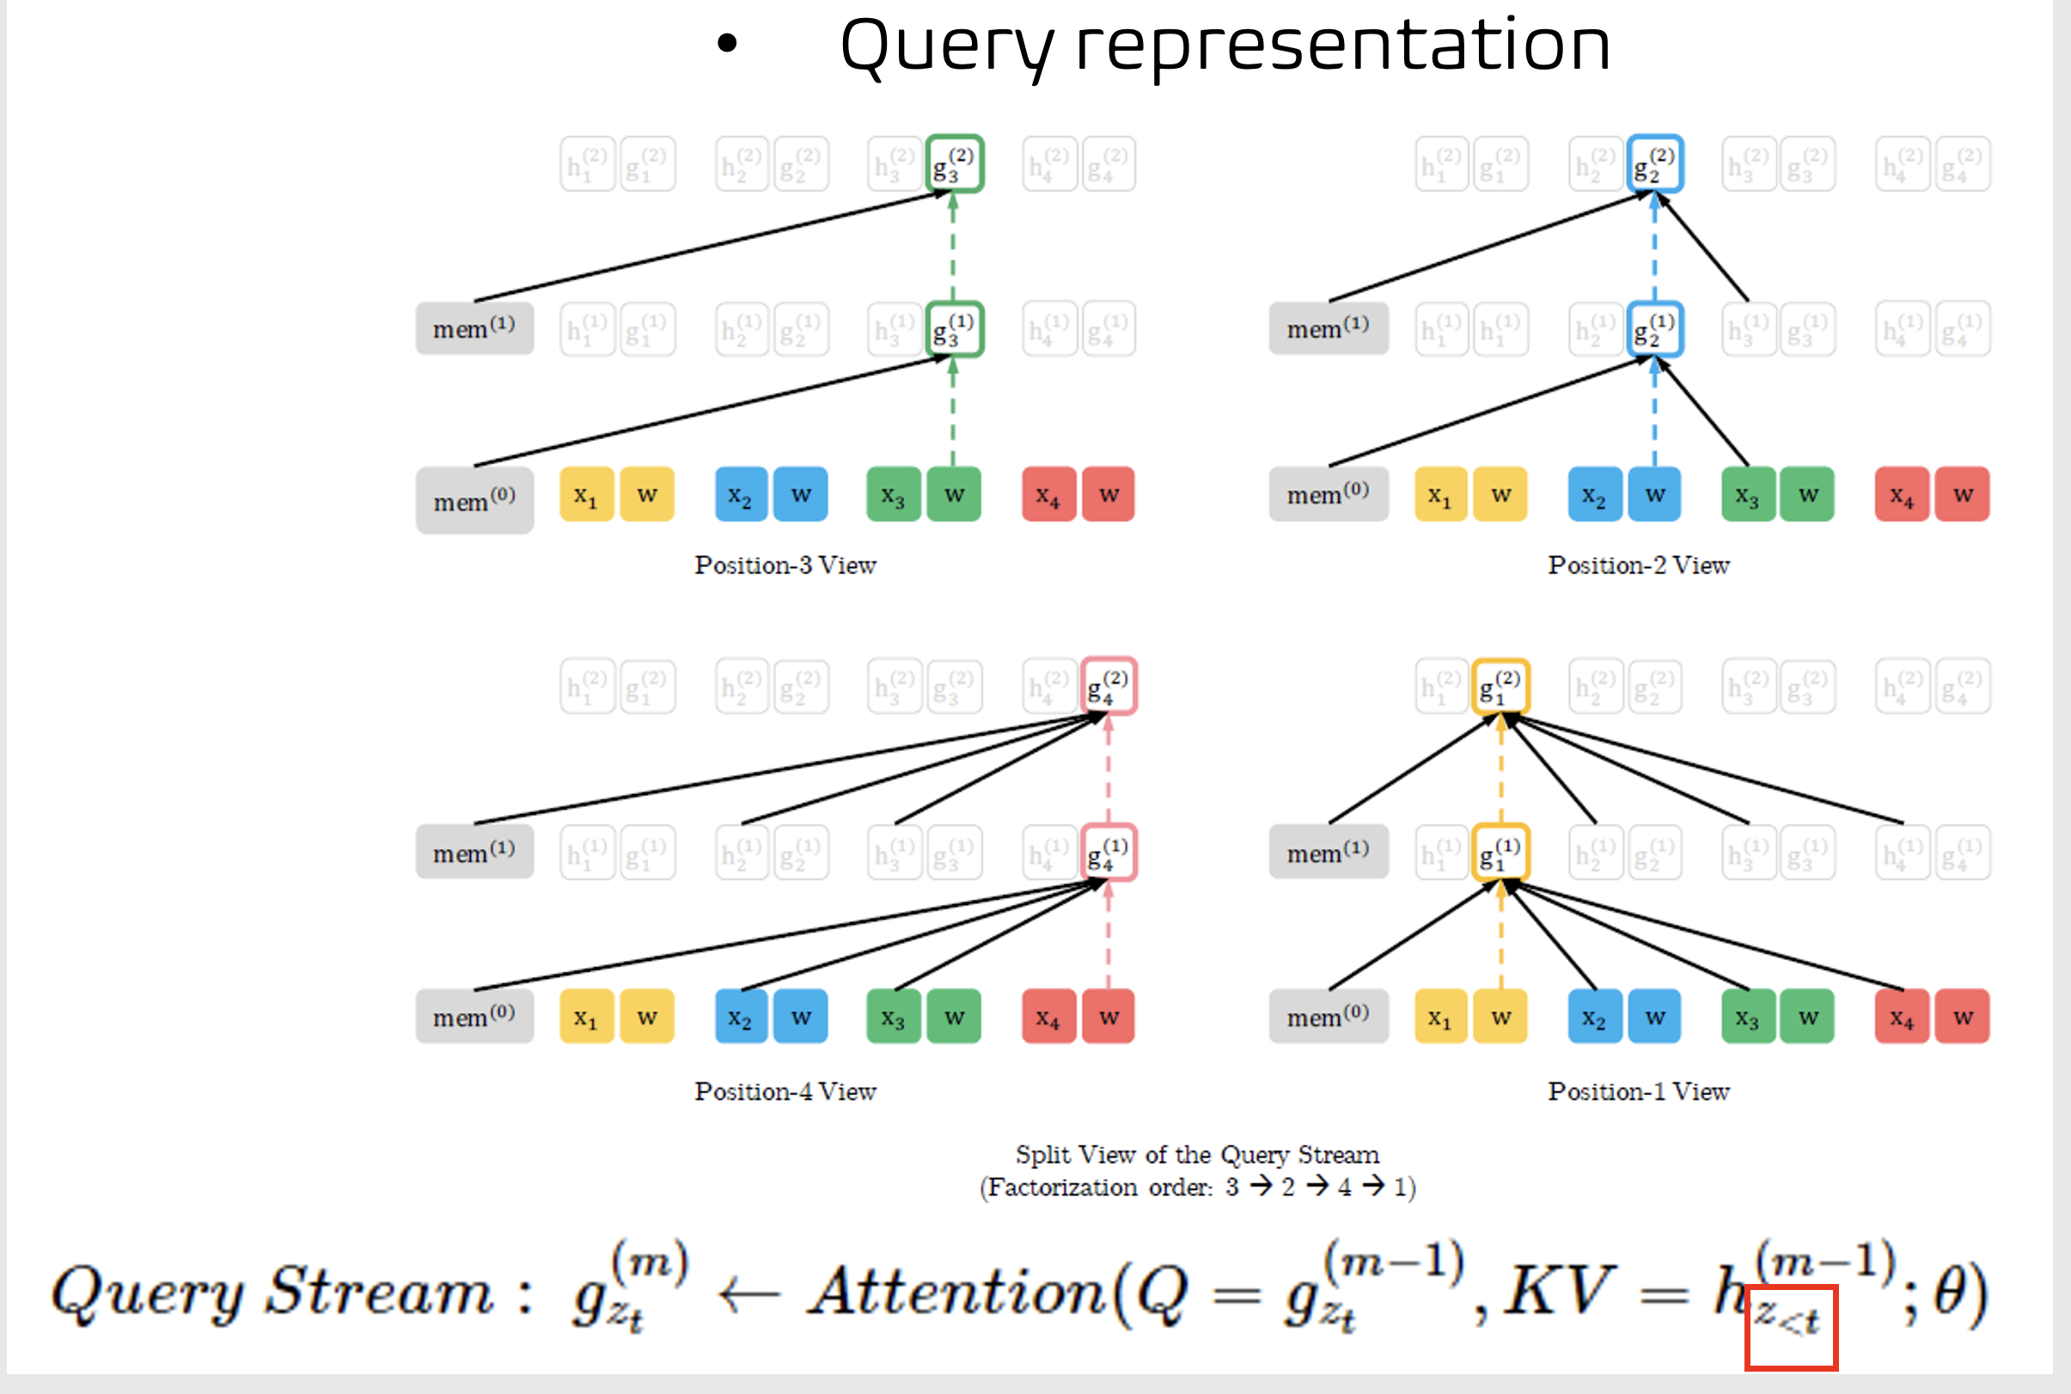
XLNET(Generalized Autoregressive Pretraining for Language Understanding

Slide 26
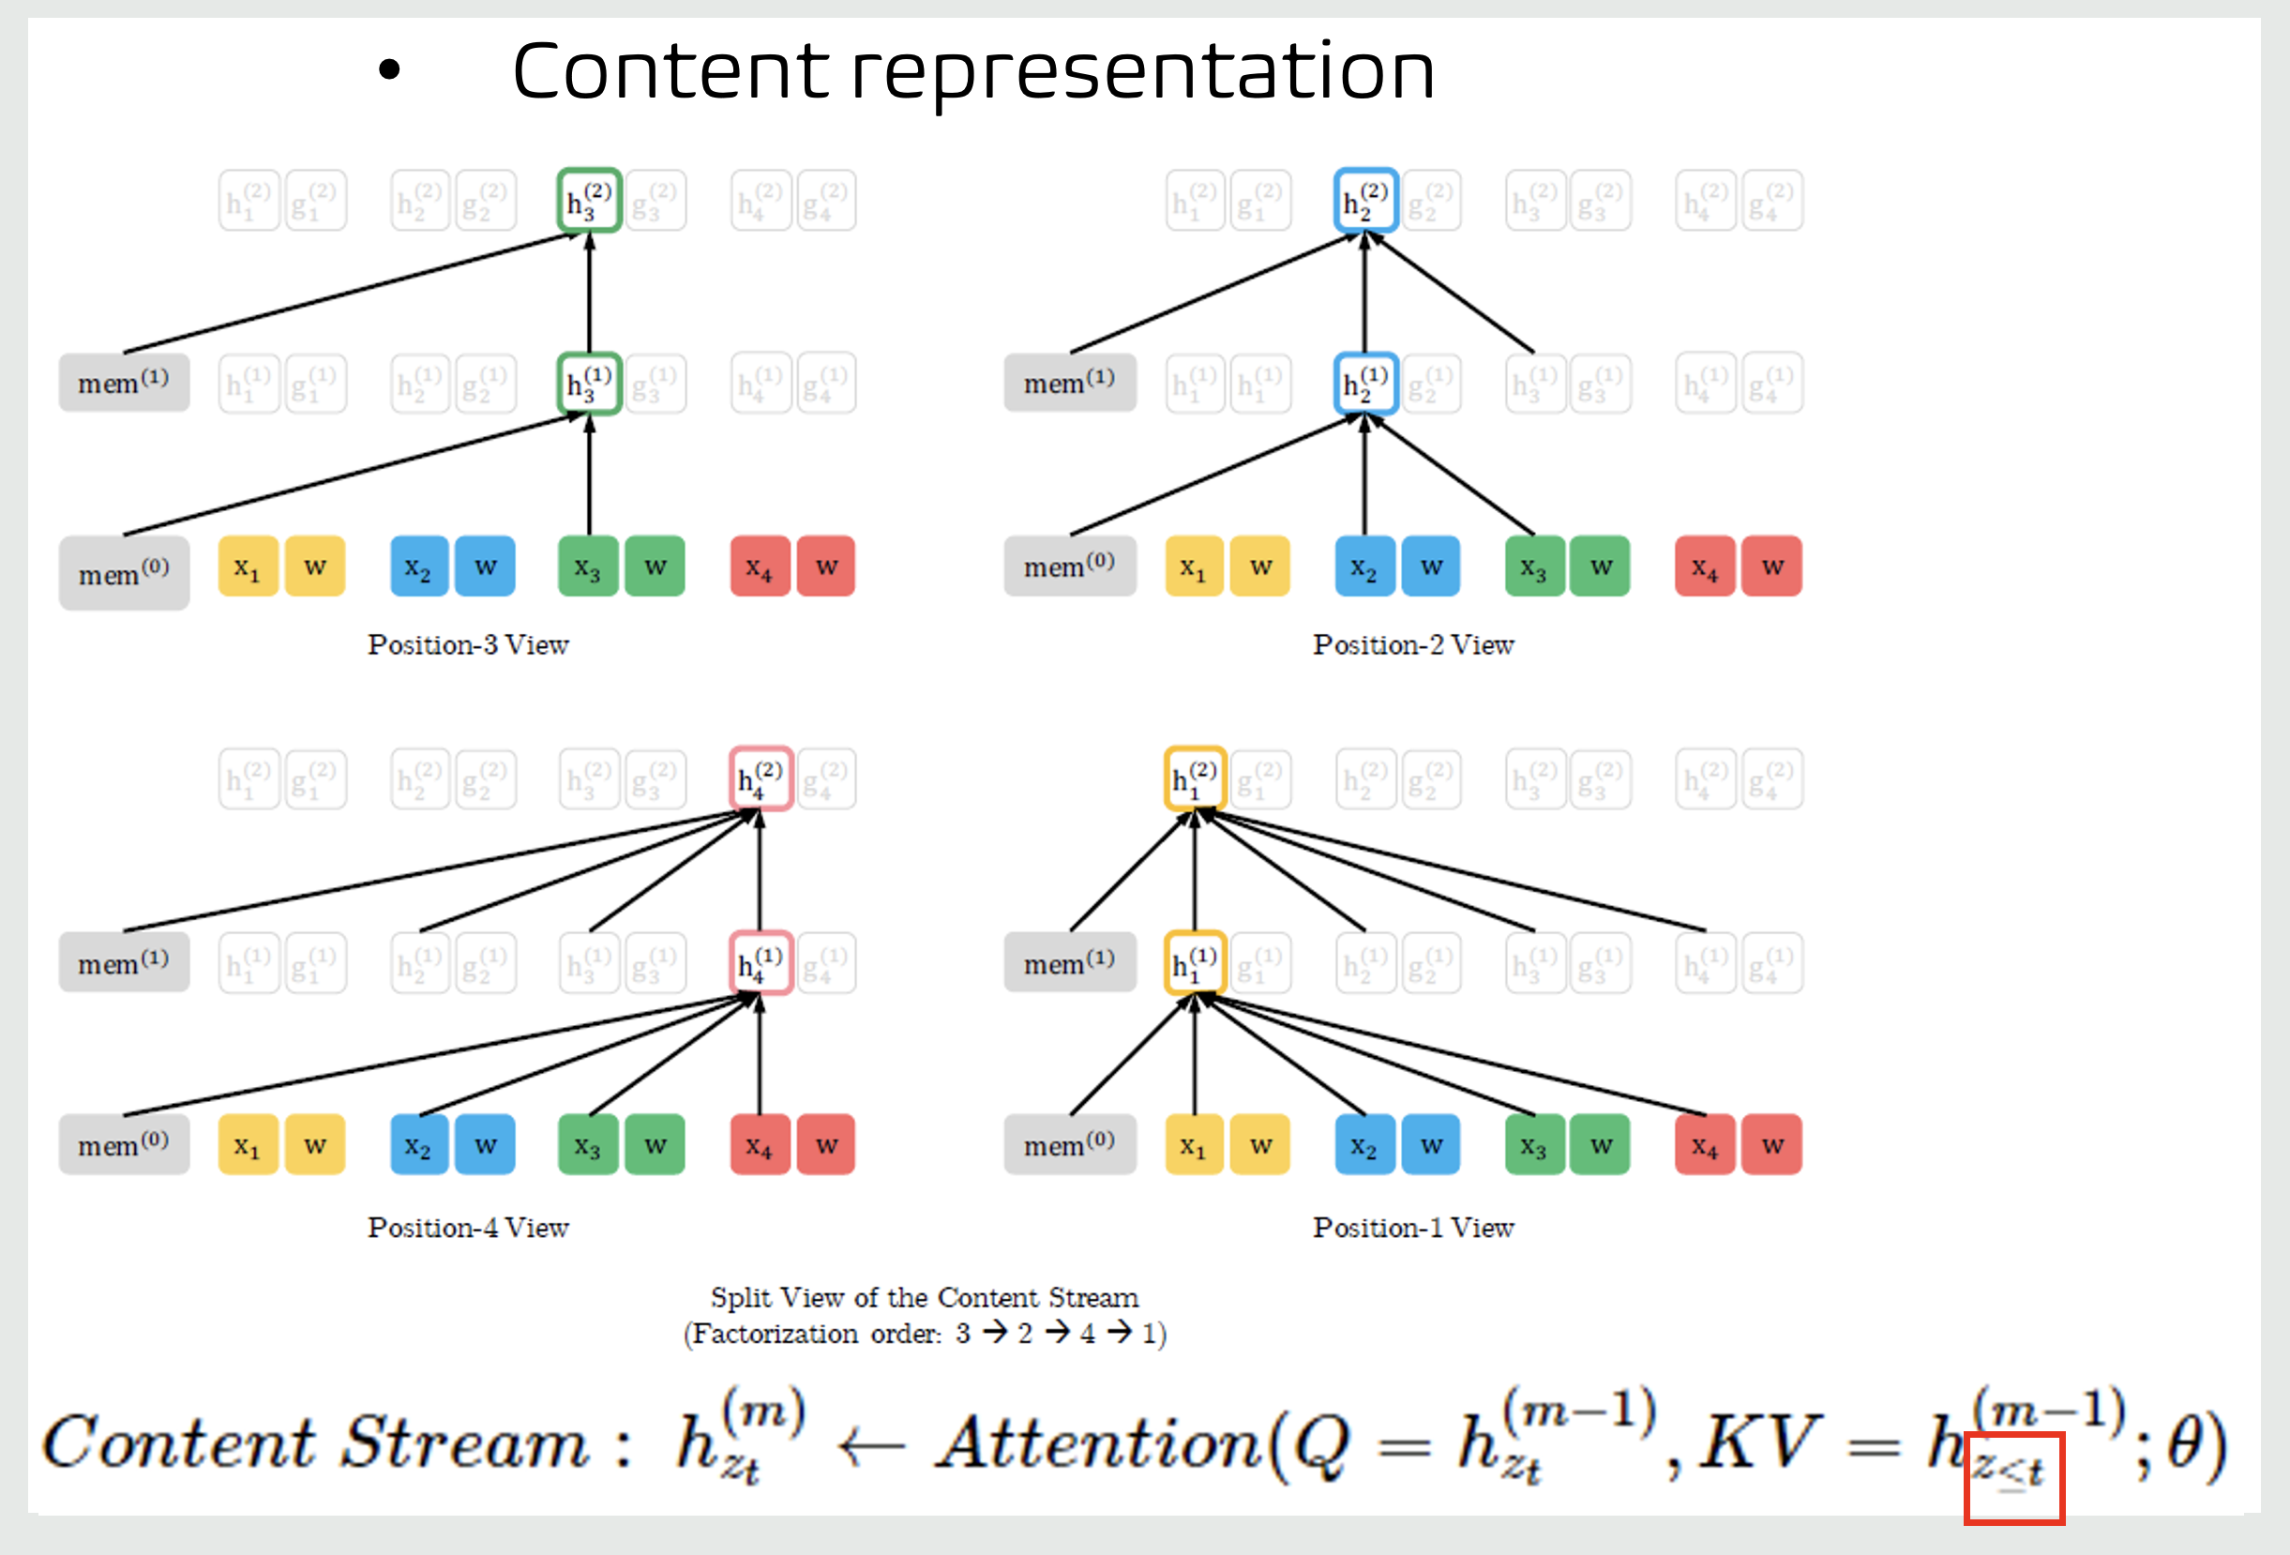
XLNET(Generalized Autoregressive Pretraining for Language Understanding

Slide 27
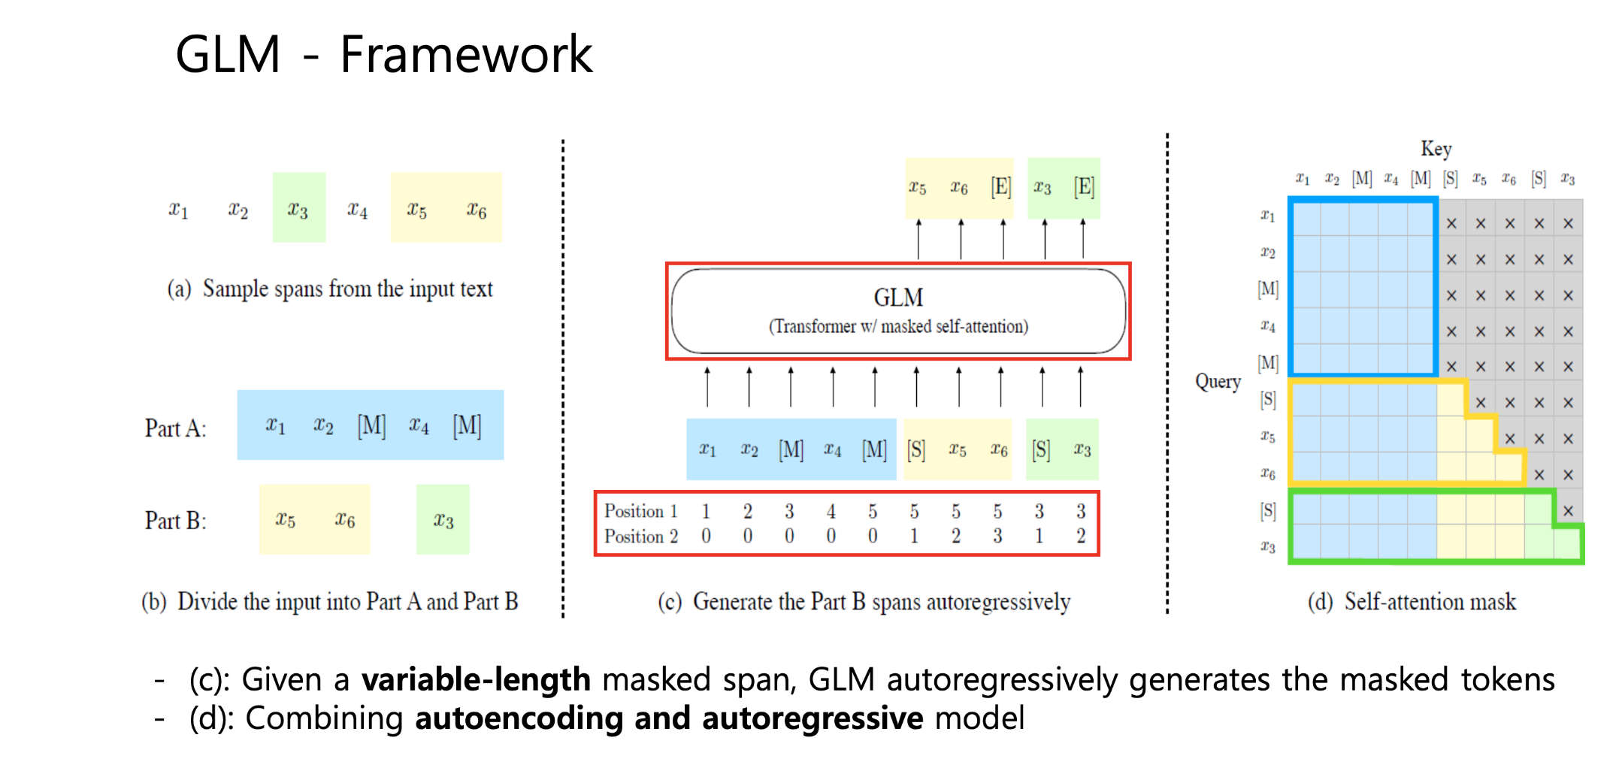
GLM (All NLP Tasks Are Generation Tasks: A General Pre-training Framework)

Slide 28
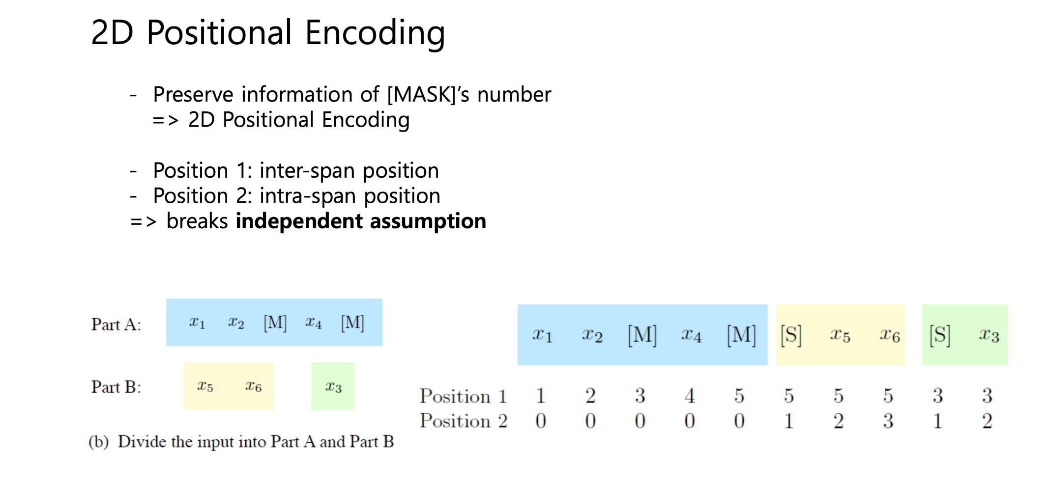
GLM (All NLP Tasks Are Generation Tasks: A General Pre-traing Framework)

Slide 29
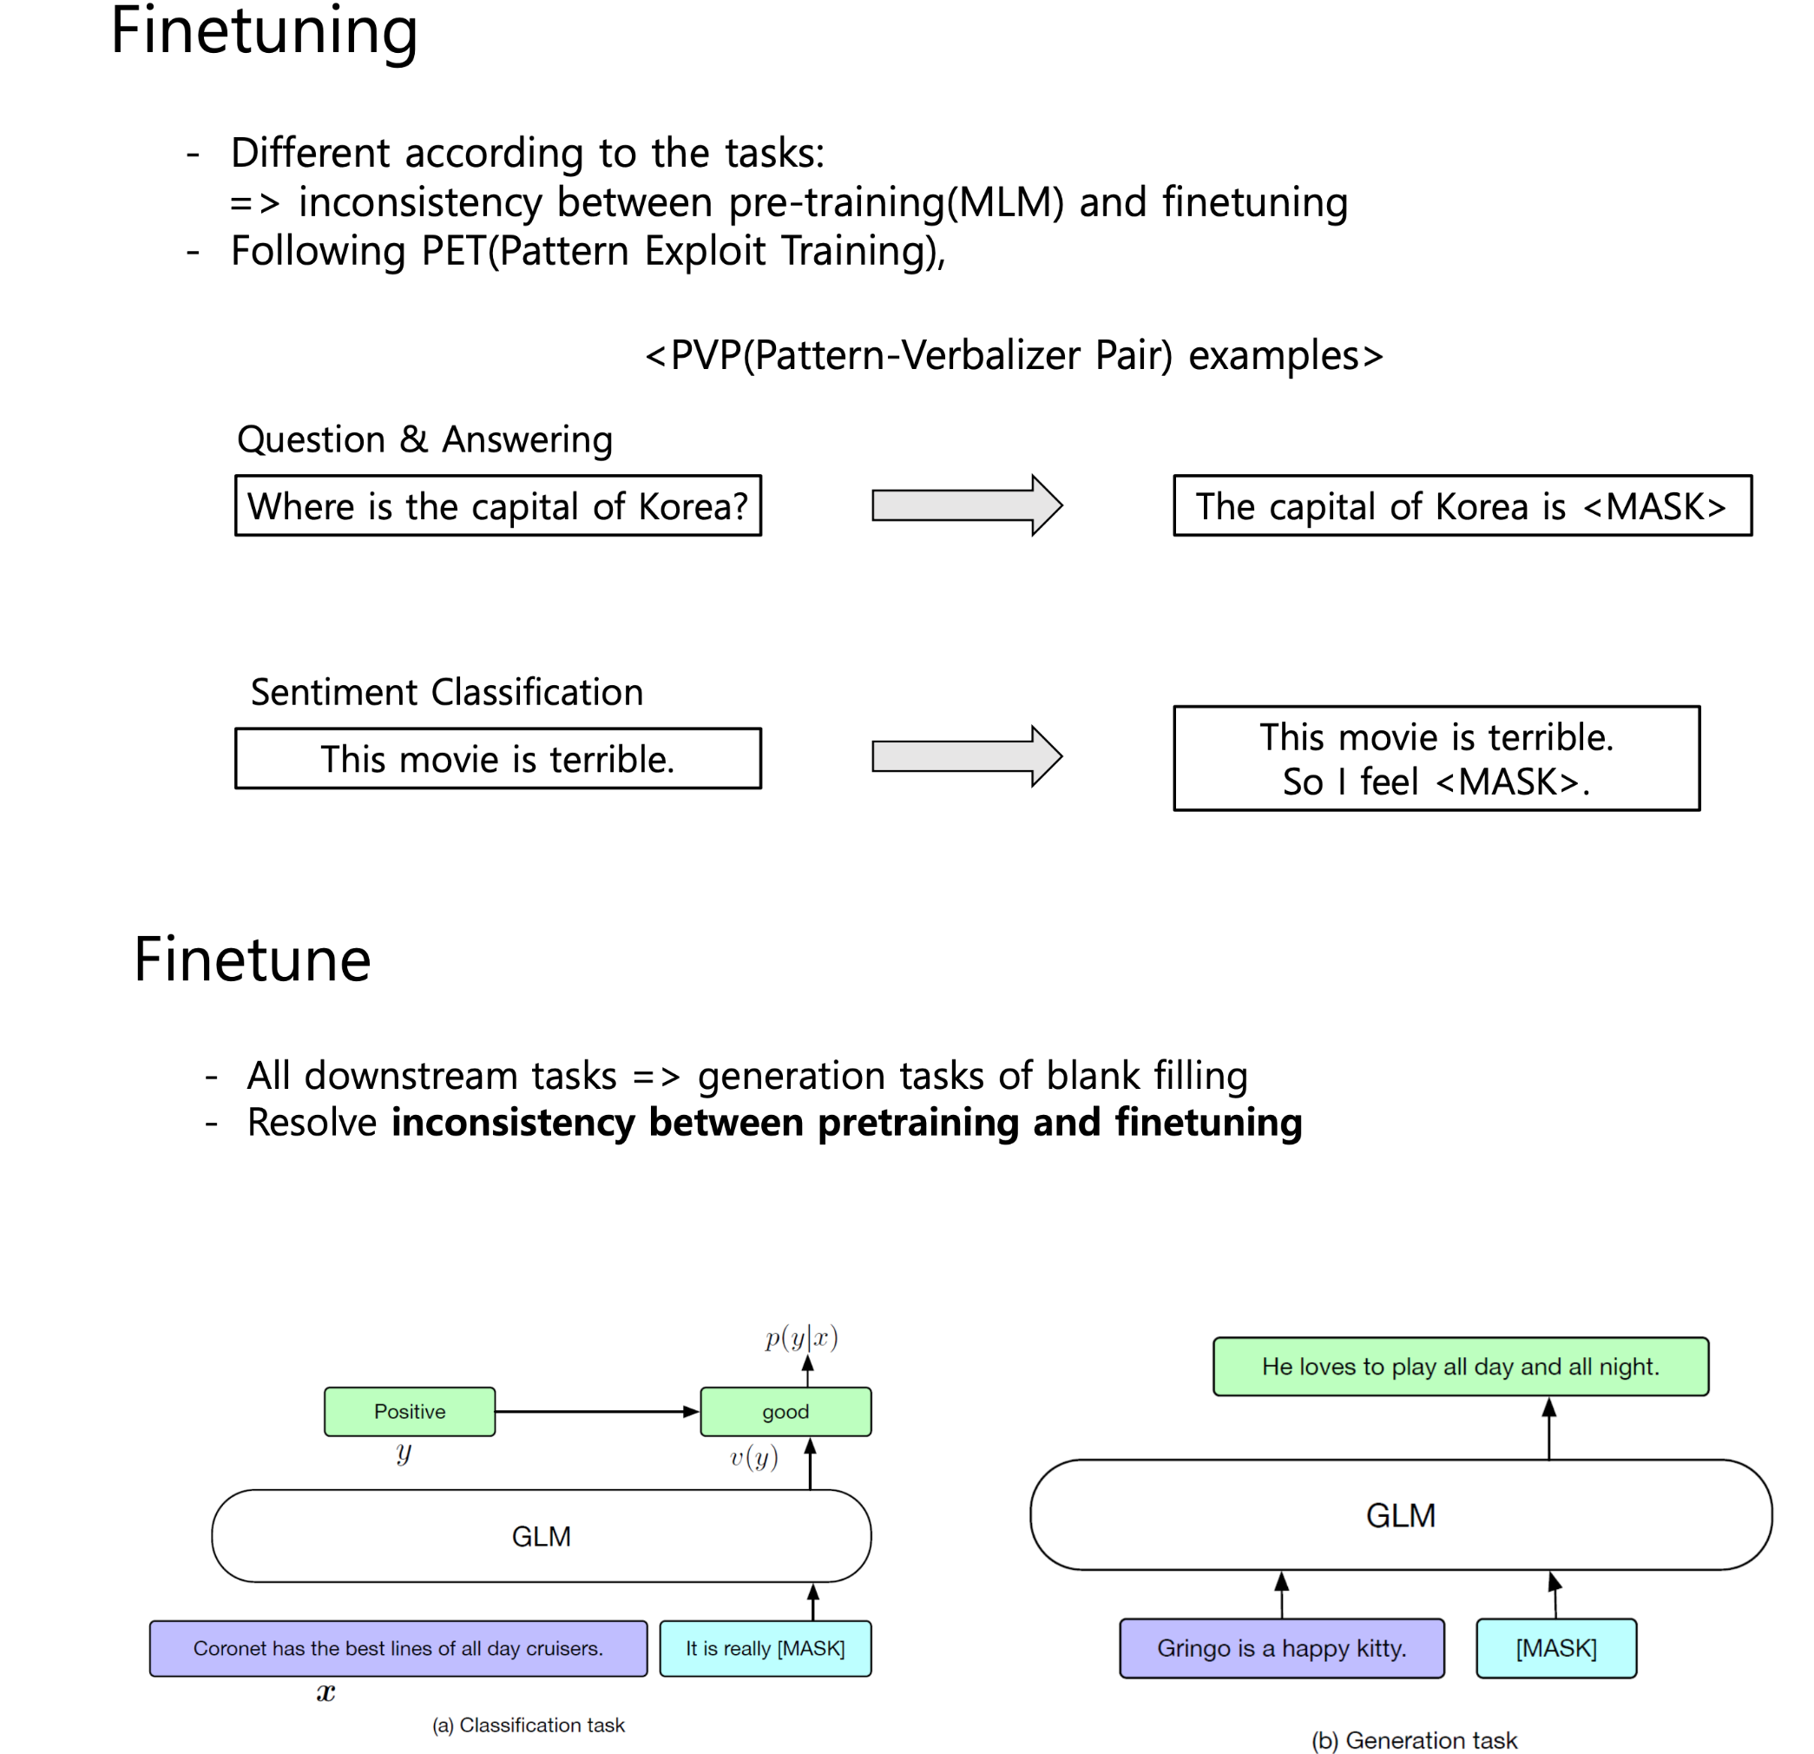
GLM (All NLP Tasks Are Generation Tasks: A General Pre-training Framework)

Slide 30
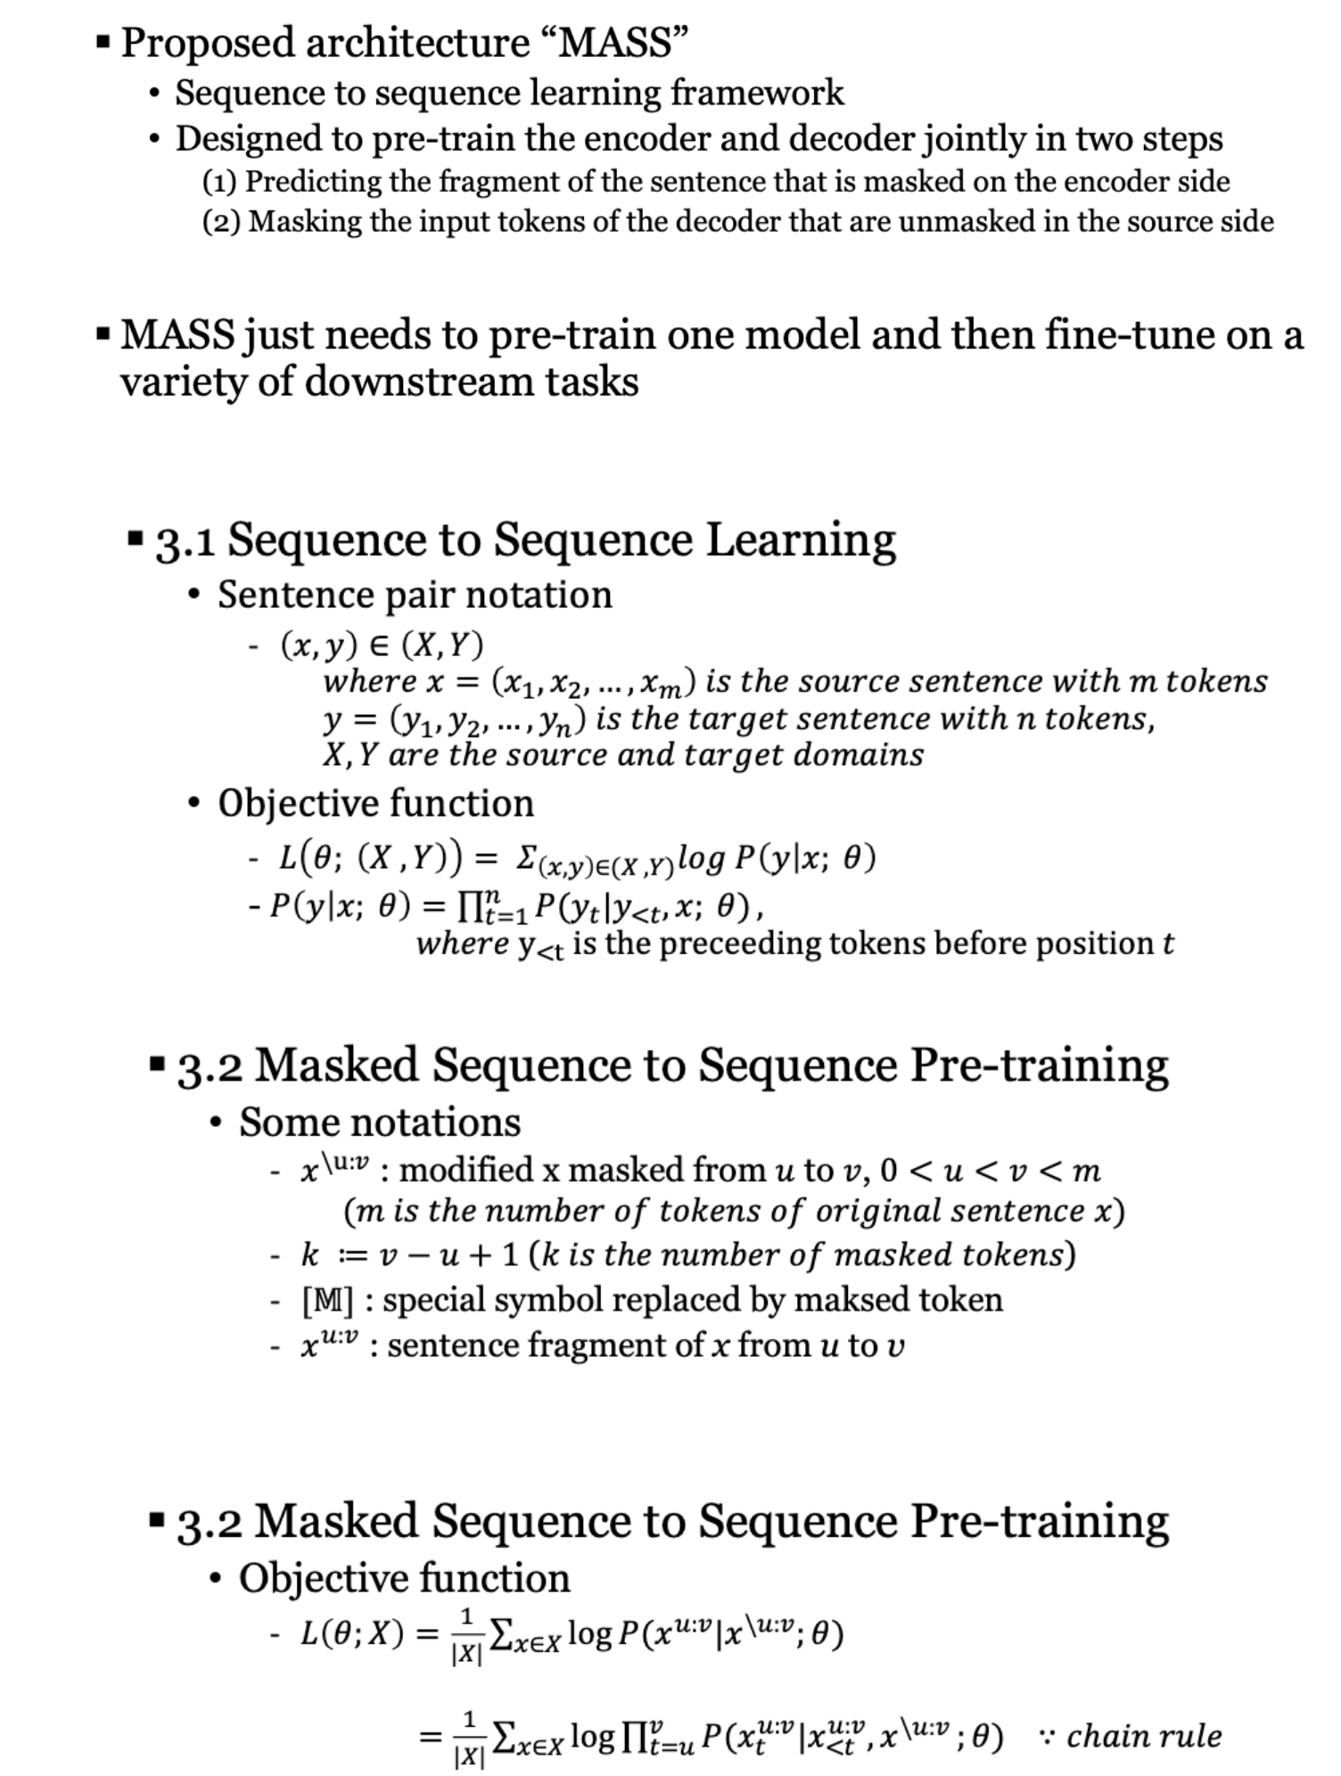
MASS (Masked Sequence to Sequence Pre-training for Language Generation)

Slide 31
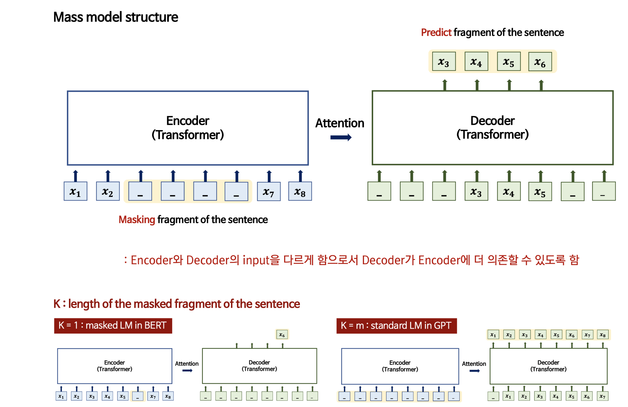
MASS (Masked Sequence to Sequence Pre-training for Language Generation)

Slide 32
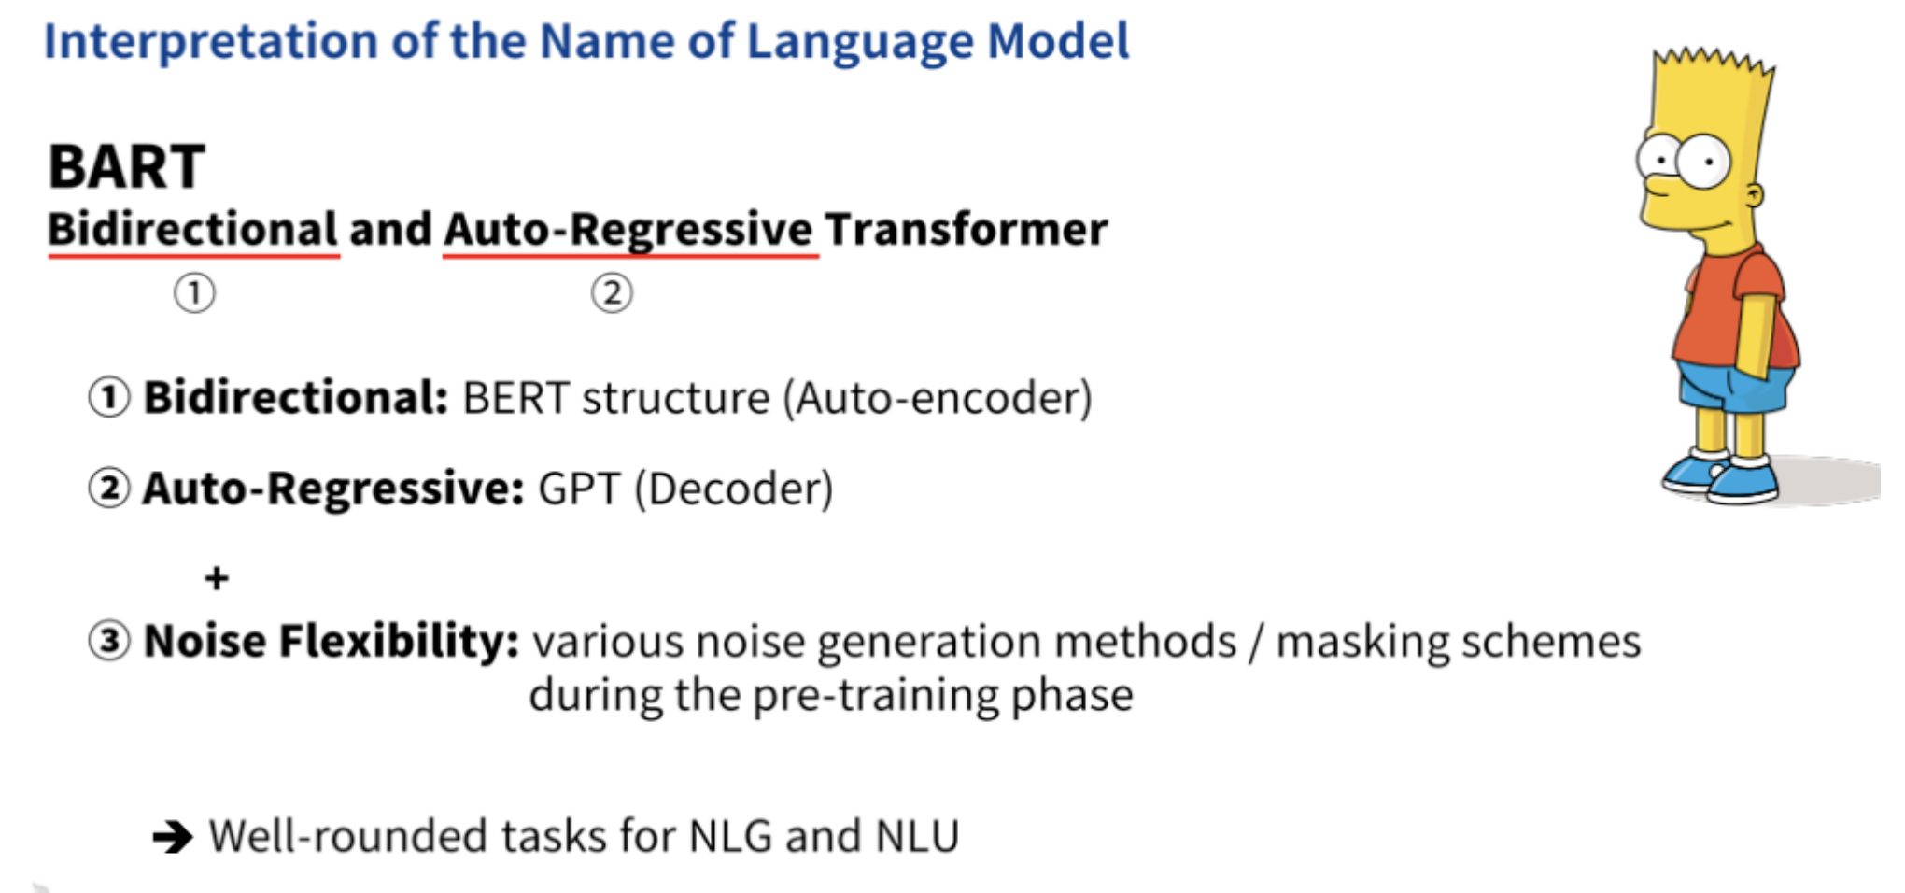
BART (Bi-directional and Autoregressive Transformer)

Slide 33
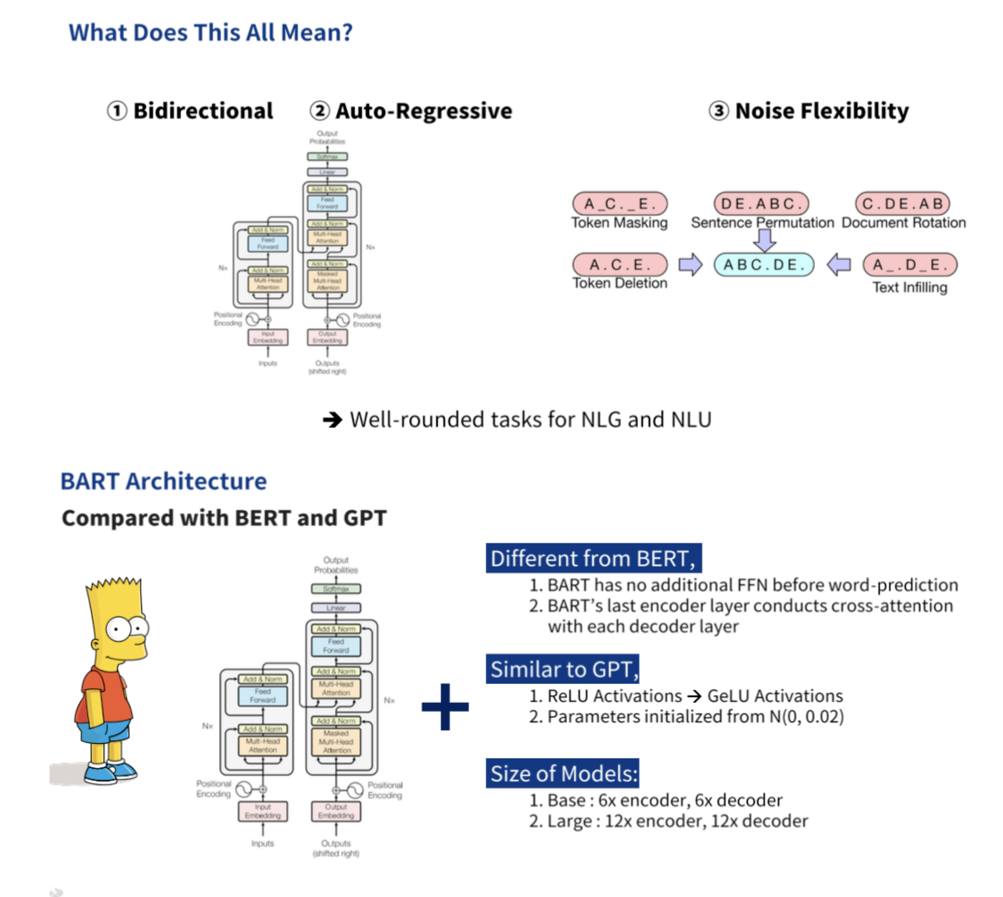
BART (Bi-directional and Autoregressive Transformer)

Slide 34
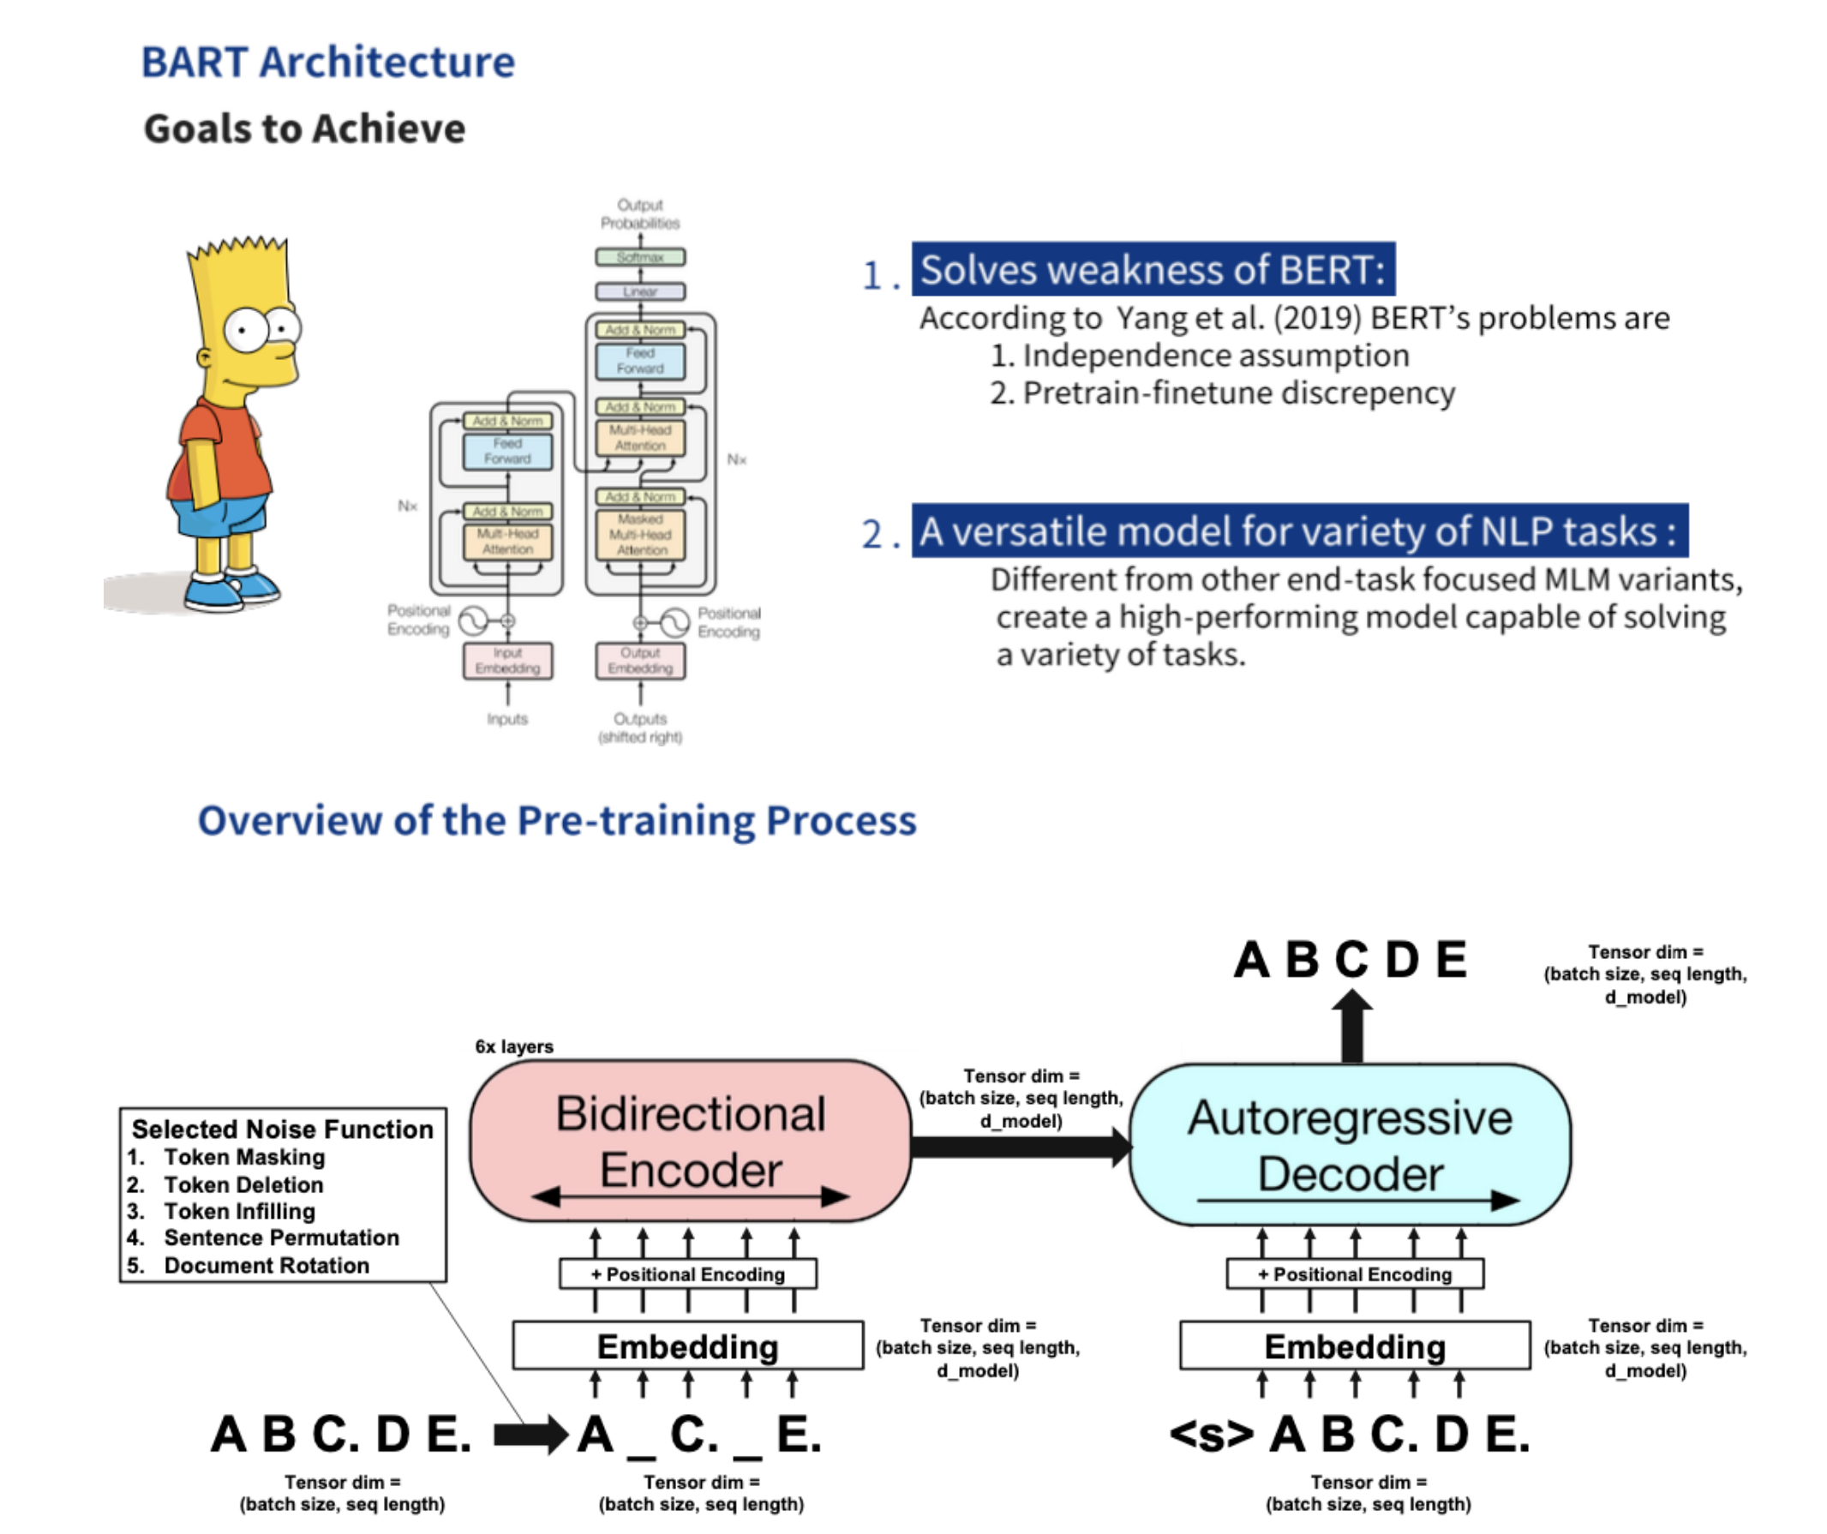
BART (Bi-directional and Autoregressive Transformer)

Slide 35
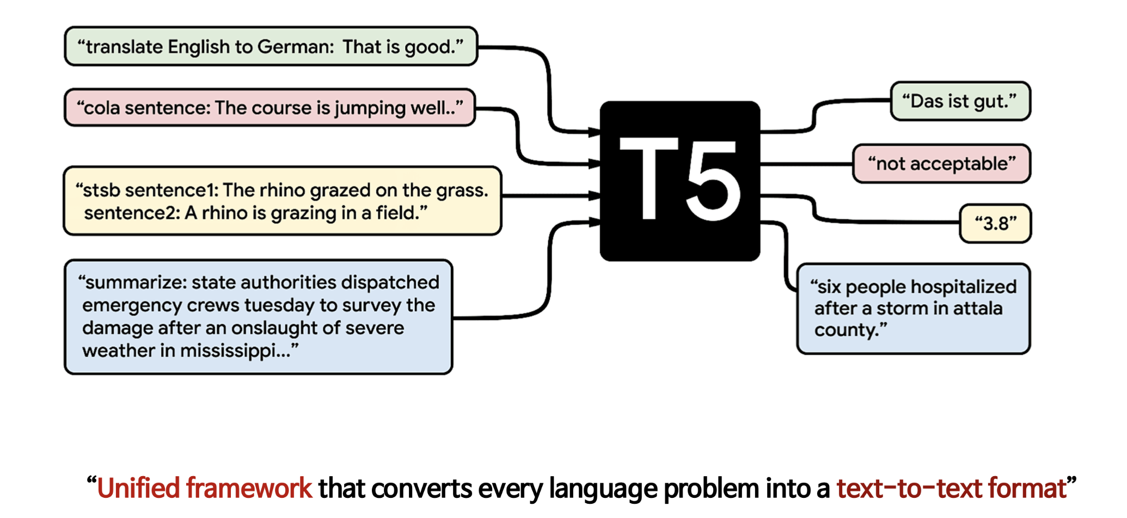
T5 (Exploring the Limits of Transformer Learning with a Unified Text-to-Text Transformer)

Slide 36
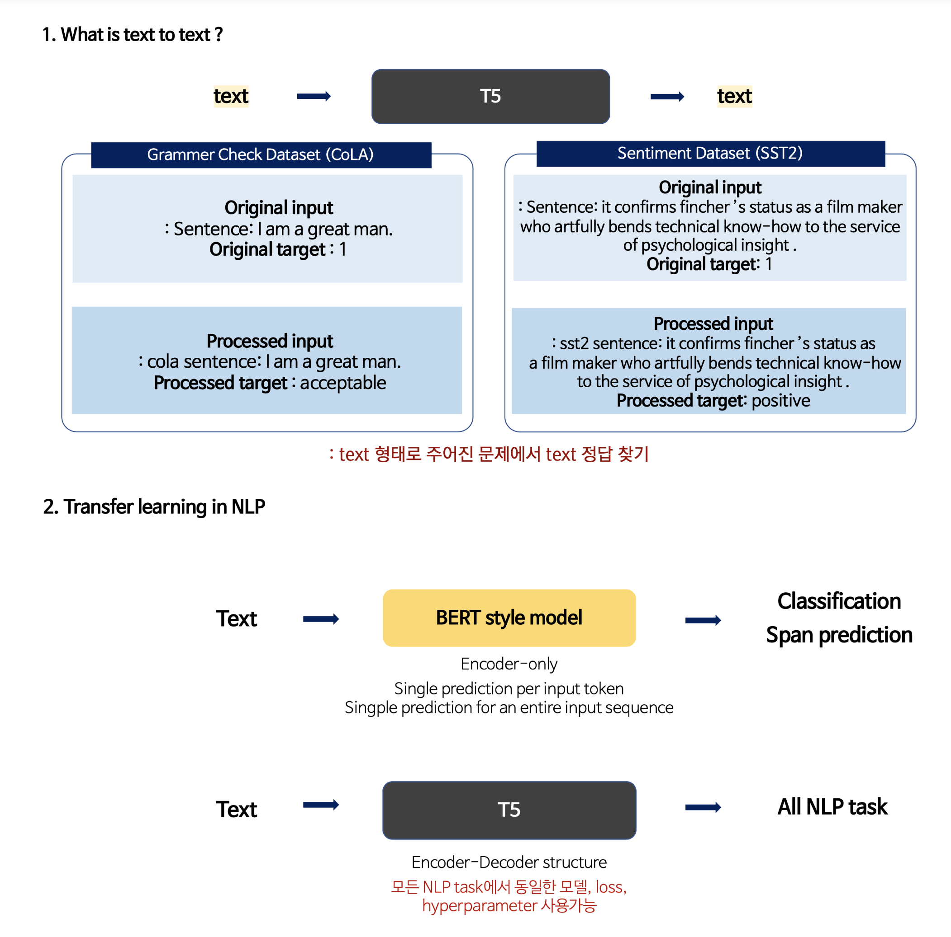
T5 (Exploring the Limits of Transformer Learning with a Unified Text-to-Text Transformer)

Slide 37
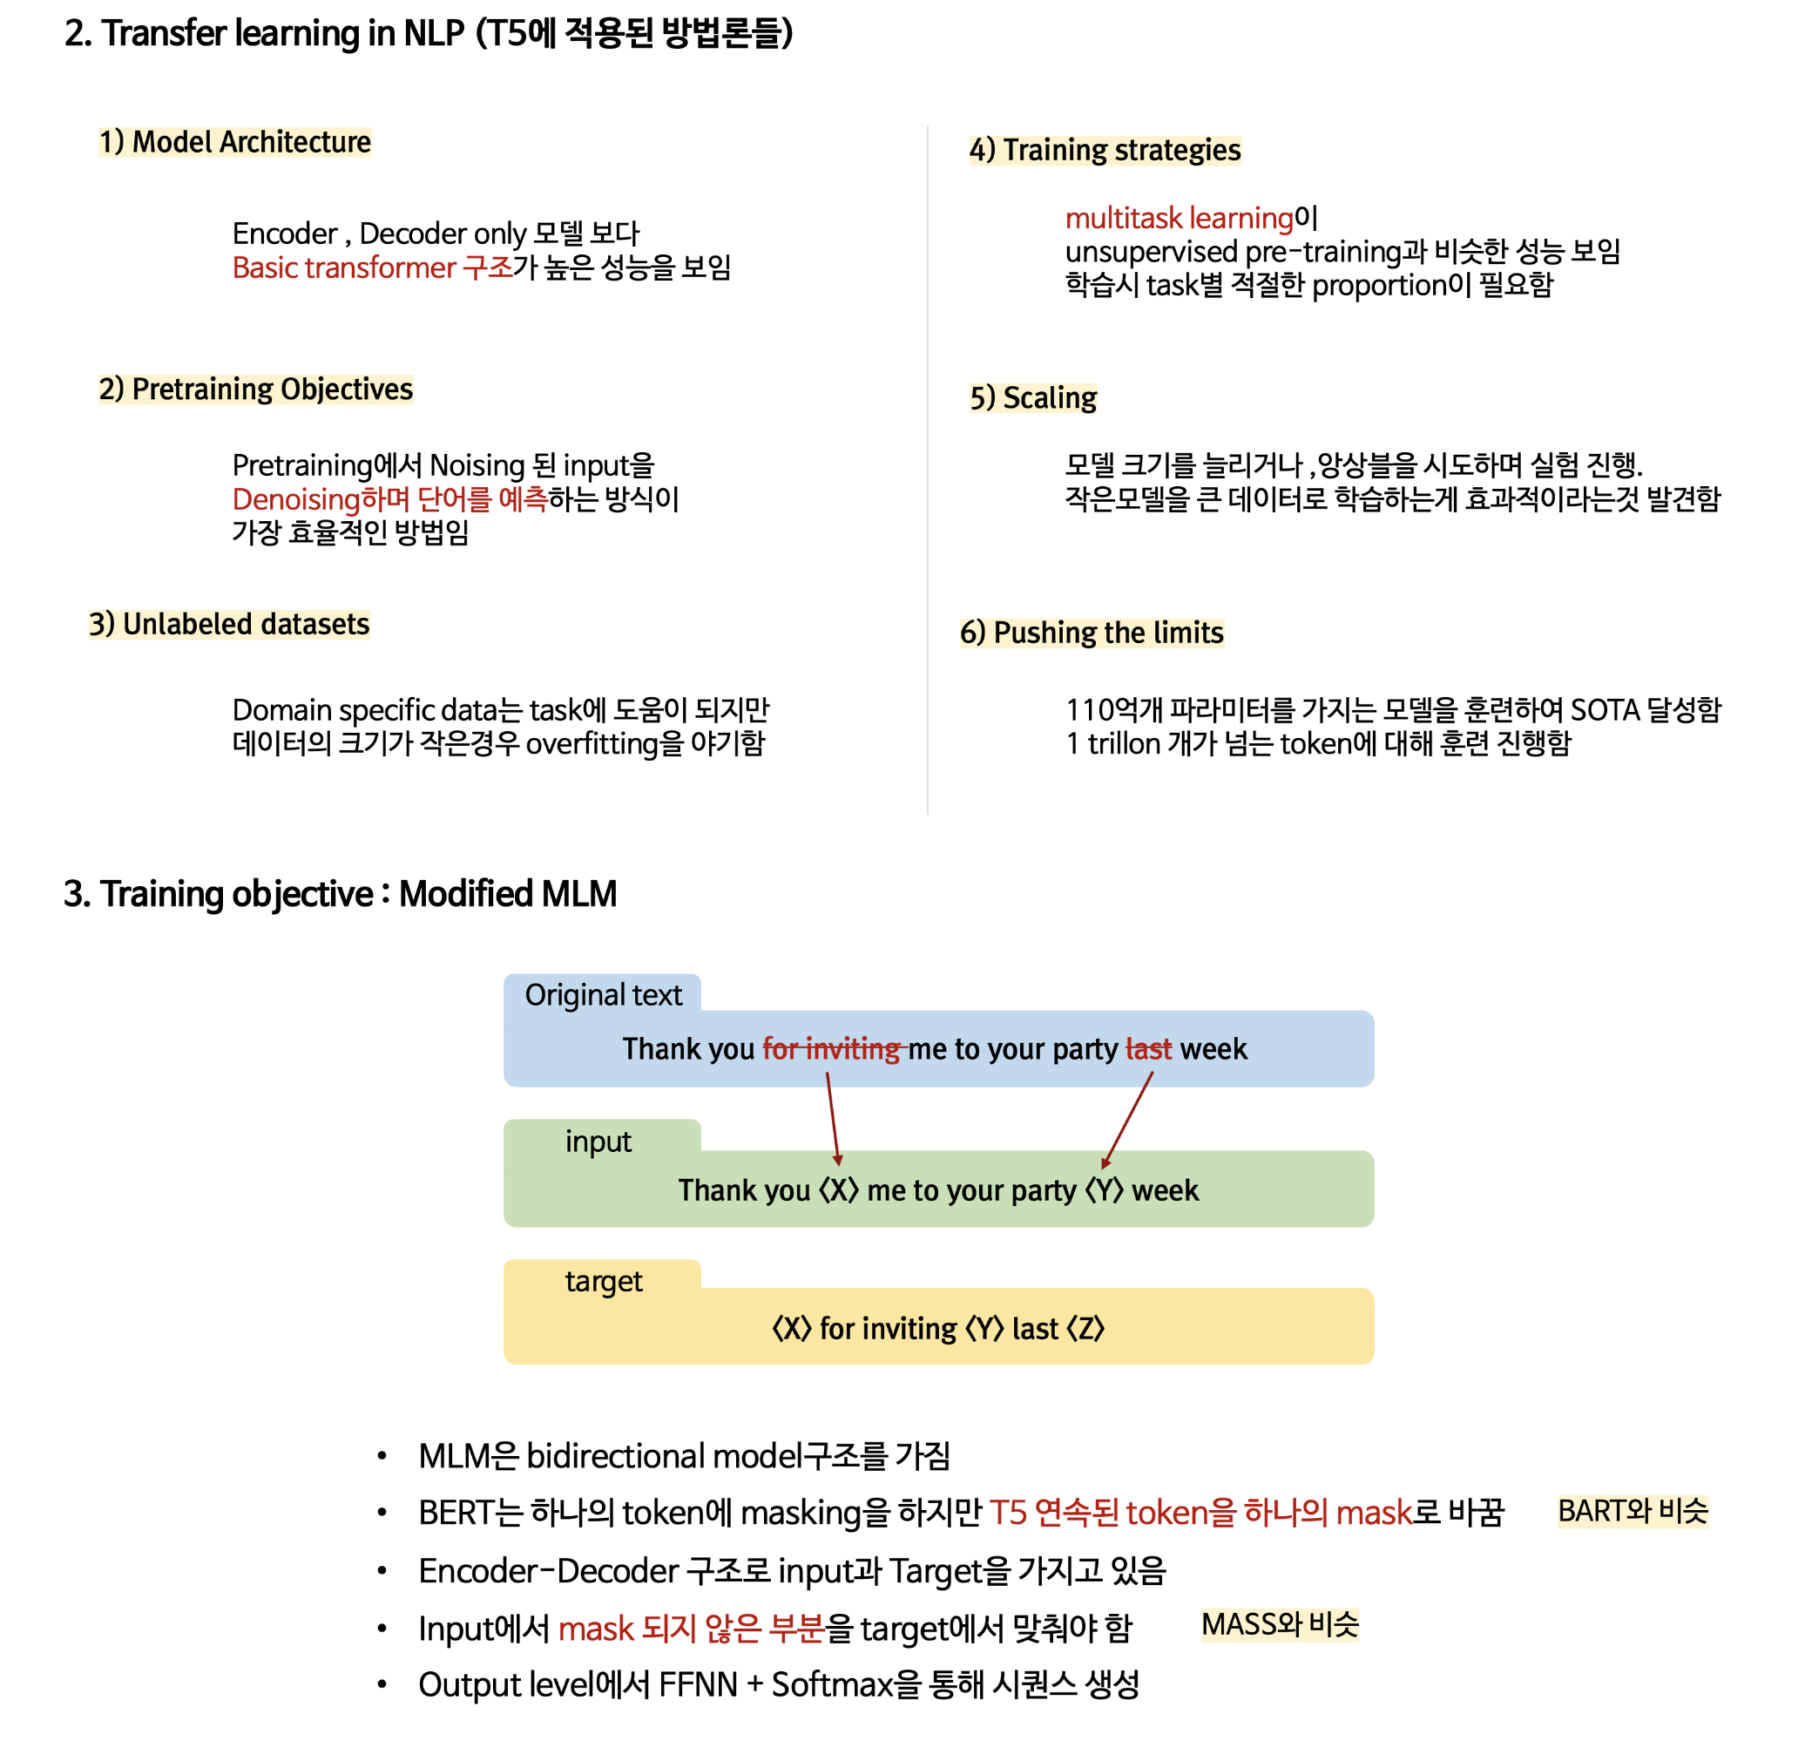
T5 (Exploring the Limits of Transformer Learning with a Unified Text-to-Text Transformer)

Slide 38
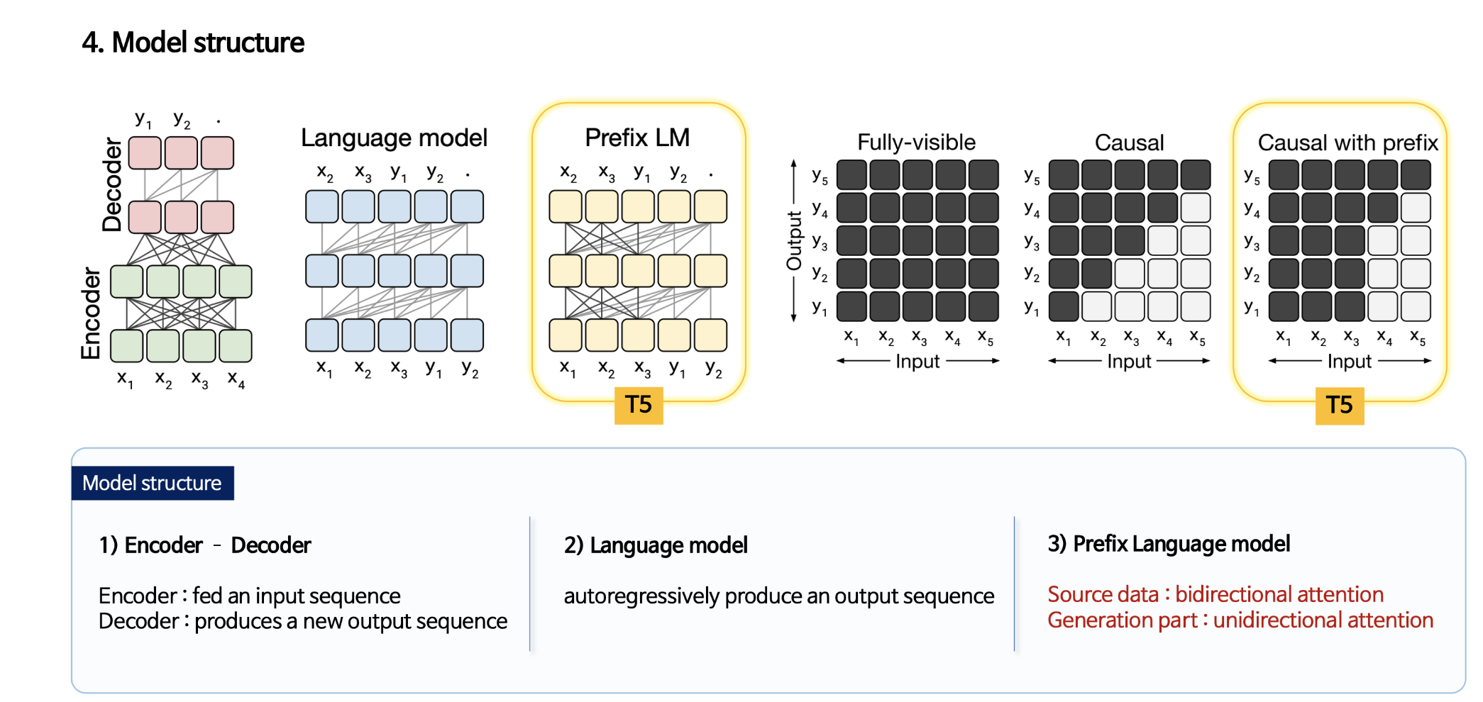
T5 (Exploring the Limits of Transformer Learning with a Unified Text-to-Text Transformer)

Slide 39
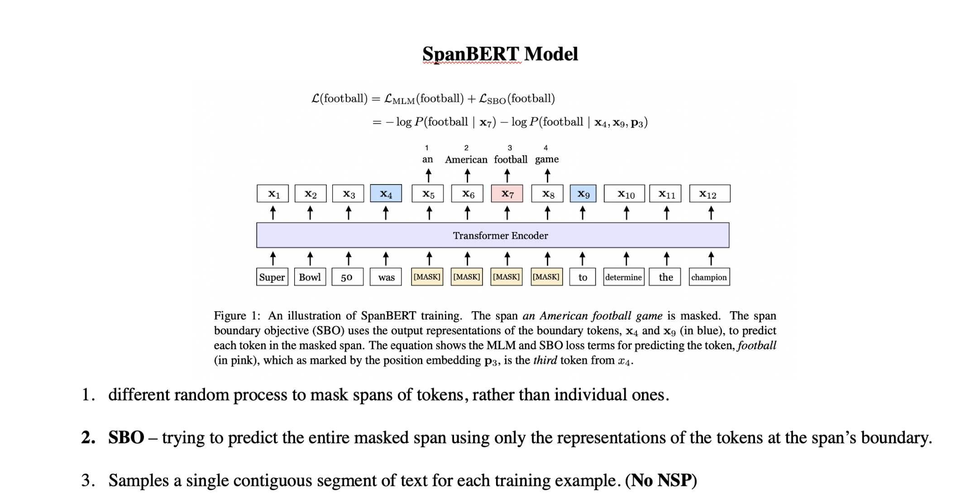
More Variants of Existing PTMs: Masking Strategy: SpanBERT (Improving Pre-training by Representing and Predicting Spans)

Slide 40
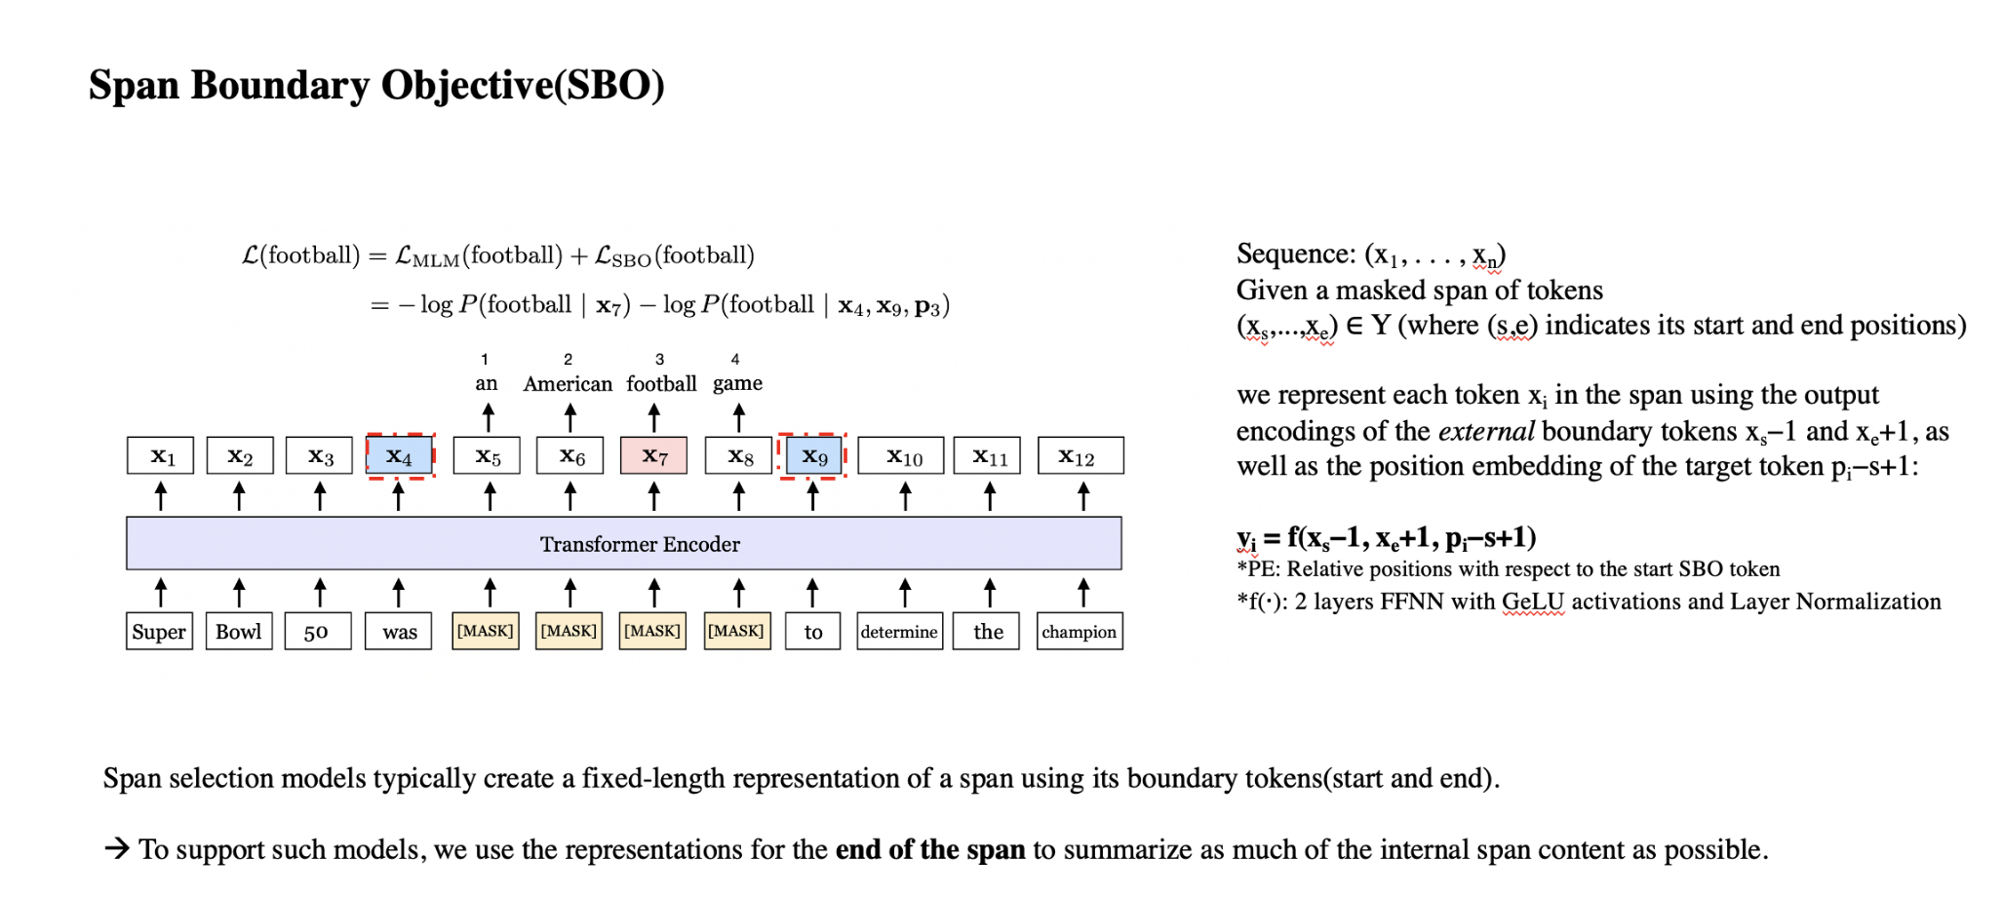
More Variants of Existing PTMs: Masking Strategy: SpanBERT (Improving Pre-training by Representing and Predicting Spans)

Slide 41
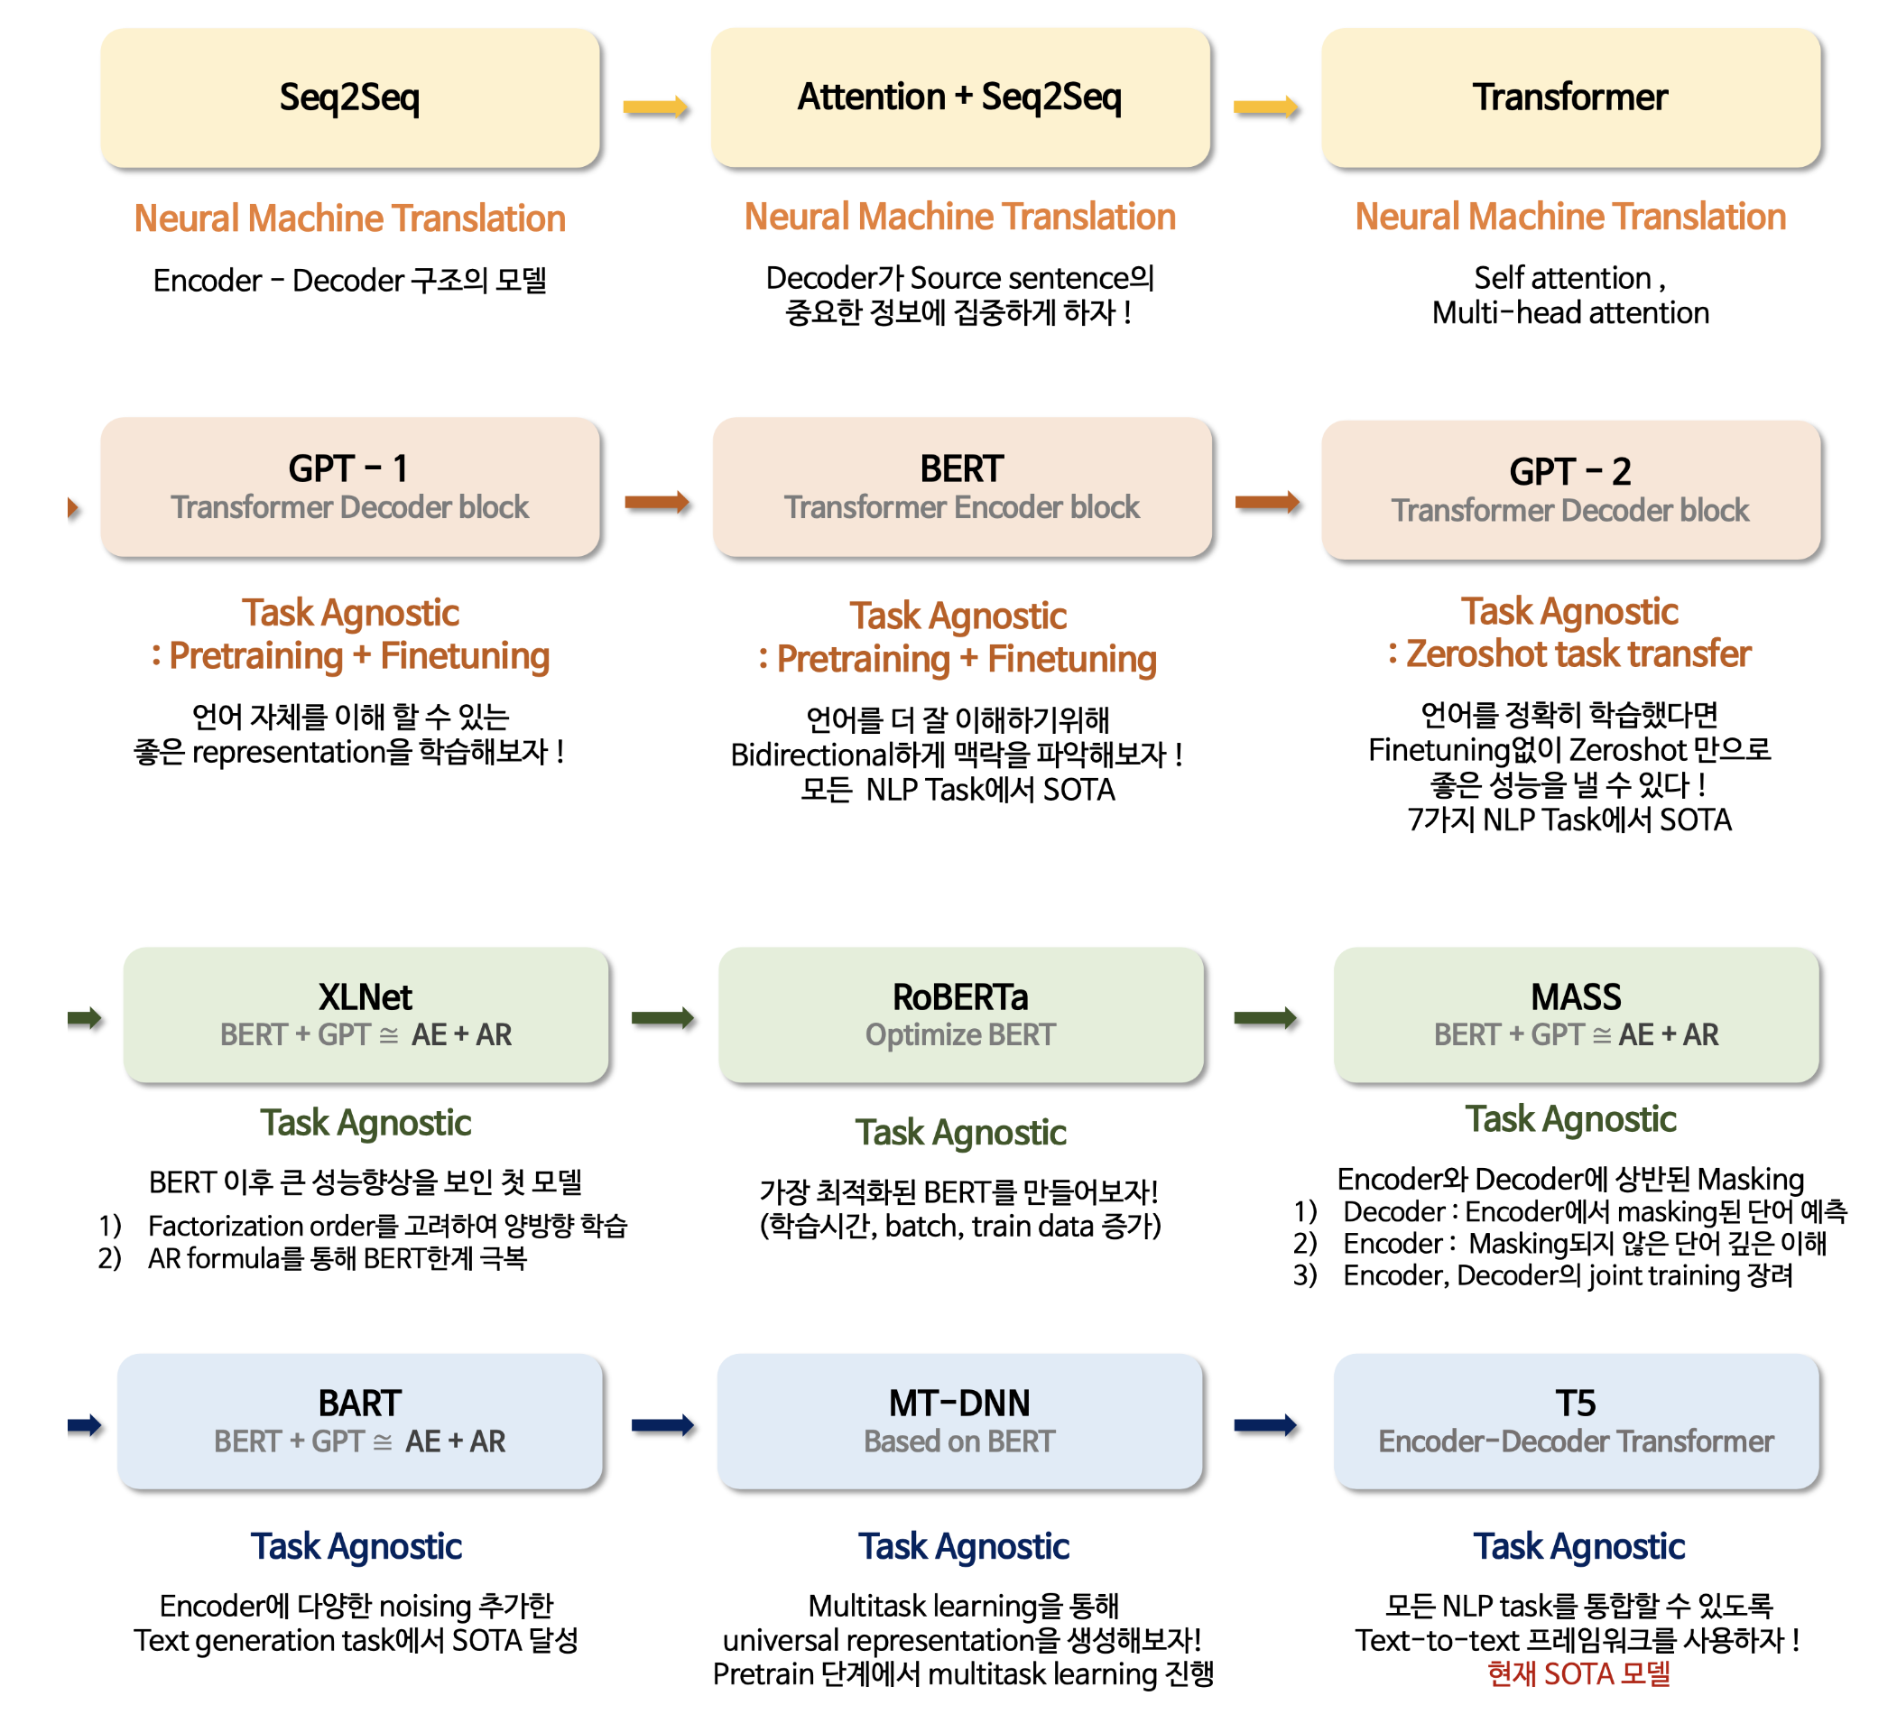
RoundUp: Evolution of Transformer Architecture

Slide 42
02
Utilizing Multi-Source Data
Multilingual, Multimodal, Knowledge Enhanced Pretraining

Slide 43
Utilizing multi-source data
Multilingual pre-training
Unicoder: A Universal Language Encoder by Pre-training with Multiple Cross-lingual Tasks
Multimodal pre-training
Unicoder-VL: A Universal Encoder for Vision and Language by Cross-modal Pre-training
ViLBERT: Pretraing Task-Agnostic Visionlinguistic Representations for Vision-and-Language Tasks
Zero-Shot Text-to-Image Generation
Knowledge enhanced pre-training
KEPLER: A Unified Model for Knowledge Embedding and Pre-trained Language Representation
KGLM: Using Knowledge-Graphs for Fact-Aware Language Modeling
ERNIE(1.0): Enhanced Representation through Knowledge Integration
ERINIE 2.0: A Continual Pre-training Framework for Language Understanding
A Knowledge-Enhanced Pretraining Model for Commonsense Story Generation

Slide 44
Unicoder: A Universal Language Encoder by Pre-training with Multiple Cross-lingual Tasks
Summary
We present Unicoder, a universal language encoder that is insensitive to different languages.
Given an arbitrary NLP task, a model can be trained with Unicoder using training data in one language and directly applied to inputs of the same task in other languages. Comparing to similar efforts such as Multilingual BERT (2018) and XLM (2019), three new crosslingual pre-training tasks are proposed, including cross-lingual word recovery, crosslingual paraphrase classification and crosslingual masked language model.
Experiments are performed on two tasks: cross-lingual natural language inference (XNLI) and cross-lingual question answering (XQA), where XLM is our baseline.
On XNLI, 1.8% averaged accuracy improvement (on 15 languages) is obtained.
On XQA, which is a new cross-lingual dataset built by us, 5.5% averaged accuracy improvement (on French and German) is obtained.

Slide 45
Unicoder: A Universal Language Encoder by Pre-training with Multiple Cross-lingual Tasks
Approach : model structure
Model structure based on XLM
Shared sub-word vocabulary over multiple languages
Using byte pair encoding (BPE)
Downsampling rich resource languages corpus
Preventing words of low-resource languages from being split too much
Approach : pre-training tasks in Unicoder
Masked Language Modeling from BERT
Translation Language Modeling from XLM
Cross-lingual Word Recovery new
Cross-lingual paraphrase classification new
Cross-lingual masked language model new

Slide 46
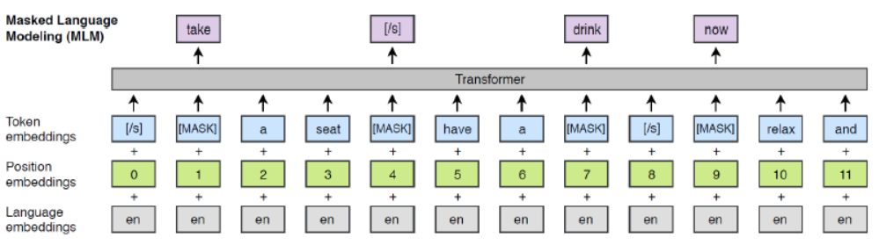
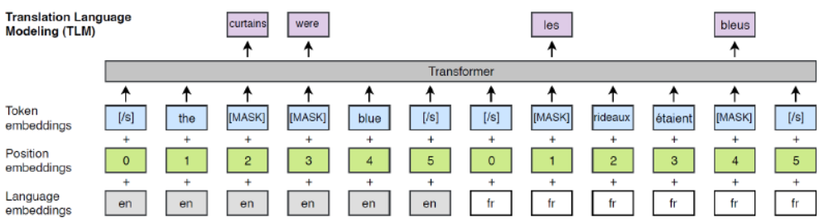
Unicoder: A Universal Language Encoder by Pre-training with Multiple Cross-lingual Tasks
Approach : pre-training tasks in Unicoder
Masked Language Modeling from BERT
Translation Language Modeling from XLM
Concatenating parallel sentences → predicting masked words

Slide 47
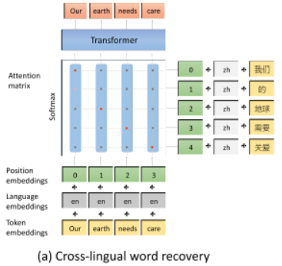


Unicoder: A Universal Language Encoder by Pre-training with Multiple Cross-lingual Tasks
Approach : pre-training tasks in Unicoder
Cross-lingual word recovery
Word alignment between two languages

Slide 48

Unicoder: A Universal Language Encoder by Pre-training with Multiple Cross-lingual Tasks
Approach : pre-training tasks in Unicoder
Cross-lingual paraphrase classification : whether two sentence same meaning
Positive sample : obtained from machine translation dataset
Negative sample : select with high similarity to X but not equal to Y

Slide 49

Unicoder: A Universal Language Encoder by Pre-training with Multiple Cross-lingual Tasks
Approach : pre-training tasks in Unicoder
Cross-lingual masked language model
Sequence of sentences written with different languages
Extracted from parallel documents

Slide 50

Unicoder: A Universal Language Encoder by Pre-training with Multiple Cross-lingual Tasks
Approach : fine-tuning
Typical cross-lingual fine-tuning settings
Only one language has training data
Test is conducted on other languages
Three baseline approaches
Cross-lingual test
Pretrain a model on training data in source
Fine-tune the model on test in target
Translate-train
Translate the training data into the target
Pre-train a model on the translated training data
Fine-tune the model on test in target
Translate-test
Translate the test data into the source
Pretrain a model on training data in source
Fine-tune the model on the translate test data

Slide 51


Unicoder: A Universal Language Encoder by Pre-training with Multiple Cross-lingual Tasks
Experiments

Slide 52


Multimodal: Modality
What is Modality? The “way” for a certain event(Data) => composing “source”(text, speech, audio, image..) shares a modality
Image
Text
Main issues of Vision Language multimodal Learning:
Learning the “Aligning” between Visual Stimuli and Natural Language
Previous works lack a unified foundation, and instead starting with separate pretrained models for each tasks and merge them often results in poor generalizations when paired data is limited or biased

Slide 53

Multimodal: Vision & Language
Pre-Trained Multi-modal Models: Model Architecture Comparison for Vision

Slide 54
ViLBERT: Pretraing Task-Agnostic Visionlinguistic Representations for Vision-and-Language Tasks
Summary
We present ViLBERT, a model for learning task-agnostic joint representations of image content and natural language.
We extend the popular BERT architecture to a multi-modal two-stream model, processing both visual and textual inputs in separate streams that interact through co-attentional transformer layers.
We pretrain our model through two proxy tasks on the large, automatically collected Conceptual Captions dataset and then transfer it to multiple established vision-and-language tasks – visual question answering, visual commonsense reasoning, referring expressions, and caption-based image retrieval – by making only minor additions to the base architecture.
We observe significant improvements across tasks compared to existing task-specific models –achieving state-of-the-art on all four tasks.
Our work represents a shift away from learning groundings between vision and language only as part of task training and towards treating visual grounding as a pretrainable and transferable capability

Slide 55

Multimodal Pre-Training: ViLBERT Vision Language BERT
Image representations are marked with a new special token <IMG> (이미 BERT에는 special token을 사용-> 이미지에만 더 붙여준다)
이미지와 text간 alignment를 잘 배우는 common model을 학습시키는 것이 목표
Image representations processed through Faster R- CNN with ResNet101 backbone(top)
Language representations processed through BERT(bottom)
Individual paths for image(top)/language(bottom) representation processing
Self supervised Learning: BERT, GPT와 같은 learning 방식
Separation of streams for Vision/Language processing, and use Co-attention for the interaction between two modalities(modalities 사이의 interaction을 구하는 요소)
Used Visual Language pretraining tasks for training objectives
Masked multi modal modelling: Predicts a distribution over semantic classes for the masked image regions, instead of direct regression –--> Minimize the KL divergence with the distribution from the feature extractor(R-CNN에서 얻게 되는 distribution), Unlikely to reconstruct “ image features, but will learn to identify the high-level semantics of visual content
Multi modal alignment prediction ≈ Next Sentence Prediction in BERT predict whether the image and text are aligned

Slide 56
Unicoder-VL: A Universal Encoder for Vision and Language by Cross-modal Pre-training
Summary
We propose Unicoder-VL, a universal encoder that aims to learn joint representations of vision and language in a pre-training manner.
Borrow ideas from cross-lingual pretrained models, such as XLM (2019) and Unicoder (2019), both visual and linguistic contents are fed into a multi-layer Transformer (2017) for the cross-modal pre-training, where three pre-trained tasks are employed, including Masked Language Modeling (MLM), Masked Object Classification (MOC) and Visual-linguistic Matching (VLM).
The first two tasks learn context-aware representations for input tokens based on linguistic and visual contents jointly.
The last task tries to predict whether an image and a text describe each other.
After pretraining on large-scale image-caption pairs, we transfer Unicoder-VL to caption-based image-text retrieval and visual commonsense reasoning, with just one additional output layer.
We achieve state-of-the-art or comparable results on both two tasks and show the powerful ability of the cross-modal pre-training

Slide 57




Multimodal Pre-Training: Unicoder-VL A Universal Encoder for Vision and Language by Cross-modal Pre-training
•MLM (Masked Language Modeling)
•MOC (Masked Object Classification)
•VLM (Visual Language Matching)
MLM, MOC 는 positive pair 로만 학습하고 , VLM 은 negative pair 도 사용
Self attention : cross modality 를 학습

Slide 58

Multimodal Pre-Training: DALL-E
Zero-Shot Text-to-Image Generation
DALL-E라는 이름은 초현실주의 화가 살바도르 달리(Salvador Dali)와 로봇 애니메이션 속 로봇 캐릭터 윌-E(WALL-E)에서 영감을 받아 이름을 DALL-E라고 지었다고 합니다.
- Transformer 기반 language model: text to image generation process 를 autoregressively train
- GPT 3 와 유사한 형태로 , Text, Image tokens 를 single stream 으로 학습
- 이미지 𝑥,텍스트 𝑦, 인코딩 된 이미지 token 𝑧의 joint probability distribution
- 학습 후 MS COCO dataset 에 대해 Zero shot(Training set이 주어지지 않는 상황)에서도 우수한 성능을 보임
- (GPT 170억 개 대비)120 억 개의 parameters 를 가지고 있으며 , 2.5 억 개의 text image pairs 로 학습
- Text to image generation 은 MS COCO, CUB 200 과 같은 상대적으로 소규모의 dataset 을 사용

Slide 59

Multimodal Pre-Training: DALL-E
ELBO(Evidence of Lower Bound, ELB): Latent variable(z) model에 Bayes Theorem을 적용
Prior probability(사전 확률)
X <- Z (Latent variable 𝒛, observed variable 𝒙)
Evidence
적분 계산이 어려우므로 (Gaussian) Normalizing할 수 있는 𝒒를 선택
Posterior probability(사후 확률)
Divergence 란 두 확률 분포의 다름의 정도를 나타내는 것
Bayes Theorem
- log p(x) 는 상수이므로 ELBO 가 증가하면 𝐷(𝐾𝐿)은 감소
- ELBO 를 최대화하여 q(z) 와 p(z|x) 의 차이 최소화 가능
Evidence
Joint Probability
적분 시 1이 된다
음수를 곱해 최소화 문제로 변형하여 loss function 으로 정의 후 stochastic gradient descent 로 최적화

Slide 60



Multimodal Pre-Training: DALL-E
AutoEncoder(AE)
Variational AutoEncoder(VAE)
z가 차원이 다른 여러 값을 갖을 수 있기 때문에
P(x)를 maximize하는게 목표
Latent vector z가 모르는 분포가 아니라, 어떤 정해진 확률분포(일반적으로 Gaussian)를 따른다고 가정 후에 encoding
-> mean/std. dev값을 넣어주어 계산
-> z의 미분 계산이 불가능 하여 노이즈 샘플링
Latent distribution
AE
- VAE 는 latent vector 구분이 가능하며 , control 할 때 유리(가우시안을 따른다고 가정하기 때문)
- VAE 는 representation 을 sampling 가능하여 , train set 에 없는 데이터 판별 가능(아웃라이어 판별 가능)
VAE

Slide 61

Multimodal Pre-Training: DALL-E
Vector Quantized Variational AutoEncoder(VQ-VQE)
- VAE는 latent vector가 continuous 한 반면, VQ-VQE는 latent vector가 discrete
- 별도의 prior 분포를 가정하지 않고 모든 latent code에 대해 uniform한 prior를 가정.
Auto encoder와 동일한 역할
Codebook vector
Encoding parameter 조정
sg(·): stop gradient operator
Zero gradient를 가짐
고정 되어 있다
Image encoding vector와 가장 가까운 e를 넣어준다
K개 class와 D dimension
e2와 거리가 가장 가깝기 때문에 e2로 할당이 된다
w
H

Slide 62
Multimodal Pre-Training: DALL-E
discrete VAE(dVAE)
- VQ VAE 와 유사하지만 , 하나의 codebook vector(discrete) 만 선택하지 않고 posterior probability distribution 을 stochastic 하게 표현
- Backpropagation 을 위해 Gumbel softmax Trick 을 사용해 argmax 를 softmax 로 근사 (argmax 사용 시 gradient 계산 불가)
Temperature가 0 에 가까울수록 distribution 이 hard
Distribution의 형태로 사용
학습할 때는 softmax 를 사용해 gradient 를 계산

Slide 63






Multimodal Pre-Training: DALL-E
Two Stage training
256-> 32, RGB 3dim
아예 그림이 망가지지는 것은 아님(dVAE결과물)
Text-image concat

Slide 64









Multimodal Pre-Training: CLIP Contrastive Language-Image Pre-training
The main idea of CLIP is learning from natural language supervision. CLIP learns similarity between image representation and text representation(Joint representation). CLIP has great capability on zero-shot transfer and representation learning in computer vision.
EX) zero-shot = no support set
The text encoder is a Transformer with 63M-parameter 12-layer 512-wide model.
For an image encoder 5 CNNs and 3 ViTs are trained.
Compared to using contextless class, prompt
engineering and ensembling boost zero-shot
classification performance.

Slide 65
Multimodal Pre-Training: CogView
Combining VQVAE and Transformers for text-to-image generation: 4B parameter Transformer with VQ-VAE tokenizer
이미지를 어떻게 끊어줄 것인가?
transformer내부에서 대응시킬 이미지 tokenizer
GAN: dataset의 distribution과 generation의 distribution을 일치시키는 것
텍스트는 rule base
이미지는 learning base
VQVAE
Latent space에서 sparsity를 극대화 시켜서 일반화 능력을 강화 시킨 VQVAE 사용
GAN-based models can perform reasonable synthesis in simple and domain-specific dataset. BUT, the results on complex and domain-general scenes are far from satisfactory. => dataset의 complexity가 올라가면 학습이 너무 어려워진다
Text는 word라는 최소 단위 존재
1. Disentangle shape, color, gesture and other features from pixels
2. Understand the input text
3. Align objects and features with corresponding words
4. Learn complex distributions to generate the overlapping and composite of different objects and features
Discrete한 언어를 continuous한 이미지로 연결
auto-regressive transformer
Large-scale generative joint pretraining for both text and image tokens.
달리의 경우 같은 화질의 이미지 혹은 카툰 이미지를 사용했지만, General + 다양한 화질의 이미지 학습 시키고 싶은 cogview
Param size + dataset size 둘 다 늘림 => 크면 클수록 모델이 불안정함 = Text-to-image pretraining is very unstable
= gradient가 계속 바뀜(큰 값으로 요동침 -> 즉, 미분값의 변동성이 큼) => 여러 학습 테크닉 추가
1. Precision Bottleneck Relaxation (PB-Relax)
2. Sandwich LayerNorm (Sandwich-LN)
Similar to Layer norm( LayerNorm(x) = LayerNorm(x/max(x)) )
결과값이 바뀌지 않는 선에서 나눠버리자! => gradient를 줄임
Layer norm은 결과값이 바뀌지 않는 선에서
(max 값이 바뀌지 않는 선에서) 최대값으로 나눈다.
Gradient가 튀는 순간이 attention 전에 발생하는 것을 확인
=> attention 상에서 값이 바뀌어도 결과값은 바뀌지 않도록 하는 테크닉을 사용

Slide 66

Multimodal Pre-Training: CogView
Finetuning strategies for various downstream tasks
: Super-resolution, self-reranking, style transfer, fashion design
1. Super-resolution
2. Image Captioning and Self-reranking
image가 주어지고 문장이 주어지면 관련된 부분의 해상도가 증가하는 Task
Exchanging the order of text and image tokens in the input sequence. ➔ Self-reranking
달리는 동일 resolution 이미지로만 학습한 반면, cogView는 일부러 다양한 resolution과 많은 domain image에서 image token을 representation하였다.
같은 도메인의 resolution 변화 또한 representation space내에 표현이 되어있음
이부분을 강조하여 fine tuning
60 generated images for “A man in red shirt is playing video games“
Displayed in the order of CapLoss
3. Style transfer Learning
4. Industrial Fashion Design
스타일 별(4개)로 1000개 정도밖에 학습하지 않았는데도 좋은 성능을 보여줌.
1. Train a domain-specific VQGAN instead of general VQVAE.
: 대신 pretrained cogView는 사용
2. Decrease the number of parameters and increase the length of sequences for a higher resolution.
“A {object} of {style} style"

Slide 67




Knowledge-Enhanced Pre-Training: KnowBERT
Knowledge Attention and Recontextualization (KAR) mechanism
별도로 존재하는 도메인 지식이 반영된 entity embeddings 를 BERT wordpiece tokenizer layer 에 통합시키는 방법을 제안, Bert objective에 관련 loss를 추가
[1] Mention-span(entity) representations
[2, 3] Entity linker, Knowledge enhanced entity-span representations
Entity 는 ‘Prince’, ‘Purple Rain’, ‘Rain’ 총 3 개
Two-layer MLP (100 hidden dimensions) 를 이용하여 score 계산
score가 threshold 아래이면 0 으로 취급 ,
threshold 를 넘기면 normalize 하여 사용
차원을 줄이기 위해 쓰인 파라미터
Entity embedding의 차원에 맞추어 projection(512-> E)
Self-attentive span pooling (Lee et al., 2017) 방식을 이용하여 mention span(=entity) 에 대한 모든 WordPieces 를 pooling
=> entity-entity co-occurrence 반영 효과
inverse matrix
[4] Recontextualization
다시 BERT 의 hidden vector size(512) 로 projection
Entity linking objectives:
Log likelihood 식과 max margin 식 (g 는 정답 인덱스를 의미)
Query
Value, key
query
key
value

Slide 68








Knowledge-Enhanced Pre-Training: KEPLER A Unified Model for Knowledge Embedding and Pre-trained LanguagE Representation
= Training Objectives
Relation
Not modifying the Transformer encoder structure(RoBERTa)
Entity
Entity description
Relation
Downstream Tasks
related to Relational Knowledge
FewRel (Few-Shot Relation Classification Dataset)
TACRED
Open Entity

Slide 69
Knowledge-Enhanced Pre-Training: KGLM Knowledge Graph Language Model
Language model with mechanisms for selecting and copying information from an external knowledge graph (KG), using LSTM
Marginalizing out the local knowledge graph to compute the probability of the tokens(inference),
Entity(t)
Entity(<t)
Using a single-layer softmax over hidden state of LSTM
to predict one of {new, related, Ø }
Input Sequence
Decide the type of token
1) Related entity (in the local KG)
mimicking the TransE
: 지식 정보 그래프 정보를 embedding 공간으로 옮겨서 해석 가능하게 만드는 방법
=> head entity 와 relation 벡터 합이 tail entity가 유사하게 만드는 것
2) New entity (not in the local KG)
3) Not an entity
Initially, the graph is empty
Building a local KG by KGLM

Slide 70


ERNIE: Enhanced Representation through Knowledge Integration, 2019
https://arxiv.org/abs/1904.09223
 | The vast majority of Language representation pre-training studies model the representations by predicting the missing word only through the contexts. These works do not consider the prior knowledge in the sentence. It is intuitive that if the model learns more about prior knowledge, the model can obtain more reliable language representation. |  | ERNIE 1.0, Language representation model, Knowledge masking strategy, Basic-Level Masking, Phrase-Level Masking, Entity-Level Masking, Dialogue embedding
 | ERNIE (enhanced representation through knowledge integration) by using knowledge masking strategies. In addition to basic masking strategy, we use two kinds of knowledge strategies: phrase-level strategy and entity-level strategy. Instead of adding the knowledge embedding directly, ERNIE implicitly learned the information about knowledge and longer semantic dependency ERNIE is pre-trained on heterogeneous Chinese data, and then applied to 5 Chinese NLP tasks.
 | Using a multi-layer Transformer as basic encoder like previous pre-training model such as GPT, BERT and XLM For Chinese corpus, we add spaces around every character in the CJK Unicode range and use the WordPiece to tokenize The first token of every sequence is the special classification embedding([CLS]). A multi-stage knowledge masking strategy to integrate phrase and entity level knowledge into the Language representation (1) Basic-Level Masking: the basic language unit is word, and for Chinese, the basic language unit is Chinese Character (2) Phrase-Level Masking: Phrase is a small group of words or characters together acting as a conceptual unit. |  | (3) Entity-Level Masking: Name entities contain persons, locations, organizations, products, etc. First analyzing the named entities in a sentence, and then masking and predicting all slots in the entities
Motive
Keywords
Introduction
BERT
ERNIE
Model
/ 135

Slide 71




ERNIE: Enhanced Representation through Knowledge Integration, 2019
https://arxiv.org/abs/1904.09223
 | ERNIE was chosen to have the same model size as BERT-base for comparison purposes. 12 encoder layers, 768 hidden units and 12 attention heads |  | Mixed corpus: Chinese Wikepedia (21M), Baidu Baike(51M), Baidu news(47M), Baidu Tieba(54M) Baidu Baike contains encyclopedia articles written in formal languages, Baidu news provides the latest information about movie names, actor names, football team names, etc. Baidu Tieba (for DLM) is an open discussion forum like Reddits
 | DLM (Dialogue Language Model) . introducing dialogue embedding to identify the roles in the dialogue . ERNIE’s dialogue embedding plays the same roles as token type embedding in BERT, except that ERNIE can also represent multi-turn conversations (e.g., QRQ, QRR, QQR, Q for ”Query”, R ”Response”). . Like MLM in BERT, masks are applied to enforce the model to predict missing words conditioned on both query and response. . The model architecture of DLM task is compatible with that of the MLM task, thus it is pre-trained alternatively with the MLM task.
 | The test results on 5 Chinese NLP tasks can be seen that ERNIE outperforms BERT on all tasks, creating new state-of-the-art results on these Chinese NLP tasks. |  | Ablation Studies: Adding phrase-level mask to the baseline word-level mask can improve the performance of the mode, 0.7%/1.0% of improvement in develop/test accuracy is achieved on this DLM task
 | From the paper: https://github.com/PaddlePaddle/ERNIE
Model
Dataset
Model
(DLM)
Results
Code
/ 135

Slide 72




ERNIE 2.0: A Continual Pre-training Framework for Language Understanding, 2019
https://arxiv.org/abs/1907.12412
 | Current pre-training procedures usually focus on training the model with several simple tasks to grasp the co-occurrence of words or sentences. However, besides co-occurring information, there exists other valuable lexical, syntactic and semantic information in training corpora. |  | ERNIE 2.0, Continual pre-training framework, Continual multi-task learning, Continual learning,
 | a continual pre-training framework named ERNIE 2.0 which incrementally builds pre-training tasks and then learn pre-trained models on these constructed tasks via continual multi-task learning. ERNIE 2.0 model is to capture lexical, syntactic and semantic aspects of information in the training data.
 | ERNIE 2.0: instead of training with a small number of pre-training objectives, it could constantly introduce a large variety of pre-training tasks to help the model efficiently learn the lexical, syntactic and semantic representations Continual Pre-training (1) Pre-training Tasks Construction: Constructing different kinds of tasks at each time that the learned parameters encodes the previously learned knowledge, Allocating each task N training iterations (2) the architecture of continual multi-task learning in each stage contains a series of shared text encoding layers to encode contextual information, which can be customized by using recurrent neural networks or a deep Transformer consisting of stacked self-attention layers (3) Loss functions: Token-level loss, Sentence-level loss Fine-tuning for Application Tasks : the pre-trained model can be adapted to different language understanding tasks, such as question answering, natural language inference
Motive
Keywords
Introduction
1
Model
2
/ 135

Slide 73





ERNIE 2.0: A Continual Pre-training Framework for Language Understanding, 2019
https://arxiv.org/abs/1907.12412
 | Transformer Encoder: Using a multi-layer Transformer as the basic encoder like other pre-training models Task Embedding: The model feeds task embedding to represent the characteristic of different tasks with an id ranging from 0 to N. Using the same model settings of transformer as BERT Base: 12 layers, 12 self-attention heads, 768-dimensional of hidden size Large: 24 layers, 16 self-attention heads, 1024-dimensional of hidden size |  | Pre-training
 | The results on GLUE benchmark, where the results on dev set are the median of five runs and the results on test set are scored by the GLUE evaluation server ERNIE 2.0_{BASE} outperforms BERT_{BASE} on all of the 10 tasks and obtains a score of 80.6. ERNIE 2.0_{LARGE} consistently outperforms BERT_{LARGE} and XLNet_{LARGE} on most of the tasks except MNLI-m.
 |  |  | Fine-tuning: GLUE dataset for English (Left), Chinese task (Right)
 | From the paper: https://github.com/PaddlePaddle/ERNIE
Model
Dataset
Results
Code
/ 135

Slide 74
03
Improving Computational Efficiency

Slide 75
Improving computational efficiency
System-level optimization
Megatron-LM: Training Multi-Billion Parameter Language Models Using Model Parallelism
Efficient pre-training
Train No Evil: Selective Masking for Task-Guided Pre-Training
Accelerating Training of Transformer-Based Language Models with Progressive Layer Dropping
Model compression
ALBERT: A Lite BERT for Self-supervised Learning of Language Representations
Compressing BERT: Studying the Effects of Weight Pruning on Transfer Learning
Knowledge Distillation: A Survey
DistilBERT, a distilled version of BERT: smaller, faster, cheaper and lighter
MINILM: Deep Self-Attention Distillation for Task-Agnostic Compression of Pre-Trained Transformers

Slide 76






System-Level Optimization: Megatron-LM Training Multi Billion Parameter Language Models Using Model Parallelism
Parameter sharing
Self attention block 과 MLP block을 통해 model parallelism 구현
Matrix 곱셈이 parallelize
Row 단위로 하면 양립 불가이기 때문에 논문에선 concat (2)
다시 축소
2) Split A along its columns
layer를 넘어가면서 데이터 통신이 필요
=> 모델을 어떻게 자르는 것에 따라 통신 overhead가 많을 수도 있음
초거대 모델 ex. GPT3(param수가 많아지면 성능이 좋아진다) 추세
=> 그러나 gpu 메모리 부족!(cpu처럼 대응이 불가능)
Dimension을
4개로 늘렸다가
일종의 통신인데, device로 산재 되어 있는 데이터를 하나로 모아서 평균 내거나, 하나로 더하여 넘긴다
self attention block
MLP block
Multi-head self attention의 경우, 처음부터 자체가
parallelizing을 염두하고 만들어짐

Slide 77





Efficient Pre-Training: Progressive layer dropout
Training the transformer-based language models is expensive (in terms of training time/memory/cost). Ex. Batch 사이즈를 키우면 memory cost가 크다
Progressive layer dropping (PLD) is proposed to reduce the training time.
PostLN
PreLN
Switchable gates
PreLN preserves norm of representation & gradient, more stable/robust for the random layer dropping.
전체적으로 layer가 균일하게 weight 증가
=> 훈련 용이
Layer를 통으로 없애 주는
즉, 0을 곱해주는 gate
Drop out을 하기가 용이 해진다
(BERT w/ stochastic depth )
Schedule dropout (w.r.t. time and depth)
Input and output embeddings for BERT(Input과 output을 차이가 어떻게 되는지를 표시)
PreLN의 경우, step수 가 많아지면 Layer가 뒤로 가면 갈 수록 input을 바꾸는 정도가 적어진다(뒤로 갈수록 변화량이 크지 않다) => 뒤쪽 layer dropout을 많이 해도 앞쪽 layer는 덜 damaging 받는다.
step수가 많아질수록 뒤쪽 layer dropout rate를 높이는 방향(progressive scheduling)
PLD is robust to high learning rate, faster convergence (2.8x speedup) Ratio of retained layers 0.5~0.9 is appropriate. PLD also benefits downstream task (GLUE) performance & training speed. PLD takes a more robust optimization path toward the optimum.
나중에 0.5로 수렴
약 25% 연산량 절약(forward-backward)
Learning rate

Slide 78


Model Compression: Compressing BERT
Explore weight pruning for BERT and ask: how does compression during pre-training affect transfer learning?
Pruning BERT
Magnitude Weight Pruning
We conclude that BERT can be pruned once during pre-training rather than separately for each task without affecting performance.
Two layers feed forward network : Accounts for 50% of model memory
Weight Magnitude(절대값) 기준으로 가중치가 0에 가까우면, 이에 대한 Input은 무시하는 것
Linear Projection Multi-Head Attention : Accounts for 25% of model memory
Low levels of pruning (30-40%) do not affect pre-training loss or transfer to downstream tasks at all. (30퍼센트까지는 downstream task accuracy에 영향을 주지 않음을 알 수 있음. Pre-trained loss도 30퍼센트까지는 영향을 주지 않음. )
Word Embedding : Accounts for 20% memory of model memory
Medium levels of pruning increase the pre-training loss and prevent useful pre-training information from being transferred to downstream tasks.
Why does pruning affect transfer Learning?
• 가설1 : Regularization;
• Weight pruning prevents certain weights from changing during fine-tuning, preventing adaption
• 가설2 : Information Deletion
• Weight pruning deletes valuable information stored in the weights by setting them to 0
• This information could not be recovered by training on the downstream data alone
Re-initialize pruned weights to 0 then fine-tune. This will eliminate the regularizing effects of hypothesis.
• Until 60% of sparsity, any decrease in performance can be attributed to information deletion.
• Past the point(60%), an additional penalties encourage for over regularizing the model
Is it better to prune before/after fine-tuning?
Fine tuning does not improve credibility when using magnitude weight Pruning. Even if it continues fine tuning for much longer, it will not change which magnitude weight pruning selects for pruning. Pruning before fine-tuning is fine.

Slide 79




Model Compression: ALBERT A LITE BERT FOR SELF-SUPERVISED LEARNING OF LANGUAGE REPRESENTATIONS
ALBERT(Lan et al., 2019) is another important variant of BERT, which provides several interesting observations on reducing parameters. As a sacrifice to its space efficiency, ALBERT has a slower fine-tuning and inference speed.
1. Factorized embedding parameterization
2. Cross-layer parameter sharing
3. Inter-sentence coherence loss
The power of BERT-like representations comes from the use of context to provide the signal for learning such context-dependent representations. (from a modeling perspective)
NSP(next sentence prediction)
Topic prediction & coherence prediction are conflated, BUT topic prediction is easier to learn than coherence prediction
and overlapped with the learning with MLM loss.
input word
embedding matrix
O(V × H)
Factorize
O(V × E + E × H)
E ≡ H
H >> E
The WordPiece* embedding size E (context-independent)
Hidden-layer embeddings H (context-dependent)
1) Projection of one-hot encoded vector V into the low dimension space E
2) Projection of E into the hidden layer H
Sentence Order Prediction(SOP) loss: a loss based mainly on coherence
※ subword tokenization methods
Byte Pair Encoding (BPE): tokenization based on frequency, Byte-Level Byte Pair Encoding (BBPE): tokenization based on frequency
Shared feedforward network & Shared attention
*WordPiece: tokenization based on likelihood
Training Efficiency
Data-throughput for BERT-large is about 3.17x higher compared to ALBERT-xxlarge.
Likelihood 기준 vocabulary를 만든다

Slide 80

MiniLM: Deep Self-Attention Distillation for Task-Agnostic Compression of Pre-Trained Transformers, 2020
https://arxiv.org/abs/2002.10957
 | Pre-trained language models usually consist of hundreds of millions of parameters which brings challenges for fine-tuning and online serving in real-life applications due to latency and capacity constraints. |  | MiniLM, Knowledge distillation, Deep self-attention distillation, Teacher assistant, Self-Attention Distribution Transfer, Self-Attention Value-Relation Transfer
 | MiniLM is the deep self-attention distillation framework for task-agnostic Transformer based LM distillation The key idea is to deeply mimic the self-attention modules: distilling the self-attention module of the last Transformer layer of the teacher model, alleviating the difficulties in layer mapping between the teacher and student models |  | Using the scaled dot-product between values in the self-attention module as the new deep self-attention knowledge: converting representations of different dimensions into relation matrices with the same dimensions Teacher assistant helps the distillation of large pre-trained Transformer based model
 | Deep self-attention distillation (1) training the student by deeply mimicking the self-attention module of the teacher’s last layer (2) transferring the relation between values to achieve a deeper mimicry in addition to performing attention distributions (i.e., the scaled dot-product of queries and keys) transfer in the self-attention module (3) Using a teacher assistant when the size gap between the teacher model and student model is large : First distilling the teacher into a teacher assistant with L-layer Transformer, The assistant model is then used as the teacher to guide the training of the final student MiniLM avoids restrictions on the number of student layers and the effort of finding the best layer mapping. Distilling relation between self-attention values allows the hidden size of students to be more flexible and avoids introducing linear matrices to transform student representations
Motive
Keywords
Introduction
Model
1
2
/ 135

Slide 81
04
Interpretation and Theoretical Analysis

Slide 82
Interpretation and theoretical analysis
Knowledge of PTMs: Linguistic knowledge & world knowledge
A Structural Probe for Finding Syntax in Word Representations
Linguistic Knowledge and Transferability of Contextual Representations
What Does BERT Learn about the Structure of Language?
Open Sesame: Getting Inside BERT's Linguistic Knowledge
Evaluating Commonsense in Pre-Trained Language Models
Robustness of PTMs
Trick Me If You Can: Human-in-the-loop Generation of Adversarial Examples for Question Answering
Is BERT Really Robust? A Strong Baseline for Natural Language Attack on Text Classification and Entailment
Structural sparsity of PTMs
What Does BERT Look At? An Analysis of BERT's Attention
Revealing the Dark Secrets of BERT
Theoretical analysis of PTMs
Why Does Unsupervised Pre-training Help Deep Learning?
A Theoretical Analysis of Contrastive Unsupervised Representation Learning

Slide 83


A Structural Probe for Finding Syntax in Word Representations, 2019
https://aclanthology.org/N19-1419/
 | Recent work has improved our ability to detect linguistic knowledge in word representations. Current methods for detecting syntactic knowledge do not test whether syntax trees are represented in their entirety. Open questions remain as to whether deep contextual models encode entire parse trees in their word representations. |  | Linguistic knowledge, Syntactic knowledge, Dependency parse trees,
 | A structural probe is a simple model which tests whether syntax trees are consistently embedded in a linear transformation of a neural network’s word representation space A simple structural probe for finding syntax in word representations Tree structure is embedded if the transformed space has the property that squared L2 distance between two words’ vectors corresponds to the number of edges between the words in the parse tree |  | Distances are guaranteed non-negative and symmetric The model not only encodes which word is governed by which other word, but each word’s proximity to every other word in the syntax tree
 | Goal: testing whether a neural network embeds each sentence’s dependency parse tree in its contextual word representations – a structural hypothesis Definition: to embed a graph is to learn a vector representation of each node such that geometry in the vector space - distances and norms - approximates geometry in the graph, it is finding the distance on the original space that best fits the tree metrics Every inner product corresponds to a distance metric. squared distances is defined as The parameters of our probe are exactly the matrix B, approximating through gradient descent which we train to recreate the tree distance between all pairs of words in all sentences in the training set of a parsed corpus |  | The parse tree depth: defined as the number of edges in the parse tree between a word and the root of the tree. To see if there exists a squared norm on the word representation space that encodes this tree norm. Replacing the vector distance function with the squared vector norm Training B to recreate the parse tree depth of a word
 |  |  | Whether representations from ELMo and BERT (BASE and LARGE), models pre-trained on language modeling-like objectives, embed parse trees ELMo and BERT-large layers are dimensionality 1024; BERT-base layers are dimensionality 768
Motive
Keywords
Introduction
Properties
Model
(Structural Probe)
Model
(Tree depth Structural Probe)
Evaluation
/ 135

Slide 84

Linguistic Knowledge and Transferability of Contextual Representations, 2019
https://arxiv.org/abs/1903.08855
 | Contextual word representations (CWR) derived from large-scale neural language models are successful across a diverse set of NLP tasks, suggesting that they encode useful and transferable features of language. However, their linguistic knowledge and transferability are not yet well understood |  | Pretrained word representations, Contextual word representations, Probing model,
 | Studying CWRs with a diverse set of 17 probing tasks designed to assess a wide array of phenomena, such as coreference, knowledge of semantic relations, and entity information, among others. Using probing models to analyze the linguistic information within CWRs and Generating features for words from pretrained contextualizers and train a model to make predictions from those features |  | 1. What features of language do these vectors capture, and what do they miss? 2. How and why does transferability vary across representation layers in contextualizers? 3. How does the choice of pretraining task affect the vectors’ learned linguistic knowledge and transferability?
 | Probing Tasks Token Labeling part-of-speech tagging (POS), CCG supertagging (CCG, syntactic roles), syntactic constituency ancestor tagging, semantic tagging task (ST), Preposition supersense disambiguation (PS), event factuality (EF) Segmentatoin Syntactic chunking (Chunk), Named entity recognition (NER), Grammatical error detection (GED), Conjunct identification (Conj) Pairwise Relations Arc prediction, arc classification, coreference arc prediction Probing Model : a linear model as our probing model; limiting its capacity enables us to focus on what information can be easily extracted from CWRs Contextualizers: ELMo, OpenAI transformer, BERT
Motive
Keywords
Introduction
Model
1
2
3
/ 135

Slide 85


What Does BERT Learn about the Structure of Language?, 2019
https://aclanthology.org/P19-1356/
 | BERT is a recent language representation model that has surprisingly performed well in diverse language understanding benchmarks. This remarkable result suggests that BERT could “learn” structural information about language. Can we unveil the representations learned by BERT to proto-linguistics structures? |  | BERT, Linguistic structures, BERT by Layers, Span representations,
 | Investigating the linguistic structure implicitly learned by BERT’s representation, Performing a series of experiments to probe the nature of the representations learned by different layers of BERT The lower layers capture phrase-level information, which gets diluted in the upper layers BERT captures a rich hierarchy of linguistic information, with surface features in lower layers, syntactic features in middle layers and semantic features in higher layers |  | BERT requires deeper layers for handling harder cases involving long-distance dependencies Using the recently introduced Tensor Product Decomposition Network (TPDN) (McCoy et al., 2019) to explore different hypotheses about the compositional nature of BERT’s representation and find that BERT implicitly captures classical, tree-like structures
 | Phrasal Syntax Based on the bert-base-uncased variant, which consists of 12 layers, each having a hidden size of 768 and 12 attention heads (110M param) Extracting span representations from each layer of BERT Computing the span representation at each layer by concatenating the first and last hidden vector, along with their element-wise product and difference BERT mostly captures phrase-level information in the lower layers and that this information gets gradually diluted in higher layers |  | (Phrasal Syntax) Randomly picking 3000 labeled chunks and 500 spans not labeled as chunks from the CoNLL 2000 chunking dataset
 |  |  | Performing a k-means clustering on span representations with k = 10, the number of distinct chunk types, Evaluating the resulting clusters using the Normalized Mutual Information (NMI) metric The lower layers encode phrasal information better than higher layers
Motive
Keywords
Introduction
Model
& Results
Dataset
/ 135

Slide 86



Evaluating Commonsense in Pre-Trained Language Models, 2020
https://arxiv.org/abs/1911.11931
 | relatively little work has been done investigating commonsense knowledge contained in contextualized representations, which is crucial for human question answering and reading comprehension. Commonsense knowledge spans “a huge portion of human experience, encompassing knowledge about the spatial, physical, social, temporal, and psychological aspects of typical everyday life.” |  | Commonsense knowledge, Contextualized representations, Conjunction Acceptability, CAT dataset,
 | The models include off-the-shelf embeddings from GPT, GPT2, BERT, XLNet and RoBERTa The benchmarks include Conjunction Acceptability, Sense Making, Winograd Schema Challenge, SWAG (multiple choices), HellaSwag (agumented version of SWAG) , Sense Making with Reasoning, and Argument Reasoning Comprehension |  | Evaluating commonsense knowledge contained in the above models by unifying the form of all the datasets and comparing LM perplexities on positive and negative sample For word-level testing, negative samples are drawn by replacing words from positive samples. For sentence-level testing, negative examples are drawn by replacing a full sub-sentences (such as a clause) with irrelevant or conflicting contents
 | Commonsense ability (1) a model with commonsense ability should have basic knowledge about the world, for example, water always goes down (2) a model should have the ability to reason over commonsense knowledge, such as water always goes down because there is gravity on the earth Reframing all the tasks into sentence-scoring tasks by substitution or concatenation Score |  | Bi-directional context can be more useful for learning commonsense. Intuitively, the models with bi-directional context can make more sentence-level inference. A larger training dataset intuitively allows a model to have access to more commonsense knowledge, thus performs better There is a decrease of performances as inference step increases. SWAG and HellaSwag fall out the trend. The commonsense knowledge contained in the pre-trained models may remain in a surface level without deep semantic comprehension
 | From the paper: https://github.com/XuhuiZhou/CATS
Motive
Keywords
Introduction
Model
Results
/ 135
Code

Slide 87
Robustness of PTMs: TEXTFOOLER IS BERT REALLY ROBUST? A STRONG BASELINE FOR NATURAL LANGAUGE ATTACK ON TEXT CLASSIFICIATION AND ENTAILMENT
자연어 공격 시스템 필요한 3 가지 속성
–사람의 시각에서 결과 (Label)는 동일 (원본 문장 Label = 적대적 문장 Label) But 모델 결과는 반대
–의미적 유사성 원본 문장 의미 = 적대적 문장 의미
–언어적 유창성 (문법 오류 x)
- 𝑁개의 문장, label
–X = {X1, X2,...,XN } , Y = {Y1, Y2,...,YN }
–F : X(input) → Y(output). Pre-trained model
–𝑋𝑎𝑑𝑣: 적대적 예시문장(adversarial example)
–Sim: 두 문장의 유사도를 측정하는 함수
–ϵ: 최소 유사도 허용수치
Step1: Word Importance Ranking
–𝑋\𝑤𝑖: X에서 𝑤𝑖단어를 제거한 문장
–원본 문장(X)라벨과 단어 제거 문장(𝑋\𝑤𝑖) 라벨이 같을 경우: 두 문장의 confidence 값 차이
–원본 문장(X)라벨과 단어 제거 문장(𝑋\𝑤𝑖) 라벨이 다를 경우: 원본Class(Y)에 대한 두 문장의confidence 값 차이+바뀐Class(𝑌)에 대한 두 문장의 confidence 값 차이
중요 단어 순서 정렬
Step2: Word Transformer
필터링 Stop words(The, when, none 등), 문법적 오류
Synonym Extraction
CANDIDATES: 𝑤𝑗(현재단어)와 교체가능한 단어집합
= 𝑤𝑗와 코사인 유사도가 δ(델타)보다 높은 top N개의 단어들 집합
– N & δ (N: 50, δ: 0.7 균형적)
: N이 높을수록, δ가 낮을수록 다양한 동의어 후보, but 의미적 유사성 하락
87

Slide 88
Robustness of PTMs: TEXTFOOLER IS BERT REALLY ROBUST? A STRONG BASELINE FOR NATURAL LANGAUGE ATTACK ON TEXT CLASSIFICIATION AND ENTAILMENT
TextFooler를 통한 NLP 모델공격 문장 생성 예시
다른 기존 알고리즘 대비 더 작은 단어를 교체 했음에도 더 높은 성공률을 기록하였다
두가지 Task로 실험
–Text Classification
–Text Entailment
Adv. 를 추가하여 training시킬 경우, 더 높은 성능을 보인다
88

Slide 89



Structural Sparsity of PTMs What Does BERT Look At? An Analysis of BERT’s Attention
Recent/Previous works
•outputs of language models on chosen input sentences
•internal vector representations of the model
This study
•explore how BERT’s attention heads behave. (attention map)
•probe each attention head for linguistic phenomena.
•evaluate the ability of the heads to classify various syntactic relations.
•propose an attention-based probing classifier
The output o(i th token) of the attention head is a weighted sum of the value vectors.
3. Surface-Level Patterns in Attention
Setup
•attention maps from bert base over 1000 random Wikipedia segments
•Each segment consists of 128 tokens corresponding to 2 consecutive paragraphs
•[CLS]<paragraph-1>[SEP]<paragraph-2>[SEP]
3.1 Relative Position
BERT’s attention head attend to the current, previous, or next token
•Most heads put little attention on the current token
•Four attention heads(in layers 2,4,7,8) put > 50% on the previous token
•Four attention heads(in layers 1,2,3,6) put > 50% on the next token
3.2 Attending to Separator Tokens ([SEP] [CLS] [ . or , ])
•Over half of Layers 6-10 focuses on [SEP]
([SEP] exists twice on average in 128 tokens segment : around 1/64)
•[SEP] aggregates segment-level information ? No
=> expect attention heads processing [SEP] to attend broadly over the whole segment to build up these representations. they instead almost entirely attend to themselves and the other [SEP] token.
•Attending to [SEP] does not change BERT’s output
•Gradient based measures of feature importance is low
•[SEP] is supposed to be used as a “no-op” for attention heads
89

Slide 90



Structural Sparsity of PTMs What Does BERT Look At? An Analysis of BERT’s Attention
3.3 Focused vs Broad Attention
•whether attention heads focus on a few words or broadly over words
•Broad = high entropy, focused = low entropy
•Entropy가 높다 = 정보량이 낮다
•In lower layers, some heads have very broad attention
•High entropy attention heads spend at most 10% on any single word
•The output of these heads is a bag-of-vectors representation of the sentence.
•Measured entropies for all attention heads from only the [CLS] token
•The last layer has a high entropy from [CLS]
•Make sense [CLS] token is used as input for the “next sentence prediction”
4. Probing Individual Attention Heads
4.1 Method
•BERT uses byte-pair tokenization (words are split up into multiple tokens)
•Convert token-token attention maps to word-word attention maps
•Sum up the attention weights over its tokens
4.2 Dependency Syntax
Setup
•On the WSJ Penn Tree-bank
•Evaluate both “directions” of prediction
•Head word attending to the dependent
•Dependent word attending to the head
Results
•No single attention head for syntax “overall”
•Some attention heads specialize to specific dependency relations
: we would not say individual attention heads capture dependency structure as a whole (future work)
•The dependent attends to the head word rather than the other way
90

Slide 91


Revealing the Dark Secrets of BERT, 2019
https://arxiv.org/abs/1908.08593
 | BERT-based architectures currently give state-of-the-art performance on many NLP tasks. However, the exact mechanisms that contribute to the BERT’s outstanding performance still remain unclear. We address this problem through selecting a set of linguistic features of interest and conducting a series of experiments |  | BERT, Self-attention weights, Self-attention maps, Self-attention patterns,
 | Aiming to provide insights about how well these features are captured by BERT. We propose a methodology and offer the first detailed analysis of BERT’s capacity to capture different kinds of linguistic information by encoding it in its self-attention weights |  | We present evidence of BERT’s over-parametrization and suggest a counterintuitive yet frustratingly simple way of improving its performance,
 | Using bert-base, 12-layer, 768-hidden, 12-heads, 110M paramameters Q1. What are the common attention patterns, how do they change during fine-tuning, and how does that impact the performance on a given task? BERT’s self-attention patterns: five frequently occurring patterns (Manual inspection of self-attention maps for both basic pre-trained and fine-tuned BERT models) 1) Vertical: attention to special BERT tokens [CLS], [SEP] 2) Diagonal: attention to the previous/following tokens 3) Vertical + Diagonal: a mix of the previous two types 4) Block: intra-sentence attention with two distinct sentences 5) Heterogeneous: cannot be characterized Manually annotated around 400 sample self-attention maps as belonging to one of the five classes Training a convolutional neural network with 8 convolutional layers and ReLU activation functions to classify input maps into one of these classes. This model achieved the F1 score of 0.86 on the annotated dataset. We used this classifier to estimate the proportion of different self-attention patterns for the target GLUE tasks using up to 1000 |  | The subset of GLUE tasks for fine-tuning: MRPC, STS-B, SST-2, QQP, RTE, QNLI, MNLI
 |  | The first three types are most likely associated with language model pre-training, while the last two potentially encode semantic and syntactic information (Left) Estimated percentages of the identified self-attention classes for each of the selected GLUE task | The first three types are most likely associated with language model pre-training, while the last two potentially encode semantic and syntactic information
Motive
Keywords
Introduction
Model
&
Results
Dataset
1
/ 135

Slide 92



Revealing the Dark Secrets of BERT, 2019
https://arxiv.org/abs/1908.08593
 | Q2. What linguistic knowledge is encoded in self-attention weights of the fine-tuned models and what portion of it comes from the pre-trained BERT? Relation-specific heads in BERT: Focusing on whether BERT captures FrameNet’s relations between frame-evoking lexical units (predicates) and core frame elements whether the links between them produce higher attention weights With 473 annotated sentences, for each of these sentences, we obtain pre-trained BERT’s attention weights for each of the 144 heads. Certain types of linguistic relations may be captured by self-attention patterns in specialized BERT heads Change in self-attention patterns after fine-tuning: To study how attention per head changes on average for each of the target GLUE tasks, we calculate cosine similarity between pre-trained and fine-tuned BERT’s flattened arrays of attention weights The last two layers encode task-specific features that are attributed to the gain of scores, while earlier layers capture more fundamental and low-level information used in fine-tuned models Attention to linguistic features: Investigating whether fine-tuning BERT for a given task creates self-attention patterns which emphasize specific linguistic features Investigating attention to nouns, verbs, pronouns, subjects, objects, and negation words , and special BERT tokens across the tasks The striped attention maps generally come from BERT pre-training tasks rather than from task-specific linguistic reasoning. | The heatmap of averaged attention scores over all collected examples suggests that 2 out of 144 heads tend to attend to the parts of the sentence that FrameNet annotators identified as core elements | The heatmap of averaged attention scores over all collected examples suggests that 2 out of 144 heads tend to attend to the parts of the sentence that FrameNet annotators identified as core elements
 | Q3. How different are the self-attention patterns of different heads, and how important are they for a given task? Token-to-token attention: Investigating the attention patterns between tokens in the same Potential head candidates that coincided with diagonally structured attention maps | Disabling self-attention heads: Unexpectedly, disabling some heads leads not to a drop in accuracy, as one would expect, but to an increase in performance. This effect is different across tasks and datasets
 |  |  | From the paper: https://github.com/text-machine-lab/dark-secrets-of-BERT
Model
&
Results
2
3
4
/ 135
Code

Slide 93
05
Beyond fine-tuning:
Prompt-based Learning

Slide 94

Pre-train, Fine-tune vs. Pre-train, Prompt, Predict
In “pre-train, prompt, and predict paradigm, instead of adapting pre-trained LMs to downstream tasks via objective engineering, downstream tasks are reformulated to look more like those solved during the original LM training with the help of a textual prompt.
For example, when recognizing the emotion of a social media post, “I missed the bus today.”, we may continue with a prompt “I felt so ”, and ask the LM to fill the blank with an emotion-bearing word.
By selecting the appropriate prompts we can manipulate the model behavior so that the pre-trained LM itself can be used to predict the desired output, sometimes even without any additional task-specific training
The advantage of this method is that, given a suite of appropriate prompts, a single LM trained in an entirely unsupervised fashion can be used to solve a great number of tasks
However, as with most conceptually enticing prospects, there is a catch – this method introduces the necessity for prompt engineering, finding the most appropriate prompt to allow a LM to solve the task at hand.

Slide 95

Prompt-based Learning: Pre-train, Prompt, and Predict

Slide 96



Prompt-based Learning: Pre-train, Prompt, and Predict
predict
Prompt

Slide 97


Prompt-based Learning: Pre-train, Prompt, and Predict
Prompt engineering is the process of creating a prompting function that results in the most effective performance on the downstream task.
Answer engineering aims to search for an answer space Z and a map to the original output Y that results in an effective predictive model.

Slide 98


Prompt-based Learning: PET(Pattern-Exploiting Training) Exploiting Cloze Questions for Few Shot Text Classification and Natural Language Inference
Semi-supervised training procedure
Reformulate input examples into cloze-style phrases
It’s Not Just Size That Matters:
Small Language Models Are Also Few Shot Learners
(두 논문 저자 동일)
PET(Pattern-Exploiting Training)
With task description, solving a task from only a few examples becomes much easier!

Slide 99










Prompt-based Learning: PET(Pattern-Exploiting Training) Exploiting Cloze Questions for Few Shot Text Classification and Natural Language Inference
Step1: Auxiliary LM
Example1
Pattern(P)
Example2
Words(v(x))
Using softmax obtain a probability distribution
Labels
Labels
words
True distribution(one-hot) of training example

Slide 100





Prompt-based Learning: PET(Pattern-Exploiting Training) Exploiting Cloze Questions for Few Shot Text Classification and Natural Language Inference
Step2: Combining PVPs
Finetune a separate language model
Cannot learn from each other models.
Iterative Pet
Train several generations of models on datasets of increasing size.
In each iteration, multiply the training set size by a constant ‘d’

Slide 101






Prompt-based Learning:P-tuning
GPT-style models perform poorly for natural understanding (NLU) tasks
P-tuning: automatically search prompts in the continuous space
competitive performance to BERT => GPT understands, too
ReLU activated two-layer multilayer perceptron (MLP)

Slide 102

Prompt-based Learning:P-tuning
Pre-trained LM’s parameters are fixed.
Experiments on two widely acknowledged NLU benchmarks
•LAMA (Language Model Analysis) knowledge probing : P-tuning is comparable to or better than fine-tuning method.
•SuperGLUE :GPT with P-tuning outperforms all the other BERT-based models on 5 out of 7 tasks. P-tuning appears to be more beneficial in low-resource settings. P-tuning outperforms both fully supervised settings and a few-shot settings.
대화형 음성 검색 시스템에 활용

Slide 103


GPT Understands, Too, 2021
https://arxiv.org/abs/2103.10385
 | Researchers have observed that GPT-style models perform poorly for natural understanding tasks with fine-tuning, thus assumed that they are not suitable for language understanding in nature. The emerging GPT-3 and its particular performance on few-shot and zero-shot learning with hand-crafted prompts has swept the ML community. However, handcrafting a best-performance prompting is like finding a needle in a haystack. |  | P-tuning, Automatically search prompts, Pseudo prompts, Anchor tokens, Prompt encoder
 | Giant models are too large to memorize the fine-tuning samples A single-word’s change in prompts can cause a drastic difference P-tuning is a method to automatically search prompts in the continuous space to bridge the gap between GPTs and NLU applications |  | P-tuning leverages few continuous free parameters to serve as prompts fed as the input to the pre-trained language models. We then optimize the continuous prompts using gradient descent as an alternative to discrete prompt searching.
 | An example of prompt search for “The capital of Britain is [MASK]”. Given the context (blue zone, “Britain”) and target (red zone, “[MASK]”), the orange zone refer to the prompt tokens. In (a), the prompt generator only receives discrete rewards; on the contrary, in (b) the pseudo prompts, and prompt encoder can be optimized in a differentiable way. Sometimes, adding few task-related anchor tokens (such as “capital” in (b)) will bring further improvement. $h_{i}$ (0 ≤ i < m) are trainable embedding tensors Discreteness: the original word embedding e of the model has already become highly discrete after pre-training (the optimizer would easily fall into local minima) Association: The values of prompt embeddings $h_{i}$ should be dependent on each other rather than independent In the P-tuning we propose to also model the $h_{i}$ as a sequence using a prompt encoder consists of a very lite neural network that can solve the discreteness and association problems.
Motive
Keywords
Introduction
Model
(a) Discrete Prompt Search
(b) P-tuning
/ 135

Slide 104




GPT Understands, Too, 2021
https://arxiv.org/abs/2103.10385
 | Prompt encoder: a bidirectional long-short term memory networks (LSTM), with a ReLU activated two-layer multilayer perceptron (MLP) to encourage discreteness. Because we want to evaluate knowledge gained from pre-training, pre-trained language models’ parameters are fixed (i.e., not fine-tuned). |  | LAMA (Knowledge probing), LAMA-29k: the intersection of GPT and BERT’s vocabulary SuperGlue,
 | LAMA: P-tuning is comparable to or better than fine-tuning-based methods The surprising thing is that fine-tuning should have been more potent since it tunes all language models’ parameters, while P-tuning not It is reasonable because, in terms of knowledge probing, many facts can only be hard-coded rather than inferenced by language models. The fine-tuning of parameters might result in catastrophic forgetting. On the contrary, P-tuning does not change the pre-trained models’ parameters but evoke the stored knowledge by finding a better continuous prompt. |  | SuperGLUE: P-tuning outperforms all the other BERT-based models on 5 out of 7 tasks. With P-tuning , GPT2 achieves comparable and even better performance as BERT-based models Few-shot learning (32 train samples) on SuperGLUE dev shows that P-tuning consistently outperforms PET and PET best
 |  |  | From the paper: https://github.com/THUDM/P-tuning
Model
Dataset
Results
Code
/ 135

Slide 105
References
Xu Han et al. (2021), Pre-trained Models: Past, present and Future, https://www.sciencedirect.com/science/article/pii/S2666651021000231
Liu Pengfei et al. (2021), Pre-train, Prompt, and Predict: A Systematic Survey of Prompting Methods in Natural Language Processing, https://arxiv.org/abs/2107.13586
Yang Zhilin et al. (2019), XLNet:Generalized Autoregressive Pretraining for Language Understanding, https://arxiv.org/abs/1906.08237
Du Zhenqxiao et al. (2022) GLM: General Language Model Pretraining with Autoregressive Blank Infilling, https://arxiv.org/abs/2103.10360
Song Kaitao et al. (2019), MASS:Masked Sequence to Sequence Pre-training for Language Generation, https://arxiv.org/abs/1905.02450
Lewis Mike et al. (2020), BART: Denoising Sequence-to-Sequence Pre-training for Natural Language Generation, Translation, and Comprehension, https://aclanthology.org/2020.acl-main.703/
Raffel Colin et al. (2020), Exploring the Limits of Transfer Learning with a Unified Text-to-Text Transformer, https://arxiv.org/abs/1910.10683
Joshi Mandar et al. (2020), SpanBERT: Improving Pre-training by Representing and Predicting Spans, https://arxiv.org/abs/1907.10529
Huang Hoyang et al. (2019), Unicoder: A Universal Language Encoder by Pre-training with Multiple Cross-lingual Tasks, https://arxiv.org/abs/1909.00964
Lu Jiasen et al. (2019), ViLBERT: Pretraining Task-Agnostic Visiolinguistic Representations for Vision-and-Language Tasks, https://proceedings.neurips.cc/paper/2019/file/c74d97b01eae257e44aa9d5bade97baf-Paper.pdf
Li Gen et al. (2019), Unicoder-VL: A Universal Encoder for Vision and Language for Vision and Language by Cross-modal Pre-training, https://arxiv.org/abs/1908.06066
Ramesh Aditya et al. (2021), Zero-Shot Text-to-Image Generation, https://arxiv.org/abs/2102.12092
Wang Xiaozhi et al. (2020), KEPLER: A Unified Model for Knowledge Embedding and Pre-trained Language Representation, https://arxiv.org/abs/1911.06136
Sun Yu et al. (2019), ERNIE: Enhanced Reprentation through Knowledge Integration, https://arxiv.org/abs/1904.09223
Logan Robert et al. (2019), Barack’s Wife Hillary: Using Knowledge Graphs for Fact-Aware Language Modeling, https://aclanthology.org/P19-1598/
Micikevicius Paulius et al. (2018), Mixed Precision Training, https://arxiv.org/abs/1710.03740

Slide 106
References
Shoeybi Mohammad et al. (2020), Megatron-LM: Training Multi-Billion Parameter Language Models Using Model Parallelism, https://arxiv.org/abs/1909.08053
Zhang Minjia and Yuxiong He. (2020), Accelerating Training of Transformer-Based Language Models with Progressive Layer Dropping, https://arxiv.org/abs/2010.13369
Sanh Victor et al. (2020), DistilBERT, a distilled version of BERT: smaller, faster, cheaper and lighter, https://arxiv.org/abs/2002.08307
Wang Wenhui et al. (2020), MINILM: Deep Self-Attention Distillation for Task-Agnostic Compression of Pre-Trained Transformers, https://proceedings.neurips.cc/paper/2020/file/3f5ee243547dee91fbd053c1c4a845aa-Paper.pdf
Hewitt John and Christopher Manning. (2019), A Structural Probe for Finding Syntax in Word Representations, https://aclanthology.org/N19-1419/
Liu Nelson et al. (2019), Linguistic Knowledge and Transferability of Contextual Representations, https://aclanthology.org/N19-1112/
Jawahar Ganesh et al. (2019), What Does BERT Learn about the Structure of Language?, https://aclanthology.org/P19-1356/
Clark Kevin et al. (2019), What Does BERT Look At? An Analysis of BERT’s Attention, https://arxiv.org/abs/1906.04341
Liu Xiao et al. (2021), GPT Understands, Too, https://arxiv.org/abs/2103.10385
Schick Timo and Hinrich Scutze. (2021), Exploring Cloze Questions for Few Shot Text Classification and Natural Language Inference, https://aclanthology.org/2021.eacl-main.20.pdf
Application of NLP and Computational Linguistics class at SNU(2022) Student Presentation Materials.

